Slide 1
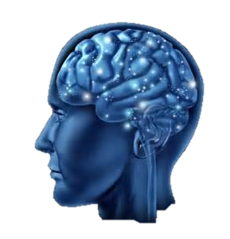
THE
Brain STEM
Quiz
Runshaw College
Simon Ambury

Slide 2
Topic
Engineering
Aims
The purpose of the resource is to get the students involved in working together in teams to solve as many problems as possible in a limited amount of time.
Level
GCSE – A Level
Method
This can be done in a small group or as a large group activity. When a question has been answered correctly click on it and a part of the picture will be revealed, students are required to guess the “say what you see” picture behind each question. During the quick fire quiz round, click on each box to reveal the “say what you see” picture.
Equipment
PC/Laptop Slides must be viewed in the ‘slideshow’ mode
Duration
Approx 1 Hour

Slide 3
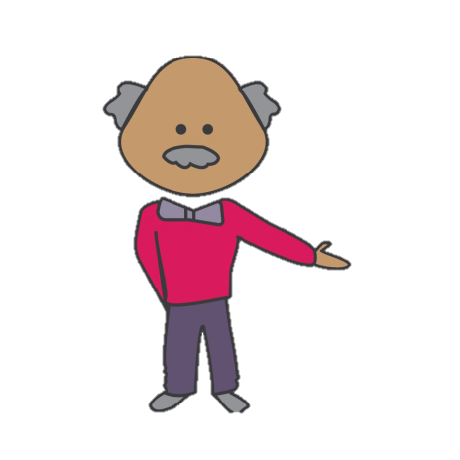
Say what you see Engineering
What kind of bridge is the Golden Gate Bridge in San Francisco?
In electricity, voltage is measured in volts, while current is measured in?
During idling process, a petrol engine requires?
Pick a question and click on it when you answer it correctly and your box will reveal a piece of the puzzle
Who made he first electric light bulb?
A pendulum is a weight suspended from a pivot so that it can swing freely. TRUE OR FALSE
OF
In computer engineering, DRAM stands for Dynamic Random – Access Memory – TRUE OR FALSE
RULE
What are Mandrels used to hold?
What is the operation of enlarging a hole is called?
What are brasses and bronzes welded using?
Notes:
ANSWERS:
RULE OF THUMB
What kind of bridge is the Golden Gate Bridge in San Francisco? Suspension Bridge
In electricity, voltage is measured in volts while current is measured in? Amperes (Amps)
During idling process, a petrol engine requires? Lean mixture
Who made the first electric light bulb? Humphry Davy
A pendulum is a weight suspended from a pivot so that it can swing freely, TRUE OR FALSE TRUE
In computer engineering, DRAM stands for Dynamic Random – Access Memory TRUE OR FALE TRUE
Mandrels are used to hold? Hollow work pieces
The operation of enlarging of a hole is called? Boring
Brasses and Bronzes are welded using? Neutral flame

Slide 4
Say what you see Quick Fire Round
1,000mm
Maid
ICE³
POD
POD
O2NE
H₂OSE
POD
Notes:
ANSWERS:
Metre Maid
Right Angle
Ice Cube
2 in One
Water Hose
Tripod

Slide 5
For further information please contact The STEM Alliance enquiries@STEMalliance.uk or visit www.STEMalliance.uk

