Slide 1
THE
Brain STEM
Quiz
Runshaw College
Simon Ambury

Slide 2
Topic
Maths
Aims
The purpose of the resource is to get the students involved in working together in teams to solve as many problems as possible in a limited amount of time.
Level
GCSE – A Level
Method
This can be done in a small group or as a large group activity. If a question has been answered correctly, a part of the picture will be revealed, the picture is a “say what you see question”. At the end of the presentation there is a quick fire quiz. Click on the box and the question will reveal itself again a “say what you see question”.
Equipment
PC/Laptop
Duration
Approx 1 Hour

Slide 3
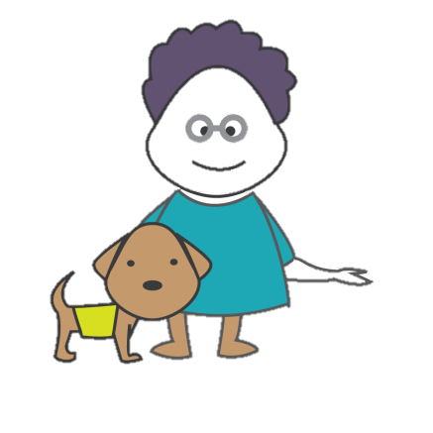
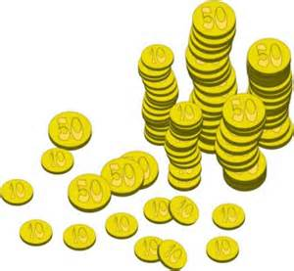
Say what you see Maths
What is the term given to the perimeter around a circle?
What is an isosceles triangle?
What is the square root of 81?
Pick a question, answer it correctly and your box will reveal a piece of the puzzle
What is the smallest prime number?
What is the meaning of Pi in math?
What is the square root of 100?
What is 60% of
40?
What is used to measure angles?
Which prime number falls after 31?
Notes:
ANSWERS:
MONEY MAKES THE WORLD GO ROUND
What is the term given to the perimeter around a circle? The circumference
What is an isosceles triangle? A triangle with at least two sides equal in length
What is the square root of 81? Nine (9)
What is the smallest prime number? Two (2)
What is the meaning of Pi in math? It’s the ratio of a circles circumference to its diameter
What is the square root of 100? Ten (10)
What is 60% of 40? Twenty Four (24)
What is used to measure angles? A protractor
Which prime number falls after 31? 37

Slide 4
Say what you see Quick Fire Round
1,000mm
Maid
ICE³
POD
POD
O2NE
H₂OSE
POD
Notes:
ANSWERS:
Metre Maid
Right Angle
Ice Cube
2 in One
Water Hose
Tripod

Slide 5
For further information please contact The STEM Alliance enquiries@STEMalliance.uk or visit www.STEMalliance.uk

