Slide 1
BEE-BOT
Jane Mountney
Family Learning
Sheffield City Council
Notes:
To Print

Slide 2
Topic
Bee Bot (Discovering Coding)
Aims
To help the learners to understand that information in = actions out Realise the steps involved to complete a task Understand the consequences of a missed action
Level
Key Stage 1
Method
Slide 3 and 4 to be used on FLIPCHART paper, students to be put in pairs for each of the Tasks. To accompany the handout each learner pair will need, 1 beebot and a grid on a flipchart sheet where each square represents the distance the beebot moves per command.
Equipment
Laptop & Projector Hand-out Pens/pencils/Rulers Post-it notes Flip Chart Paper
Duration
Depends on how many experiments are done in a lesson, the whole booklet would be >1 Hour
Notes:
Hidden

Slide 3
Task 1
Decide in your pairs which square will be start and which square will be finish. Place a post-it note on each of these square to identify them.
Using your Bee Bot map out all the possible routes you could take to get from A to B
SAMPLE
EXERCISE TO BE USED ON FLIPCHARTS
Notes:
To Print

Slide 4
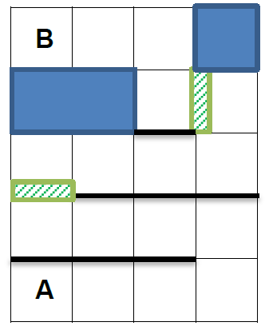
Task 2
You are now going to create an obstacle maze course for another pair.
Using your flipchart grid decide where you will pace walls, 2 door, leave opening and block of 3 squares completely.
Now draw them onto your grid.
A wall will be represented by a solid bold black line
A door will be represented by a green rectangle with diagonal lines
Once completed you will swap your grid with another group.
Their task will be to navigate around your grid; to get from A to B without crossing any walls, stopping at doors to open them before going through.
SAMPLE
EXERCISE TO BE USED ON FLIPCHARTS
Notes:
To Print

Slide 5
For further information please contact The STEM Alliance enquiries@STEMalliance.uk or visit www.STEMalliance.uk

