Slide 1
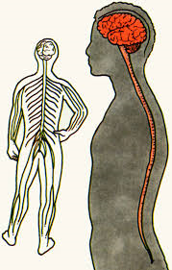
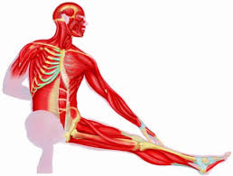
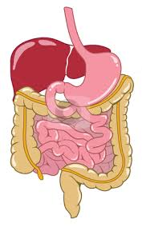
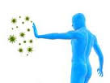
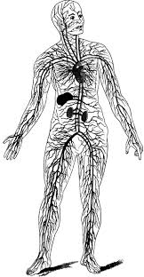
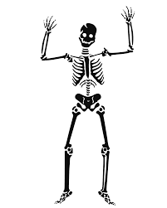
Body Systems
West Suffolk College
Karen Bell
Students Name: …………………………………………………………………..

Slide 2
Topic
Body System - Worksheet
Aims
To consolidate learning To add to learning Starting point to assessment work
Level
Level 2
Method
PowerPoint slides, Slide 3 to 4 – worksheet for students to add information about each body system. Slide 5 & 6 are the answers. This can either be done as a group or individual task.
Equipment
Laptop & Projector Hand-out Print out (Slides 3 & 4) Pens
Duration
>20 Minutes

Slide 3
Body System – Hand-Out
System | What does it do? | Main Organs Involved
Circulatory
Respiratory
Excretory
Digestive
Reproductive
Notes:
HANDOUT SLIDE

Slide 4
Body System – Hand-Out
System | What does it do? | Main Organs Involved
Endocrine
Nervous
Muscular
Skeletal
Immune
Notes:
HANDOUT SLIDE

Slide 5
Body System - Answers
System | What does it do? | Main Organs Involved
Circulatory | The circulatory system delivers nutrients and oxygen to all cells in the body. It consists of the heart and the blood vessels running through the entire body. The arteries carry blood away from the heart; the veins carry it back to the heart. | Heart, Brain, Lungs
Respiratory | When we breathe, we inhale oxygen and exhale carbon dioxide. This exchange of gases is the respiratory system's means of getting oxygen to the blood. Respiration is achieved through the mouth, nose, trachea, lungs, and diaphragm. | Nose, Pharynx, Larynx, Trachea, Bronchi, Lungs
Excretory | The excretory system is the system of an organism's body that performs the function of excretion, the bodily process of discharging wastes. The Excretory system is responsible for the elimination of wastes produced by homeostasis. | Kidneys, Ureters, Bladder, Urethra Lungs, Skin, Large Intestines, Liver
Digestive | The digestive system breaks down food and delivers nutrients to every cell in the body via the bloodstream. The digestive tract starts at the mouth and ends at the anus. Organs that are part of the digestive system include the stomach, small intestine, pancreas, liver and large intestine (bowel). | Salivary Glands, Pharynx, Oesophagus, Stomach, Small Intestine, Large Intestine, Rectum
Reproductive | The reproductive system is a collection of internal and external organs — in both males and females — that work together for the purpose of procreating | Female: Uterus Cervix Fallopian Tubes Ovaries | Male: Penis Scrotum Testicles Epididymis Vas Deferens Ejaculatory Ducts Urethra Seminal Vesicles Prostate Gland Bulbourethral Glands
Notes:
ANSWERS

Slide 6
Body System - Answers
System | What does it do? | Main Organs Involved
Endocrine | The endocrine system is made up of glands that produce and secrete hormones, chemical substances produced in the body that regulate the activity of cells or organs. These hormones regulate the body's growth, metabolism and sexual development and function. | Hypothalamus, Pituitary, Thyroid, Parathyroid Gland Adrenals, Pineal Body, Ovaries Testes, The Pancreas
Nervous | the network of nerve cells and fibres which transmits nerve impulses between parts of the body. | Brain, Spinal Cord
Muscular | The muscular system is an organ system consisting of skeletal, smooth and cardiac muscles. It permits movement of the body, maintains posture, and circulates blood throughout the body. | Cardiac Muscles
Skeletal | The skeletal system is the framework of the body, consisting of bones and other connective tissues, which protects and supports the body tissues and internal organs. The human skeleton contains 206 bones, six of which are the tiny bones of the middle ear (three in each ear) that function in hearing | Bones, Tendons, Ligaments Cartilage
Immune | The organs and processes of the body that provide resistance to infection and toxins. | Thymus, Bone Marrow, Spleen Adenoids, Liver
Notes:
ANSWERS

Slide 7
For further information please contact The STEM Alliance enquiries@STEMalliance.uk or visit www.STEMalliance.uk

