Slide 1




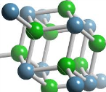
AS Level
Chemistry
Bonding
Dr Deborah Bunker
Students Name: …………………………………………………………………..

Slide 2

Topic
AS Chemistry Work Booklet – Bonding
Aims
This resource has been developed to support learners to develop their AS Chemistry subject specialist knowledge. All learners on programme are provided with a work book that contains key facts, illustrations, worksheets, past paper questions , practical schedules and methodologies, games and links to useful sites to support their learning. The booklets are also made available on the Chemistry specific subject specialist models’ for each programme with and without model answers to enable flexible learning to take place. The booklets allow learners to spend more time with the subject specialist teacher learning, how best to apply their knowledge in different situations, acquiring a deeper understanding instead of having to spend ‘in-class’ time purely note taking and copying diagrams with little time to practice knowledge application and skill development.
Level
Level 3
Method
The whole booklet to print from slide 3 to
Equipment
Laptop & Projector Hand-out (ALL SLIDES apart from slide 2) Pens
Duration
>5-10 Minutes
Notes:
Hidden

Slide 3
Bonding Checklist
3 = I fully understand;
2 = I know about this but am not very confident;
1 = I don’t know anything about this;
Learning objective | How much do I know? |  | What do I still need to do?
 | Before topic | After topic
Know that atoms bond to gain full outer shells
Define what is meant by ionic and covalent bonding
Identify which compounds are ionic and which are covalent
Draw dot and cross for ionic and covalent compounds, including compounds with double and triple covalent bonds.
Define what is meant by electronegativity
Explain that if both atoms in a compound have the same electronegativity then the compound will be purely covalent.
Explain that if both atoms in a compound have different electronegativities then the compound will have dipoles and the bonding will be polar covalent.
Recall the trends in electronegativity in the periodic table
Use the trends in electronegativity to predict the positions and sizes of the dipoles on a molecule
Notes:
To be printed for the students; to fill in before and after topic

Slide 4
Ionic & Covalent
Bonding
Which group of atoms is very unreactive? ____________________________________________
Why is this group of atoms so unreactive? ____________________________________________
Why do all other atoms bond with each other? ________________________________________
Atoms can get full outer shells of electrons by either ___________________electrons to form _____________bonds or by ________________electrons to form ______________bonds.
Ionic Bonding
Usually between a _________and a _______________________
When metals react they usually _____________electrons. As they have now have _________ electrons than protons they form _______________ions.
When non-metals react they usually __________electrons. As they have now have __________ electrons than protons they form ____________________ions.
So when a metal atom bonds with a non-metal atom the metal ____________________to the non-metal to form a _____________________metal ion and a _________________non-metal ion.
The ions attract each other to form an _____________________________bond.
An ionic bond is
Notes:
Print

Slide 5
Ionic & Covalent
Bonding
Draw a dot and cross diagram to show what happens when sodium bonds with chlorine (only show the outer shell electrons).
The sodium ion that forms has a ________________charge and the chloride ion that forms has a ____________charge.
The formula of the compound that forms is _______________________
Notes:
Print

Slide 6
Ionic & Covalent
Bonding
Covalent bonding
Usually between two ______________________________
Non-metals usually ______________________ electrons but as they both can’t gain electrons they ____________ them. The atoms join together to form ________________________ with a _______________________charge.
An covalent bond is
Draw a dot and cross diagram to show what happens when two chlorine atoms bond together to form a chlorine molecule (only show the outer shell electrons).
Notes:
Print

Slide 7
Ionic & Covalent
Bonding
The formula of the chlorine molecule that forms is ________________
The covalent bond in a chlorine molecule is made from one shared pair of electrons. We call this a single covalent bond.
Draw a dot and cross diagram to show what happens when two oxygen atoms bond together to from a oxygen molecule.
The formula of the oxygen molecule that forms is ___________
How does the covalent bond in oxygen differ from that in chlorine? ________________________
______________________________________________________________________________
We say the covalent bond in oxygen is a ________________________covalent bond.
Notes:
Print

Slide 8

Ionic & Covalent
Bonding
Test your understanding:
Draw dot & cross diagrams for the following ionic compounds (show just outer shell electrons):
Calcium Fluoride
Lithium Oxide
Magnesium Sulphide
Notes:
Print

Slide 9
Ionic & Covalent
Bonding
Draw dot & cross diagrams for the following covalent compounds (show just outer electrons):
Hydrogen Chloride
Water
Carbon Dioxide
Notes:
Print

Slide 10
Ionic & Covalent
Bonding
Now try the following compounds. Hint: are they ionic or covalent?
Calcium Oxide
Ammonia (nitrogen bonding with hydrogen)
Methane (carbon bonding with hydrogen)
A Nitrogen Molecule
Sodium Nitride
Notes:
Print

Slide 11
Ionic & Covalent
Bonding
These last two are quite tough. Try them if you feel confident!!
Ethane (C₂H₆)
Ethene (C₂H₄)
Notes:
Print

Slide 12
Bonding Questions
1 | Potassium forms an ion K⁺, how many electrons are in this ion? |  |  |  |  | ____________________
2 | Barium forms an ion Ba²⁺, how many electrons are in this ion? |  |  |  |  | ____________________
3 | Iodine forms an ion I⁻, how many electrons are in this ion? |  |  |  |  | ____________________
4 | Sulphur forms an ion S²⁻, how many electrons are in this ion? |  |  |  |  | ____________________
5 | Write the symbol of an ion which would contain 18 electrons. |  |  |  |  | ____________________
6 | Write the symbol of an ion which would contain 36 electrons. |  |  |  |  | ____________________
7 | The element iron has a proton number of 26 and a mass number of 56, it forms an ion Fe³⁺
In the iron atom there are: |  | ___________ |  | protons | _____________ |  | neutrons
In the iron ion there are: |  | ___________ |  | protons | _____________ |  | electrons
8 | The element bromine has a proton number of 35 and a mass number of 80, it forms an ion Br⁻
In the bromine atom there are |  |  | ________ | protons | _____________ |  | neutrons
In the bromine ion there are |  |  | ________ | protons | _____________ |  | electrons
Notes:
Print

Slide 13
Bonding Questions
9 | When a metallic element forms an ion it
A: Gains Electrons |  |  |  |  |  | B: Gains Neutrons |  |  |  |  | C: Loses Electrons |  |  |  | D: Gains Protons
10 |  | Hydrogen ions, H⁺ consist of
A: Electrons |  |  | B: Protons |  |  |  |  | C: Electrons & Protons |  |  | D: Electrons, Protons & Neutrons |  |  |  |  | E: Protons & Neutrons
11 |  | An element which has atoms containing 8 electrons will
A: Form negative ions |  |  |  |  |  |  | B: Be unreactive |  |  | C: Form covalent bonds only |  |  |  |  |  |  |  | D: Form ionic bonds only
12 |  | Which one of the following compounds contains no covalent bonds?
A: Ammonium Chloride |  |  |  |  |  |  |  | B: Hydrogen Chloride |  |  |  |  | C: Nitrogen Chloride |  |  |  | D: Sodium Chloride
13 |  | When magnesium combines with chlorine
A: Mg gains two electrons |  |  |  | B: CI gains one electron |  |  |  |  | C: A covalent bond is formed |  |  |  |  | D: The compound contains equal number of Mg²⁺ & CI⁻ ions
14 |  | Which one of the following correctly describes the electronic structure of the magnesium ion
A: 2.8.2 |  |  |  |  | B: 2.8.1 |  |  |  |  |  | C: 8.8.2 |  |  |  |  |  | D: 2.8.8
E: 2.8
15 |  | Which one of the following correctly describes the electronic structure of the chloride ion
A: 2.7 |  |  |  |  |  | B: 2.8.7 |  |  |  |  |  | C: 2.8 |  |  |  | D: 2.8.8
E: 8.8.7
Notes:
Print

Slide 14
Bonding Questions
1 | The atomic number of calcium is 20. Its relative atomic mass is 40. Which one of the following correctly describes the particles to be found in the calcium ion?
 |  |  |  | A |  | B | C | D | E
Protons |  |  |  | 20 |  | 40 | 20 | 20 | 20
Neutrons |  |  |  | 20 |  | 20 | 40 | 20 | 20
Electrons |  |  |  | 20 |  | 20 | 18 | 38 | 18
Q:2-5 |  |  | Chemical bonding can occur as a result of each of the following:
A |  |  | One atom transferring one electron to another atom
B |  |  | One atom transferring two electrons to another atom
C |  |  | One atom transferring two electrons, one to each of two other atoms
D |  |  | One atom sharing a pair of electrons with another atom
E |  |  | One atom sharing pairs of electrons with more than one other atom
Which of the types of bonding, A to E above is present in:
2 |  | Hydrogen Chloride |  |  | ____________________
3 |  | Calcium Chloride |  |  | ____________________
4 |  | Sodium Chloride |  |  | ____________________
5 |  | Ammonia |  |  | ____________________
Notes:
Print

Slide 15
Bonding Questions
Q: 6-9
A: | A noble gas atom |  | B: |  | A metal atom | C: |  | A metal ion | D: | A non-metal atom which is not a noble gas | E: | A non-metal ion
The next four questions give the composition of a particle. Select, from the above list A to E, the type of particle which has been given structure in each case.
6 | 2 protons |  |  | 2 neutrons |  |  | 2 electrons
7 | 13 protons |  |  | 14 neutrons |  |  | 13 electrons
8 | 17 protons |  |  | 20 neutrons |  |  | 18 electrons
9 | 8 protons |  |  | 8 neutrons |  |  | 8 electrons
Q: 10 -13
Which one of the atoms listed A to E
A B C D E
Protons 11 11 16 17 17
Neutrons 12 12 19 18 20
Electrons 11 10 16 18 17
Can form an ion with a single negative charge? _________________________________
Has the same mass number as D? _________________________________
Is an isotope of E? _________________________________
Could form a covalent compound of the type H₂X? _________________________________
Notes:
Print

Slide 16
Bonding Questions
Check your knowledge by answering the following. Delete the incorrect answers. Ionic Bonds
1 | Involve electrons being transferred/shared between atoms
2 | Are strong/weak
3 | Usually result when the following elements combine:
 | Metal + Metal |  | Metal + Non-Metal |  | Non-Metal + Non-Metal
4 | Result in the formation of individual molecules/ions
Give examples of three compounds which contain ionic bonds
______________________ |  | ________________________ |  | ________________________
5 Do elements contain ions, if not then what type of particle(s) are they made from? _______________________________________________________________________________________ _______________________________________________________________________________________
Covalent Bonds
1 | Involve electrons being transferred/shared between atoms.
2 | Are strong/weak.
3 | Usually result when the following elements combine
 | Metal + Metal |  | Metal + Non-Metal |  | Non-Metal + Non-Metal
4 | Result in the formation of individual molecules/ions
Give examples of three compounds which contain covalent bonds.
________________________ |  | ________________________ |  | ________________________
Give examples of three elements which contain covalent bonds
________________________ |  | ________________________ |  | ________________________
Summary Compounds containing a metal usually contain _____ bonds and the particles present are _____ Compounds containing only non-metals usually contain _________________ bonds and the particles present are ____________ The particles found in metallic elements are individual ___________ The particles found in most non-metallic elements are ______________ in which the _______ are joined by _________________ bonds. Noble gases consist of individual ___________.
Notes:
Print

Slide 17
Electronegativity
Define electronegativity: ___________________________________________________________
_______________________________________________________________________________
You will need a periodic table to help you answer some of the following:
Which is the most electronegative element? __________________________________________
Which is the least electronegative element? __________________________________________
Which element has the strongest attraction for electrons? ______________________________
Which element has the weakest attraction for electrons? ______________________________
State how electronegativities change on going:
Down a group in the Periodic Table _________________across a period. ____________________
In which corner of the Periodic Table are the elements with the:
Higher electronegativities? ________________Lower electronegativities? ____________________
Electronegativity is a useful concept as by comparing the difference in value between the
electronegativities of two atoms we get an idea as to the type of bond formed between them.
If the difference in electronegativities is very large the bonding is likely to be __________________
If there is no difference in electronegativities then the bonding will be ________________________
If the difference in electronegativities is small the bonding is likely to be _______________________
Which two elements show the biggest difference in electronegativity? ________________________
What type of a bond would expect to be formed between these two elements? _________________
Notes:
Print

Slide 18
Electronegativity
Metallic elements tend to have ____________electronegativity values which indicates that they only have _________________ attractions for electrons.
Non-metallic elements tend to have ______________electronegativity values which indicates that they have _____________________ attractions for electrons.
Electronegativity Difference Type of Bonding
NH₃ ……………………………… ………………….
Cs₂O ……………………………… ………………….
BrCI ……………………………… ………………….
CACI₂ ……………………………… ………………….
PCI₃ ……………………………… ………………….
Notes:
Print

Slide 19
Electronegativity
Multi-Choice
You will need a Periodic Table to help you answer some of the following questions.
1 Which one of the following compounds is most likely to be ionic?
A NH₃ B CaH C HCl D SiF4
Which one of the following is the most covalent?
2 A KCl B NaCl C CaCl₂ D CaI₂
3 A BeCl₂ B LiCl C MgCl₂ D NaCl
4 A MgF₂ B MgCl₂ C MgBr₂ D AlBr₃
Which one of the following is the most ionic?
5 A CaF₂ B CaCl₂ C CaBr₂ D CaI₂
6 A BeCl₂ B LiCl C MgCl₂ D NaCl
Which one of the following has the largest dipoles?
7 A HCl B F₂ C HBr D BrCl
8 A NH₃ B PH₃ C H₂O D HF
9 Which one of the following contains two different polar bonds?
A NH₄⁺ B CCl₄ C CH₃Cl D H₂O
10 Which one of the following does not have a pair of s electrons in its outermost orbital?
A He B H– C Ar D P³⁺
11 As atomic number increases across the third period, the electronegativity of the elements
A stays almost constant B decreases steadily
C increases to a maximum then decreases D increases steadily
12 Which one of the following statements concerning the electronegativity of elements is correct?
A that of hydrogen is zero B that of Na is greater than that of K
C that of Br is greater than that of Cl D that of Ca is greater than that of Mg
Notes:
Print

Slide 20
Dative Covalent
(co-ordinate) bonding
This is a type of covalent bond where both of the shared pair of electrons come from the same atom.
Draw a dot and cross diagram of the
ammonia molecule in the space opposite.
You should be able to see that nitrogen has only used three of its five outer shell electrons to bond with. The pair of electrons not involved in a bond is called a lone pair of electrons.
Ammonia can bond with H⁺ ion to form the ammonium ion which has the formula_________________
How many electrons does the H⁺ ion have? _______________________
It therefore can’t form a normal covalent bond with ammonia as it has no electron of its own to share.
Can you suggest how the ammonia bonds to the H⁺?_______________________________________
_________________________________________________________________________________
_________________________________________________________________________________
We can show this on a diagram using “curly arrow notation”. A curly arrow shows the movement of a pair of electrons.
Water can bond with H⁺ in the same way to form H₃0⁺.
Show this on a diagram using curly arrow notation.
Although dative covalent bonds are formed in a slightly different way to “normal” covalent bonds, once they are formed than they are identical to each other and can’t be told apart.
Notes:
Print

Slide 21
More Bonding
Questions
Define the following terms:
ionic bond _________________________________________________________________
______________________________________________________________________________
covalent bond ______________________________________________________________
______________________________________________________________________________ c. dative covalent (co-ordinate) bond _______________________________________________ _____________________________________________________________________________
a. What do you understand by the term electronegativity? ______________________________________________________________________________
______________________________________________________________________________
b. What is a polar covalent bond?
______________________________________________________________________________
c. How do we use electronegativities to decide whether compounds are pure or polar covalent
______________________________________________________________________________
d. How do we use electronegativities to decide how polar covalent a compound is?
______________________________________________________________________________
Notes:
Print

Slide 22
More Bonding
Questions
e. Use the trends in electronegativity in the periodic table to decide whether the bonding in the following compounds is ionic, pure covalent or polar covalent
NaBr; H2O; CCI4; KCI; H2S; CI2; MgF2: NH3
Ionic: ________________________________________________________________
Pure Covalent: _________________________________________________________
Polar: ________________________________________________________________
f. Place the following chlorides in order of decreasing covalency (most covalent first):
i. MgCI2; BeCI2; CaCI2; BaCI2;
Order: _______________________________________________________________
ii. MgCI2; SiCI4; CI2; NaCI; AICI3;
Order: _______________________________________________________________
Complete the table by writing in the formulas and putting ticks in the appropriate boxes so as to indicate the types of bonds present in each of the substances shown
Name | Formula | Type of Bond(s)
 |  | Ionic | Pure Covalent | Polar Covalent
Sodium Oxide
Carbon Dioxide
Calcium Fluoride
Bromine
Ammonia
Ammonium Chloride
Notes:
Print

Slide 23
More Bonding
Questions
The ammonium ion is formed when ammonia reacts with H+. It does so by forming a dative covalent (co-ordinate) bond. With the help of a diagram show how the dative covalent bond is formed. What is the essential feature on the ammonia molecule that allows it to form such bonds.
Essential feature ___________________________________________________________________
Notes:
Print

Slide 24
More Bonding
Questions
Indicate the bond polarity on the following covalent bonds and place them in order of decreasing bon polarity (number the most polar 1):
Select from the electron configurations A- F the structure of the atom/ion shown in Q6 - 11
… …
… …
… …
N-- -O
N---H
F----H
Order
………
……..
……..
A | 1s²2s²2p⁵ | B | 1s²2s²2p⁶3s²p⁶ | C | 1s²2s²2p⁶3s²
D | 1s²2s²2p⁶ | E | 1s²2s²2p⁶3s²3p¹ | F | None of A to E
6 | F _______________ | 7 | CI⁻ _______________ | 8 | Na⁺
9 | Ar _______________ | 10 | Al³⁺ ______________ | 11 | S⁻ ________________
In which group of the Periodic Table is the element who outer structure is 3s²3p⁵?
Notes:
Print

Slide 25
Ionic and Covalent
Bonding Summary
Definitions – learn these well!!!!
Ionic Bond | A strong electrostatic attraction between oppositely charged ions
Covalent Bond | A shared pair of electrons
Electronegativity | The ability of an atom to attract the shared pair of electrons in a covalent bond
Polar covalent bond | An unequally shared pair of electrons leading to dipoles forming on the bond
Dative covalent bond | A shared pair of electrons where both electrons come from the same atom
The two extreme types of bonding are ionic and covalent. However very few compounds are purely ionic or covalent – most are somewhere in between, polar covalent.
+
_
Pure covalent
Atoms share pairs of electrons to form molecules.
Each atom has the same electronegativity for the nucleus of each atom attracts the shared pair of electrons equally strongly.
The electron pair is equally shared and the molecule has no charges
If the atoms have different electronegativities then one will attract the electron pair more strongly. Dipoles will form and the bonding will become polar covalent. The bigger the difference in the electronegativities of the two atoms, the bigger the dipoles and the more polar the bonding will be
Ionic
Atoms transfer electrons to form oppositely charged ions.
The atom losing the electrons becomes positive and the atom gaining electrons becomes negative.
The ions attract each other by strong electrostatic forces
If the difference in the electronegativities of the two atoms is large then the dipoles become full charges and the bonding becomes ionic
Notes:
Print

Slide 26

For further information please contact The STEM Alliance enquiries@STEMalliance.uk or visit www.STEMalliance.uk

Slide 27
Bonding Checklist
3 = I fully understand;
2 = I know about this but am not very confident;
1 = I don’t know anything about this;
Learning objective | How much do I know? |  | What do I still need to do?
 | Before topic | After topic
Know that atoms bond to gain full outer shells
Define what is meant by ionic and covalent bonding
Identify which compounds are ionic and which are covalent
Draw dot and cross for ionic and covalent compounds, including compounds with double and triple covalent bonds.
Define what is meant by electronegativity
Explain that if both atoms in a compound have the same electronegativity then the compound will be purely covalent.
Explain that if both atoms in a compound have different electronegativities then the compound will have dipoles and the bonding will be polar covalent.
Recall the trends in electronegativity in the periodic table
Use the trends in electronegativity to predict the positions and sizes of the dipoles on a molecule
ANSWERS
Notes:
To be printed for the students; to fill in before and after topic

Slide 28
Ionic & Covalent
Bonding
Which group of atoms is very unreactive? Group O/Noble Gases
Why is this group of atoms so unreactive? Complete outer shell/ very high ionisation energy
Why do all other atoms bond with each other? To get complete outer shell
Atoms can get full outer shells of electrons by either transferring electrons to form ionic bonds or by sharing electrons to form covalent bonds.
Ionic Bonding
Usually between a metal and a non-metal
When metals react they usually lose electrons. As they have now have less electrons than protons they form positive ions.
When non-metals react they usually gain electrons. As they have now have more electrons than protons they form negative ions.
So when a metal atom bonds with a non-metal atom the metal donates electrons to the non-metal to form a positive metal ion and a negative non-metal ion.
The ions attract each other to form an ionic bond.
An ionic bond is the strong attraction between oppositely charged ions
ANSWERS
Notes:
Print

Slide 29
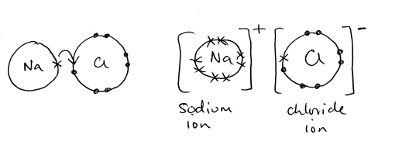
Ionic & Covalent
Bonding
Draw a dot and cross diagram to show what happens when sodium bonds with chlorine (only show the outer shell electrons).
The sodium ion that forms has a +1 charge and the chloride ion that forms has a -1charge.
The formula of the compound that forms is NACI
ANSWERS
Notes:
Print

Slide 30
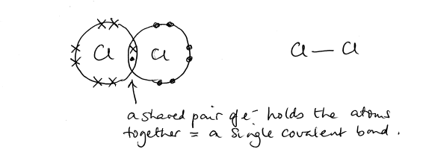
Ionic & Covalent
Bonding
Covalent bonding
Usually between two non-metals
Non-metals usually gain electrons but as they both can’t gain electrons they share them. The atoms join together to form molecules with a zero charge.
An covalent bond is a shared pair of electrons
Draw a dot and cross diagram to show what happens when two chlorine atoms bond together to form a chlorine molecule (only show the outer shell electrons).
ANSWERS
Notes:
Print

Slide 31
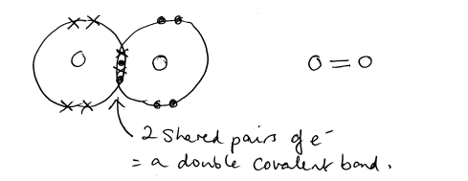
Ionic & Covalent
Bonding
The formula of the chlorine molecule that forms is CI₂
The covalent bond in a chlorine molecule is made from one shared pair of electrons. We call this a single covalent bond.
Draw a dot and cross diagram to show what happens when two oxygen atoms bond together to from a oxygen molecule.
The formula of the oxygen molecule that forms is 0₂
How does the covalent bond in oxygen differ from that in chlorine? Consists of 2 pairs of e⁻
We say the covalent bond in oxygen is a double covalent bond.
ANSWERS
Notes:
Print

Slide 32
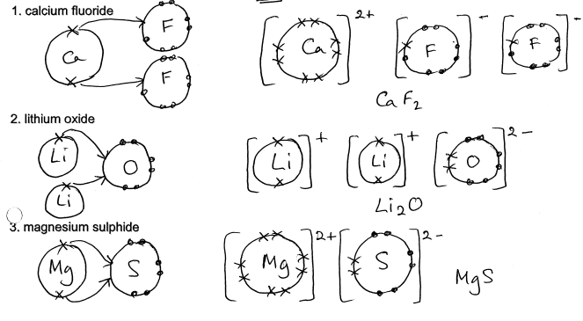
Ionic & Covalent
Bonding
Test your understanding:
Draw dot & cross diagrams for the following ionic compounds (show just outer shell electrons):
ANSWERS
Notes:
Print

Slide 33
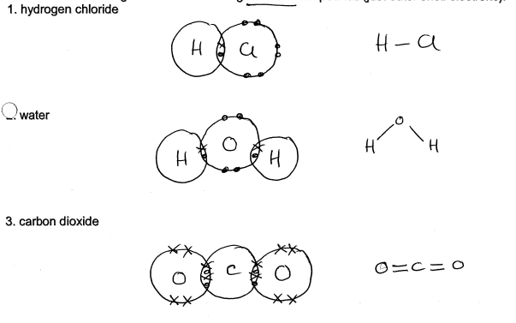
Ionic & Covalent
Bonding
Draw dot & cross diagrams for the following covalent compounds (show just outer electrons):
ANSWERS
Notes:
Print

Slide 34
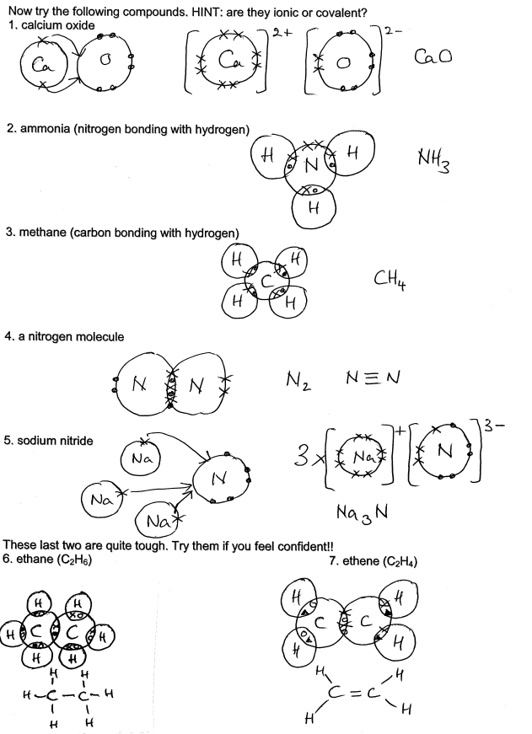
Ionic & Covalent
Bonding
ANSWERS
Notes:
Print

Slide 35
Bonding Questions
1 | Potassium forms an ion K⁺, how many electrons are in this ion? |  |  |  |  | 18
2 | Barium forms an ion Ba²⁺, how many electrons are in this ion? |  |  |  |  | 54
3 | Iodine forms an ion I⁻, how many electrons are in this ion? |  |  |  |  | 54
4 | Sulphur forms an ion S²⁻, how many electrons are in this ion? |  |  |  |  | 18
5 | Write the symbol of an ion which would contain 18 electrons. |  |  |  |  | CI ⁻
6 | Write the symbol of an ion which would contain 36 electrons. |  |  |  |  | Br⁻/R6⁺
7 | The element iron has a proton number of 26 and a mass number of 56, it forms an ion Fe³⁺
In the iron atom there are: |  | 26 |  | protons | 30 |  | neutrons
In the iron ion there are: |  | 26 |  | protons | 23 |  | electrons
8 | The element bromine has a proton number of 35 and a mass number of 80, it forms an ion Br⁻
In the bromine atom there are |  |  | 35 | protons | 45 |  | neutrons
In the bromine ion there are |  |  | 35 | protons | 36 |  | electrons
ANSWERS
Notes:
Print

Slide 36
Bonding Questions
9 | When a metallic element forms an ion it
A: Gains Electrons |  |  |  |  |  | B: Gains Neutrons |  |  |  |  |  | C: Loses Electrons |  |  |  |  | D: Gains Protons
10 |  | Hydrogen ions, H⁺ consist of
A: Electrons |  |  | B: Protons |  |  |  |  |  | C: Electrons & Protons |  |  |  |  | D: Electrons, Protons & Neutrons |  |  |  | E: Protons & Neutrons
11 |  | An element which has atoms containing 8 electrons will
A: Form negative ions |  |  |  |  |  |  | B: Be unreactive |  |  |  | C: Form covalent bonds only |  |  |  |  |  |  |  |  | D: Form ionic bonds only
12 |  | Which one of the following compounds contains no covalent bonds?
A: Ammonium Chloride |  |  |  |  |  |  |  | B: Hydrogen Chloride |  |  |  |  |  |  | C: Nitrogen Chloride |  |  |  | D: Sodium Chloride
13 |  | When magnesium combines with chlorine NO ANSWER IS CORRECT
A: Mg gains two electrons |  |  |  | B: CI gains one electron |  |  |  |  |  | C: A covalent bond is formed |  |  |  |  |  | D: The compound contains equal number of Mg²⁺ & CI⁻ ions
14 |  | Which one of the following correctly describes the electronic structure of the magnesium ion
A: 2.8.2 |  |  |  |  | B: 2.8.1 |  |  |  |  |  |  | C: 8.8.2 |  |  |  |  |  |  | D: 2.8.8
E: 2.8
15 |  | Which one of the following correctly describes the electronic structure of the chloride ion
A: 2.7 |  |  |  |  |  | B: 2.8.7 |  |  |  |  |  |  | C: 2.8 |  |  |  |  | D: 2.8.8
E: 8.8.7
ANSWERS
Notes:
Print

Slide 37
Bonding Questions
1 | The atomic number of calcium is 20. Its relative atomic mass is 40. Which one of the following correctly describes the particles to be found in the calcium ion?
 |  |  |  | A |  | B | C | D | E
Protons |  |  |  | 20 |  | 40 | 20 | 20 | 20
Neutrons |  |  |  | 20 |  | 20 | 40 | 20 | 20
Electrons |  |  |  | 20 |  | 20 | 18 | 38 | 18
Q:2-5 |  |  | Chemical bonding can occur as a result of each of the following:
A |  |  | One atom transferring one electron to another atom
B |  |  | One atom transferring two electrons to another atom
C |  |  | One atom transferring two electrons, one to each of two other atoms
D |  |  | One atom sharing a pair of electrons with another atom
E |  |  | One atom sharing pairs of electrons with more than one other atom
Which of the types of bonding, A to E above is present in:
2 |  | Hydrogen Chloride |  |  | D
3 |  | Calcium Chloride |  |  | C
4 |  | Sodium Chloride |  |  | A
5 |  | Ammonia |  |  | E
ANSWERS
Notes:
Print

Slide 38
Bonding Questions
Q: 6-9
A: | A noble gas atom |  | B: |  | A metal atom | C: |  | A metal ion | D: | A non-metal atom which is not a noble gas | E: | A non-metal ion
The next four questions give the composition of a particle. Select, from the above list A to E, the type of particle which has been given structure in each case.
6 | 2 protons |  |  | 2 neutrons |  |  | 2 electrons |  |  |  | A
7 | 13 protons |  |  | 14 neutrons |  |  | 13 electrons |  |  |  | B
8 | 17 protons |  |  | 20 neutrons |  |  | 18 electrons |  |  |  | E
9 | 8 protons |  |  | 8 neutrons |  |  | 8 electrons |  |  |  | D
Q: 10 -13
Which one of the atoms listed A to E
A B C D E
Protons 11 11 16 17 17
Neutrons 12 12 19 18 20
Electrons 11 10 16 18 17
Can form an ion with a single negative charge? E
Has the same mass number as D? C
Is an isotope of E? D
Could form a covalent compound of the type H₂X? None
ANSWERS
Notes:
Print

Slide 39

Bonding Questions
Check your knowledge by answering the following. Delete the incorrect answers. Ionic Bonds
1 | Involve electrons being transferred/shared between atoms
2 | Are strong/weak
3 | Usually result when the following elements combine:
 | Metal + Metal |  | Metal + Non-Metal |  |  |  | Non-Metal + Non-Metal
4 | Result in the formation of individual molecules/ions
Give examples of three compounds which contain ionic bonds
ANY CONTAINING METAL + NON-METAL
5 Do elements contain ions, if not then what type of particle(s) are they made from? NO either atoms e.g. all metals + noble gases or molecules e.g. H₂, 0₂, CI₂
Covalent Bonds
1 | Involve electrons being transferred/shared between atoms.
2 | Are strong/weak.
3 | Usually result when the following elements combine
 | Metal + Metal |  | Metal + Non-Metal |  |  |  | Non-Metal + Non-Metal
4 | Result in the formation of individual molecules/ions
Give examples of three compounds which contain covalent bonds.
ANY WITH TWO DIFFERENT NON-METALS e.g. HCI, H₂0
Summary Compounds containing a metal usually contain IONIC bonds and the particles present are IONS Compounds containing only non-metals usually contain COVALENT bonds and the particles present are MOLECULES The particles found in metallic elements are individual ATOMS The particles found in most non-metallic elements are MOLECULES in which the ATOMS are joined by COVALENT bonds. Noble gases consist of individual ATOMS.
ANSWERS
Notes:
Print

Slide 40
Electronegativity
Define electronegativity: The ability of an atom to attract the shared pair of electrons in a covalent bond (ATOM IS ESSENTIAL)
You will need a periodic table to help you answer some of the following:
Which is the most electronegative element? Fluorine
Which is the least electronegative element? Francium
Which element has the strongest attraction for electrons? Fluorine
Which element has the weakest attraction for electrons? Francium
State how electronegativities change on going:
Down a group in the Periodic Table decreases across a period. Increases L- R
In which corner of the Periodic Table are the elements with the:
Higher electronegativities? top right Lower electronegativities? bottom left
Electronegativity is a useful concept as by comparing the difference in value between the
electronegativities of two atoms we get an idea as to the type of bond formed between them.
If the difference in electronegativities is very large the bonding is likely to be ionic
If there is no difference in electronegativities then the bonding will be pure covalent/non-polar
If the difference in electronegativities is small the bonding is likely to be polar covalent
Which two elements show the biggest difference in electronegativity? Fluorine & Francium
What type of a bond would expect to be formed between these two elements? Ionic
ANSWERS
Notes:
Print

Slide 41
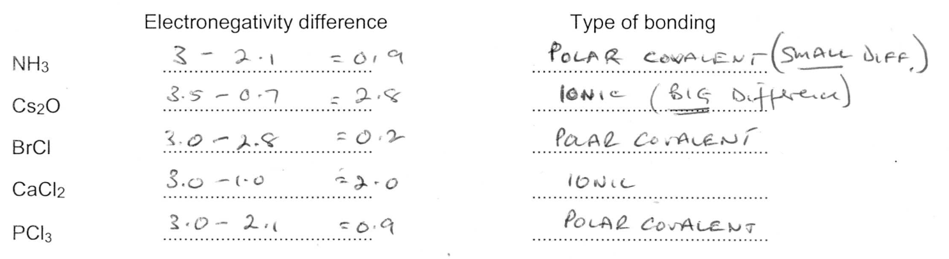
Electronegativity
Metallic elements tend to have low electronegativity values which indicates that they only have weak attractions for electrons.
Non-metallic elements tend to have high electronegativity values which indicates that they have strong attractions for electrons.
You probably will not be given these values, so you need to use the trends in the periodic table
ANSWERS
Notes:
Print

Slide 42
Electronegativity
Multi-Choice
You will need a Periodic Table to help you answer some of the following questions.
1 Which one of the following compounds is most likely to be ionic?
A NH₃ B CaH C HCl D SiF4
Which one of the following is the most covalent?
2 A KCl B NaCl C CaCl₂ D CaI₂
3 A BeCl₂ B LiCl C MgCl₂ D NaCl
4 A MgF₂ B MgCl₂ C MgBr₂ D AlBr₃
Which one of the following is the most ionic?
5 A CaF₂ B CaCl₂ C CaBr₂ D CaI₂
6 A BeCl₂ B LiCl C MgCl₂ D NaCl
Which one of the following has the largest dipoles?
7 A HCl B F₂ C HBr D BrCl
8 A NH₃ B PH₃ C H₂O D HF
9 Which one of the following contains two different polar bonds?
A NH₄⁺ B CCl₄ C CH₃Cl D H₂O
10 Which one of the following does not have a pair of s electrons in its outermost orbital?
A He B H– C Ar D P³⁺
11 As atomic number increases across the third period, the electronegativity of the elements
A stays almost constant B decreases steadily
C increases to a maximum then decreases D increases steadily
12 Which one of the following statements concerning the electronegativity of elements is correct?
A that of hydrogen is zero B that of Na is greater than that of K
C that of Br is greater than that of Cl D that of Ca is greater than that of Mg
ANSWERS
Notes:
Print

Slide 43
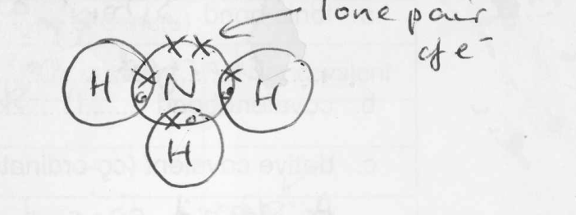
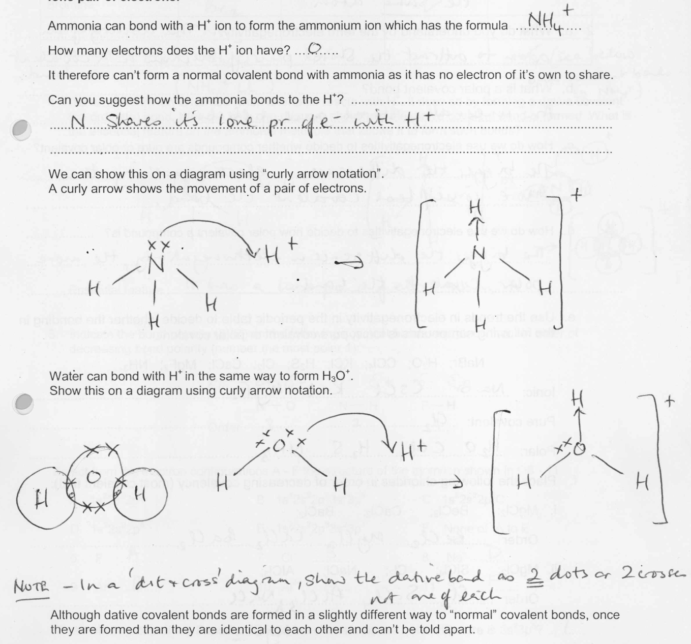
Dative Covalent
(co-ordinate) bonding
This is a type of covalent bond where both of the shared pair of electrons come from the same atom.
Draw a dot and cross diagram of the
ammonia molecule in the space opposite.
You should be able to see that nitrogen has only
used three of its five outer shell electrons to
bond with. The pair of electrons not involved
in a bond is called a lone pair of electrons.
ANSWERS
Notes:
Print

Slide 44
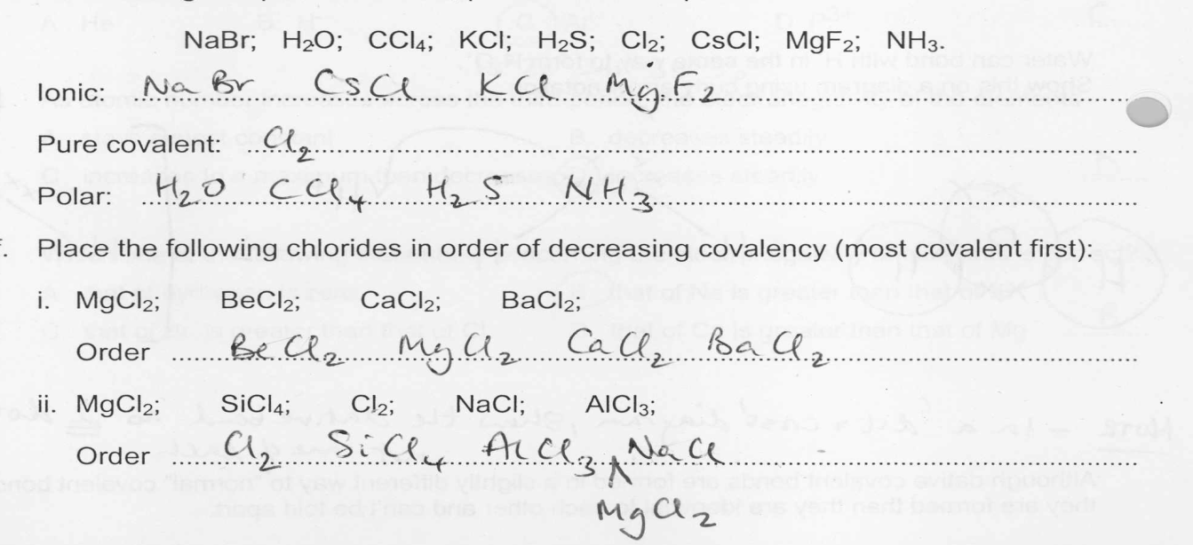
More Bonding
Questions
Define the following terms:
ionic bond Strong attraction between oppositely charged ions
covalent bond A shared pair of electrons
c. dative covalent (co-ordinate) bond A shared pair of electrons which both come from the same atom
a. What do you understand by the term electronegativity? The ability of an atom to attract the shared pair of electrons in a covalent bond.
b. What is a polar covalent bond? An unequally shared pair of electrons
c. How do we use electronegativities to decide whether compounds are pure or polar covalent? The bigger the difference in electronegativity, the more polar covalent the bond
d. How do we use electronegativities to decide how polar covalent a compound is? The bigger the difference in electronegativity, the more polar covalent the bond
e. Use the trends in electronegativity in the periodic table to decide whether the bonding in the following compounds is ionic, pure covalent or polar covalent
ANSWERS
Notes:
Print

Slide 45
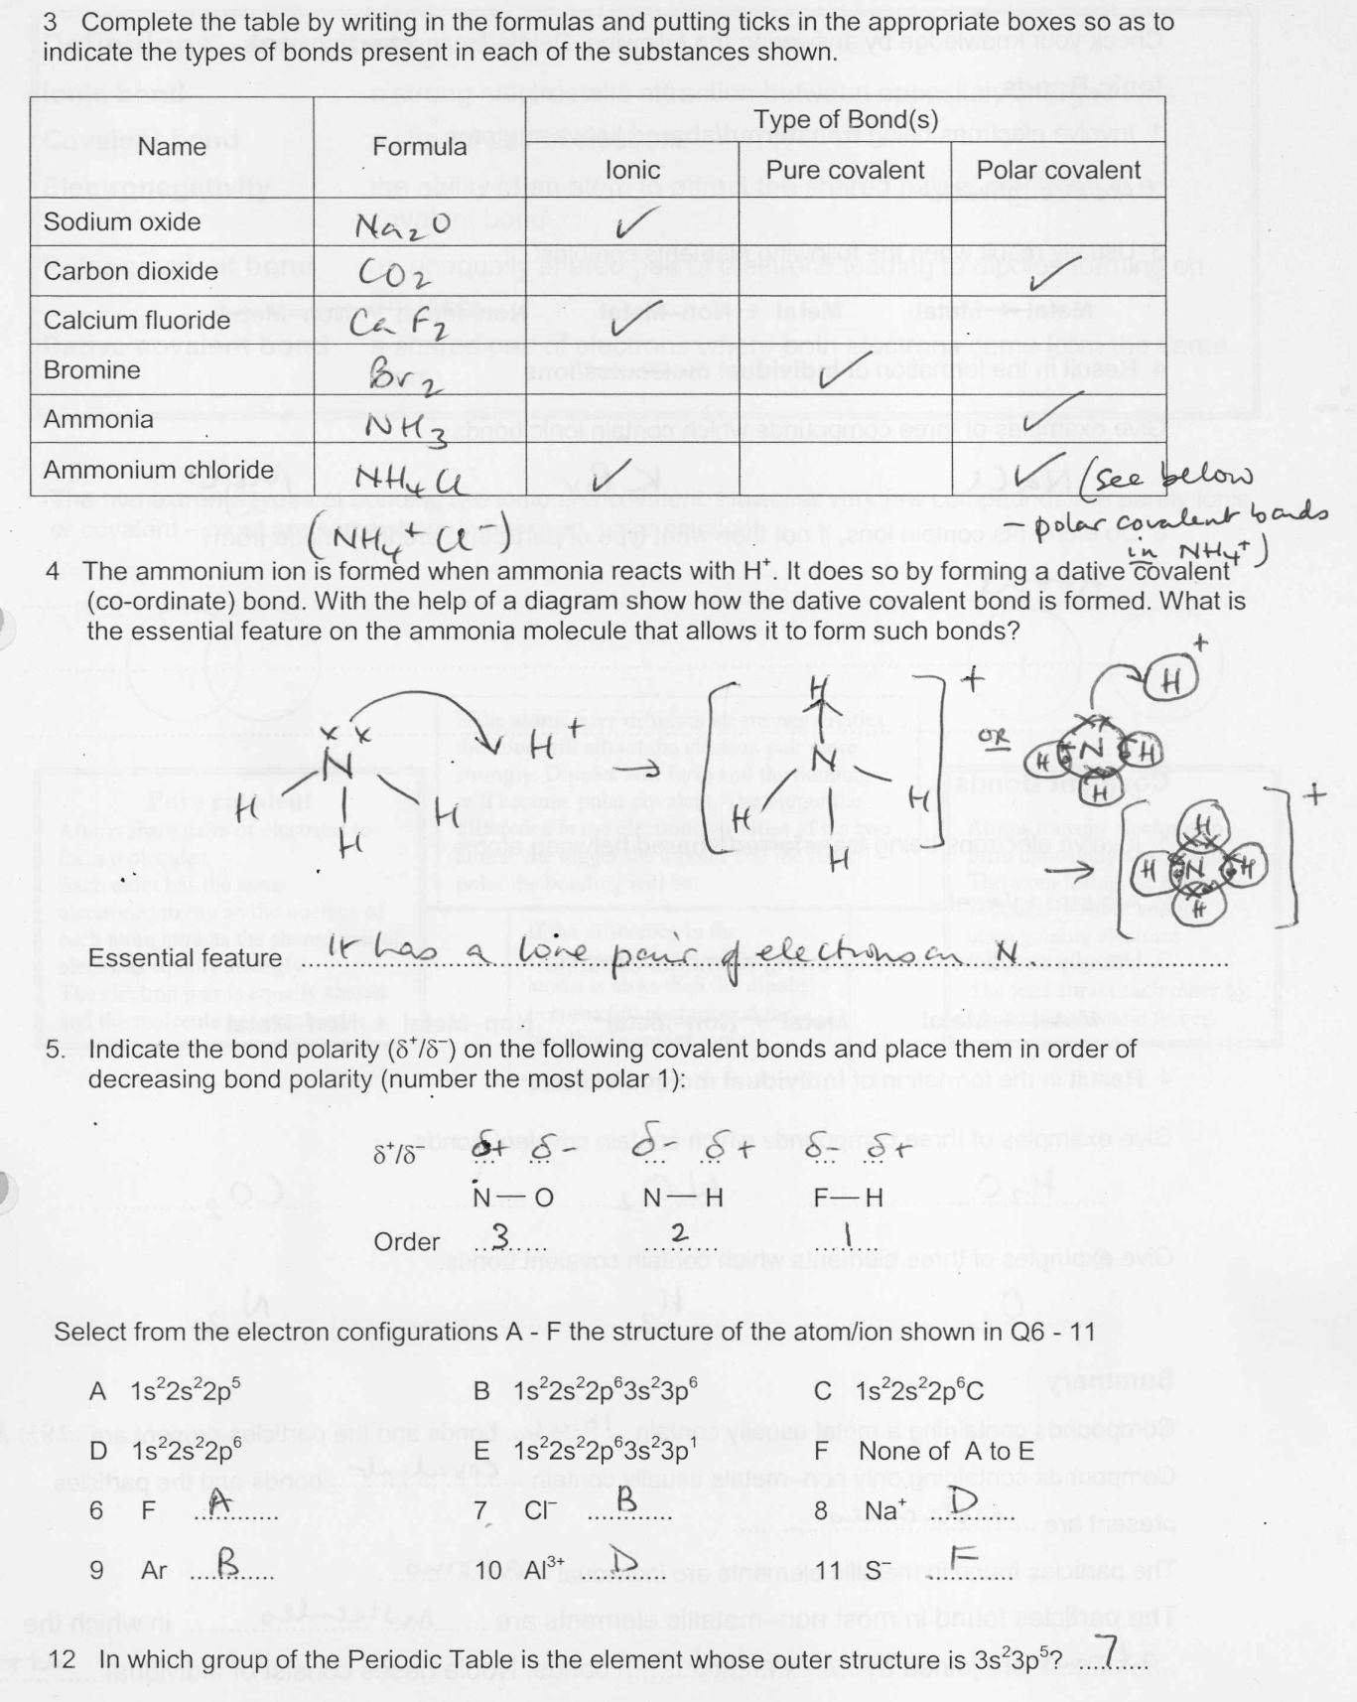
More Bonding
Questions
ANSWERS
Notes:
Print

Slide 46
For further information please contact The STEM Alliance enquiries@STEMalliance.uk or visit www.STEMalliance.uk

