Slide 1
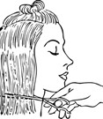
Cutting Assignment
Milton Keynes College
Christine McMillan - Bodell
Date assignment is given …………………………………………………………..
Date assignment is handed in …………………………………………………..
Candidate signature …………………………………………………..
Notes:
To print

Slide 2
Topic
Technology – Hairdressing – Cutting Assignment
Aims
To facilitate learning for cutting hair To facilitate using cutting equipment safely and hygienically Essential course work to enable to the learner to complete hairdressing qualification
Level
Level 3
Method
PowerPoint slides , all hand-outs. Tasks with assignments to complete. Answers and questions rounds,
Equipment
Laptop Projector Hand-Outs Pens and Pencils
Duration
> 30 Minutes
Notes:
Hidden

Slide 3
Basic
Techniques
For the following assignment you are expected to:
Part 1
For each of the following provide a photo of your own work:
One length cut with fringe
Long graduation cut
Uniform layered cut
Short graduation cut
For each photo produce a step by step guide on how you would achieve each look. You should use drawings or diagrams to support your notes.
Include the following:
The angles at which hair is held and cut
Tools used
Whether achieved on wet or dry hair
What factors need to be considered for each look (e.g. density, growth patterns, natural fall of hair, weight distribution)
How to cross check and balance the cut
Cutting technique used: the following techniques must be included and how and why these are used
Club cutting
Scissor/clipper over comb
Thinning
Free hand
Notes:
To Print

Slide 4
Basic
Techniques
Part 2
Write clear answers to the following questions and include the questions in your assignment:
How do the critical influencing factors in the range affect the way the hair is cut? (e.g. density, growth patterns, natural fall of hair, weight distribution)
Why is it important to check the hair before and after shampooing prior to cutting?
State the legal requirements for the disposal of sharps and other waste materials
Notes:
To Print

Slide 5
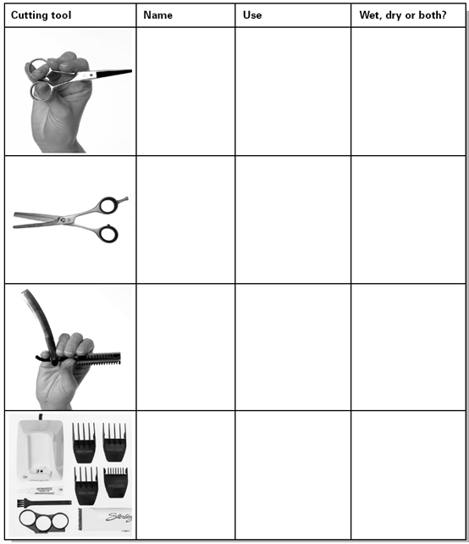
Use of Cutting
Tools
Look at the cutting tools illustrated in the table below. For each tool, state its name and use, and whether it can be used on hair that is wet, dry or both
Notes:
To Print

Slide 6
For further information please contact The STEM Alliance enquiries@STEMalliance.uk or visit www.STEMalliance.uk

