Slide 1
Designing a Control System
Sayande Adekoye
College of North West London

Slide 2
Topic
Control Systems Using IT – An Introduction
Aims
To teach IT Helps to design a control system, different types of sensors, connecting the sensors, implementing the control system, testing the control system, improving the control system and evaluations Give students a Task to complete during the PowerPoint presentation, can either work in pairs/individual or groups
Level
Level 3
Method
All Slide Show, Various tasks throughout the presentation, can be used as a group discussion, or as individual/pairs task. Can be handed to students at the end of the lesson for revision purposes.
Equipment
Laptop Projector Printer Notepad/Pens/Pencils
Duration
1 Hour

Slide 3
Objectives
Recap
What we need to achieve
1.) we go through design process(brainstorming)
2.) design your own control systems (two designs)
3.) evaluate your design and submit BOM

Slide 4
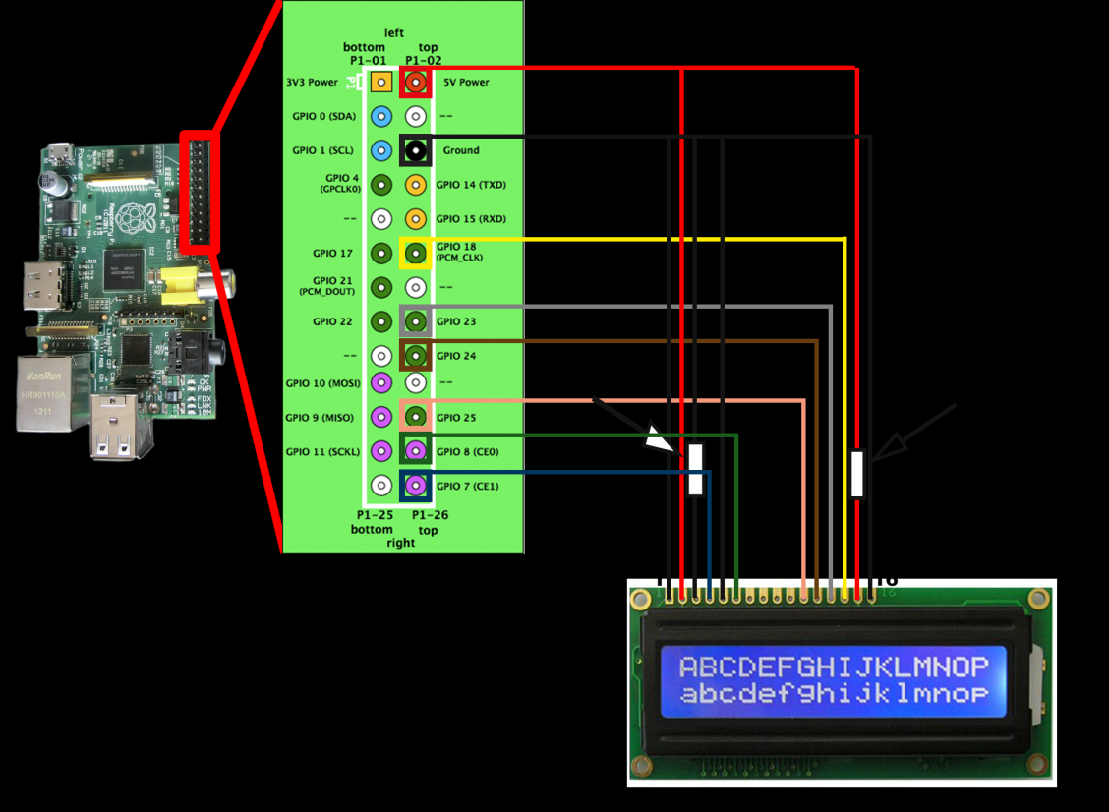
Designing a Control System
When designing your control system, it is important that you know what components are required. For you the first piece of equipment you will use is the Raspberry Pi, then on top of this it is recommended that you use an expansion/ break out board. The board available for you is the Picoborg motor controller board. This will allow you to interface your Rasp-Pi with your control system.
The next thing you will need is the control system, there are several already available, check with the teacher to find the which one you can work on.
Once you know what control system you are going to work on then it is important to realise which parts of the control system you need to connect to the Rasp-Pi via the Picoborg.
Finally you need to consider what software if any will be needed to help control/ program your control system.
Here is an example of how the Rasp-Pi is connected via the pins to the LCD screen

Slide 5
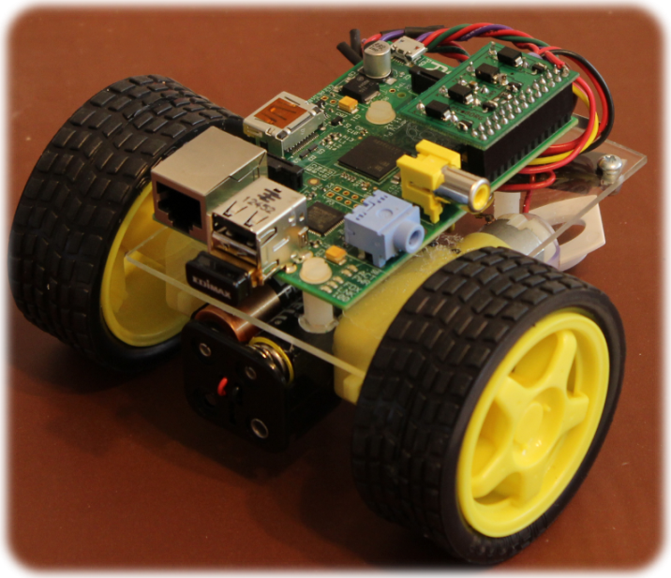
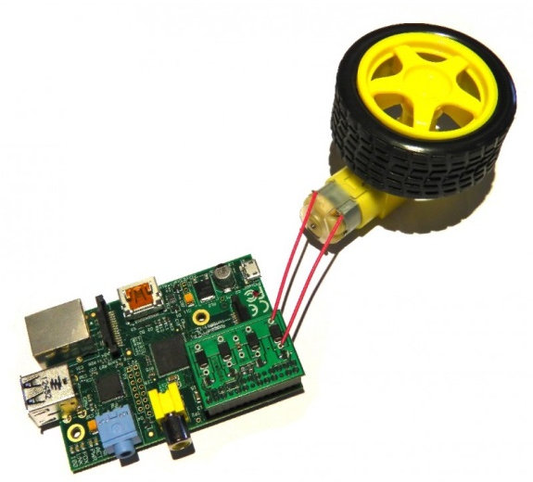
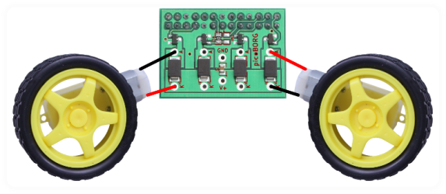
Example Control System Connection
The following is a diagram showing how the Raspberry Pi is connected to the Picoborg motor controller board and from there connected to the parts, mainly motors, of you control system.
It is important to note which pins on the Raspberry Pi will control the various connections on your Picoborg. This information is available via the Piborg website.

Slide 6
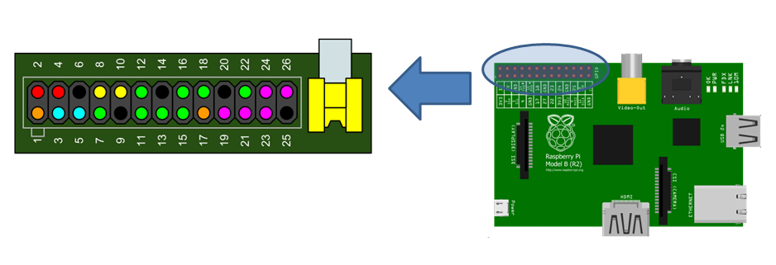
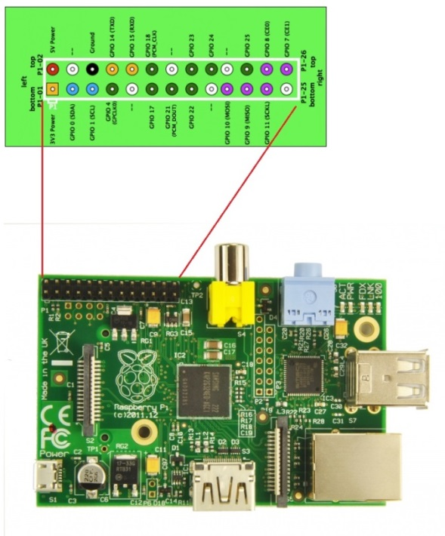
Diagrams For Use
Use 1 of the following diagrams to help you draw a representation of the Raspberry Pi pins that are connected to the different parts of your control system.
Remember, in your diagram include the software and how it will work.
When making a diagram of your control system use the example pdf given on Moodle, but make sure that you give more details of the pins needed to control the systems connected to your motor controller board.

Slide 7
Task
Design a Control System by mentioning the following:
List the components you will need to Control your system
include software and hardware needed
Show in a diagram how your components will be connected
Mention the different pins that will be connected
Give an explanation of:
What is connected to what else
Why they are needed
How they will be connected
You need to:
Write a minimum of 2 ½ pages with picture/ diagrams explaining the design your control system
Make sure the paragraphs are in your own words

Slide 8
Assessment & Criteria
Design a control system - P6
While covering the following topics:
Design:
purpose
signal type
sensor types
outputs
control operation

Slide 9
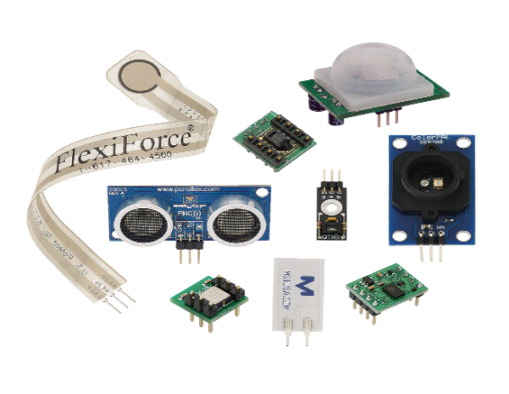
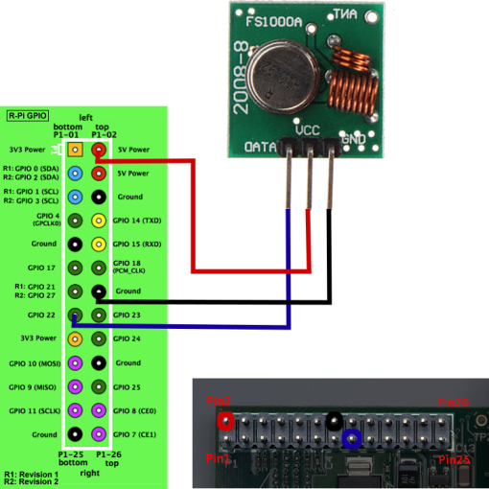
Different Types of Sensors
Adding sensors to your control systems
Once you have designed you control system it is important that you gain real world information, that will allow you or the control system to change settings according to the events around you.
You must first consider the type of sensor that you need or that would be useful to your control system, you have sensors such as:
Ultrasound
Motion
Gas/ toxic gas
Pressure
Temperature
Finally, once you have decided on the appropriate sensor, you must then understand how you could connect it to your Raspberry Pi. The diagram shows an example of how this could be done.

Slide 10
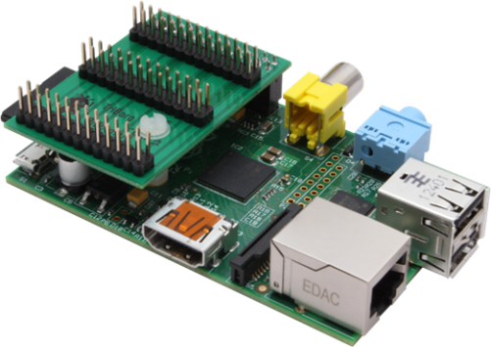
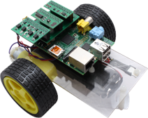
Connecting your Sensors
To connect your sensors, on of the best ways would be to use an extra expansion board called a Triborg, this is connected to all the GPIO pins on the Raspberry Pi. This will allow you to make extra connections in addition to the Picoborg motor controller board.
As the Raspberry Pi only needs to use 2-4 pins for the Picoborg, this means that there are several more pins available to connect other devices/ components.
It is important to first know which pins will be used/ needed for the Picoborg, then the remaining pins can be used to connect to your sensors.
Please remember that the Raspberry Pi has an separate connection for its camera module.
Using a Triborg allows you to connect other sensors or extra boards to your system. This is in addition to your PiBorg motor controller board.

Slide 11
Task
D1 design a control system that uses different types of sensors - D1:
You need to design a control system that uses different types of sensors, ‘Different’ in this case should be taken to mean the most diverse set possible
This is in addition to what you have designed in P6
Please make sure you have included the following
List the sensors you will add to your Control system
Show in a diagram how your components will be connected
Mention the different pins that will be connected
You need to:
Write a minimum of 1 ½ pages including pictures in addition to your P6
Make sure the paragraphs are in your own words

Slide 12
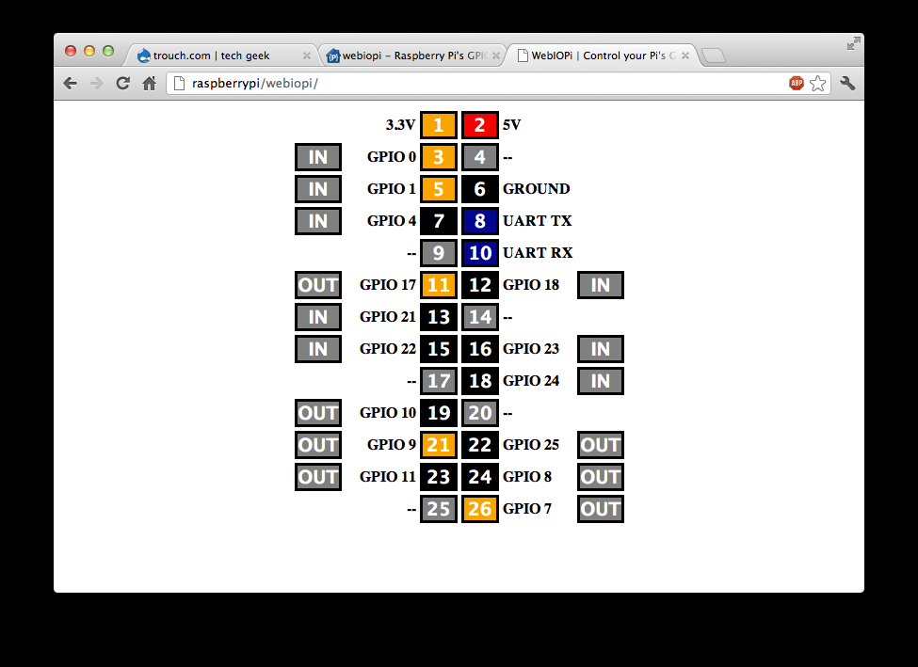
Implement a Control System
Please show how you installed and configured tightVNC for your Rasp Pi. TightVNC is needed to help you connect your Rasp Pis to a computer remotely, via virtual desktop.
WebIOPi will let you run a Webserver program on your Rasp Pi, this will allow a connection straight to your GPIO ports, in order for you to deploy your control system.
You will also need other preparations for your Rasp Pi, adding Picoborg, Triborg, Mobile Power pack, extra sensors etc
You need to show how physical connections have been made to connect you Rasp Pi to your control system
Show the interface to control your control System and programs that have been written for this task

Slide 13
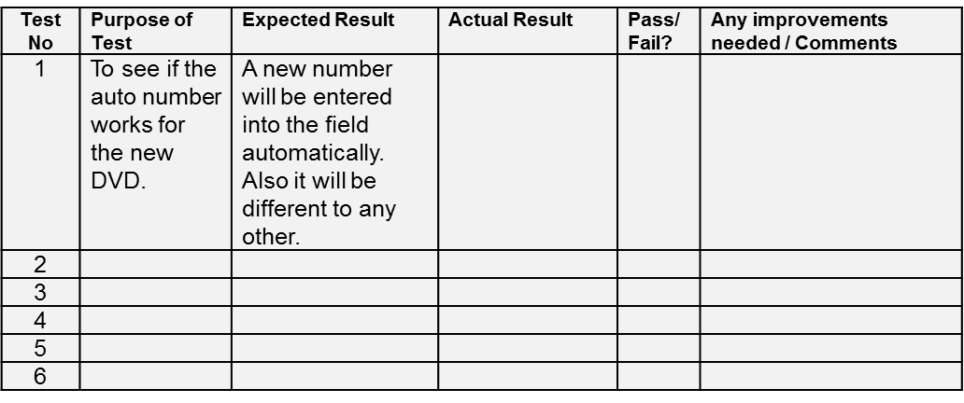
Testing your Control System
Please use a test table like the following below
Enter what you are testing for and expected results and complete the other columns

Slide 14
Task
Implement and Test a Control System by doing the following [P7]:
With screenshots/photos show how you have prepared then connected your control system by connecting it to a Raspberry Pi, show:
How you installed VNC on to your Rasp Pi
How you installed WebIOPi
The other preparations made to your Rasp Pi
The physical connections made from your Rasp Pi to your control system
The interface you used to control your control System
Any programs made for your implementation
Produce a test table of things you tested in your control system with outcomes and recommendations
You need to:
Write a minimum of 4 ½ pages with picture/ diagrams explaining the implementation your control system
Make sure the paragraphs are in your own words

Slide 15
Assessment & Criteria
Implement a control system – P7
While covering the following topics:
Control system implementation:
assembly
testing
documentation
Testing:
test plan
functional testing
performance testing

Slide 16
Suggest Improvement to a Control System TASK
Suggest improvements to your control system - [M4]:
Think about what parts of your control system you could improve, here are some suggestions, but think of others as well:
Control Interface (on browser)
Rasp Pi
Interface boards
Wi-Fi Dongle
Connectors/ wires
Power issues
More sensors/ placement of sensors/ calibration of sensors
Weight problems
You need to:
Write a minimum of 1 page
Make sure the paragraphs are in your own words

Slide 17
Assessment & Criteria
Suggest improvements to your control system - M4
While covering the following topics:
Control system implementation:
assembly
testing
documentation
Testing:
test plan
functional testing
performance testing

Slide 18
Evaluate the Design & Performance of a Control System TASK
Evaluate the Design and Performance of a Control System - [D2]:
Show you have comprehended control systems to the point where they are capable of making a lucid and well-argued evaluation of the control system
Choose several key points then write:
What it is
The good points
The bad points
Possible improvements that could be made
You need to:
Write a minimum of 1 ½ pages with picture/
Make sure the paragraphs are in your own words

Slide 19
For further information please contact The STEM Alliance enquiries@STEMalliance.uk or visit www.STEMalliance.uk

