Slide 1
Understanding what employers need to employ learners with SEND
Elaine Dale City College Norwich
Guest speakers Bradley Tuckfield and Blain Price

Slide 2

Today we will explore:
Understanding what employers need to employ learners with SEND
Education and Training Foundation ETF
Data to reflect on
Research and reports
Employer incentives
Inclusive practice perspective local employer Bradley Tuckfield
Discussion and take away actions
Notes:
We will explore the benefits for employers to engage with SEND learners and understand what employers really want.
How do we do this in the current climate of COVID 19 to ensure that employers have the tools and knowledge to understand and support the needs and complexities of our SEND learners ?
We can’t put our SEND learners’ future on hold during this time, but we can start to make plans for their future and how to engage with employers.
This webinar will support some of the issues we are facing currently and how to address these.

Slide 3

About ETF – Education & Training Foundation
Gateway https://www.excellencegateway.org.uk/
SEND home page https://send.excellencegateway.org.uk/
SEND Centres for Excellence https://send.excellencegateway.org.uk/centres-for-excellence
Three colleges leading on workshops, webinars and activities:
People
led by Weston College
Leadership Hub:
Strategy Discussion with the CEO
Corrienne Peasgood CEO and Principal of the college has set aside some peer one to one time for leaders to discuss strategy in creating a culture of inclusion.
Book CfESEND@ccn.ac.uk
Curriculum
led by Derby College
Community
led by Norwich College.

Slide 4
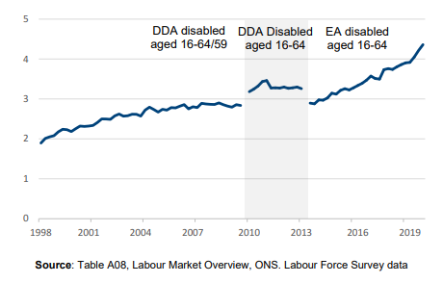
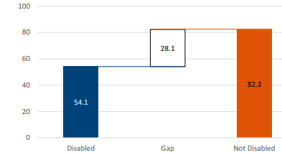
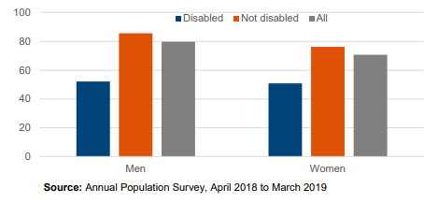
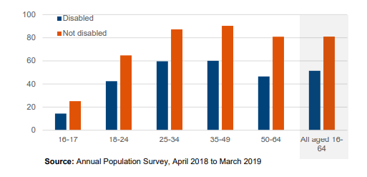
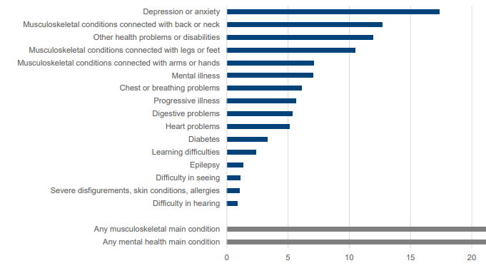
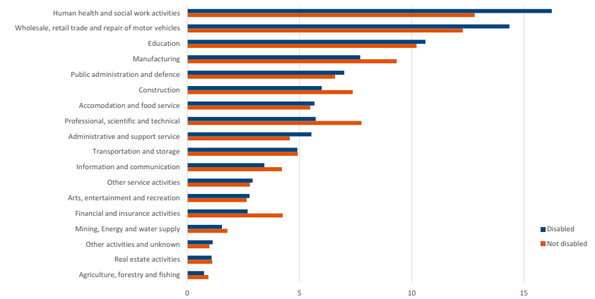
Key data to reflect on from department for work and pensions
inform employer of disability
disability employment rate gap
employment by gender
employment by age
employment by disability
employment by sector
Notes:
8.1 million people of working age (16-64) reported a disability in 2019
4.4 million people with disability are working
54% employment rate for people with disability
28. 1 % lower than person without disability

Slide 5
Learning and Work Institute research and reports - disability employment
Evidence review
employment support for people with disability and health condition
Opportunities for all
Eleven leading thinkers on disability,
health and employment set out what
we need to do next to tackle the
disability employment gap
Tackling disability employment gap
Halving the Gap: Making the Work and Health Programme work for disabled people
Working well
an early stage impact assessment of the Working Well (WW) pilot programme on behalf of the Department for Work and Pensions

Slide 6



Employer incentives, support and views
1
Good business sense approaches consumer, community reputation and workforce satisfaction
Employer guide disability inclusive toolkit
2
3
4
Disability confident employer
Access to Work
fact sheet for employers
5
6
7
8
Engagement
and
Recruitment
Support reaching a broader talent pool
Job trails through Supported Internship or work experience
Job Coaches to support both learner and employer in workplace
Employer confidence
https://www.youtube.com/watch?v=LxQSRdoHESY

Slide 7
FE experience with employer confidence in disability
Employer
Will I need
to give extra time to
support additional needs
What ‘s your approach with new employees and induction …I am sure you treat everyone individually and will communicate and share information in different ways
Response
Employer
Will they have the skills I am looking
for
Response
Everyone has their own skills and attributes to bring to a role. It’s about the right skills for the job. You may have to make some reasonable adjustments as you would do with any member of staff
Employer
I am worried
How they will fit in
Response
You will have staff already working for you that have a disability or difficulty, you just might not be aware. I can give you some examples of types disabilities and share our toolkit
Employer
Will I need to be trained in disabilities as I am not confident with my knowledge
response
We have a toolkit, I can talk you through and share as well as a digital version

Slide 8
Inclusive Practice perspective – Local Employer
Bradley Tuckfield Store Manager and elected employee Director for central England Co-op
Blain Price – Team Leader
Notes:
chance to reflect and pick up questions in a moment

Slide 9
CfESSEND@ccn.ac.uk
#SENDinFE
Thank You
Notes:
End of presentation thank you
Take questions

