Slide 1



Engineering Materials
Neil Mawson
Hydram

Slide 2
Topic
NEEDS TO BE COMPLETED BY NEIL MAWSON
Aims
Level
Method
Equipment
Duration

Slide 3







Aim
Students will generate and discuss ideas around the modes of failure of materials

Slide 4

objectives
Learners will be able to distinguish between the various modes of material failure
Learners will gain a practical insight and be able to demonstrate fatigue failure of materials under cyclic loading
Learners will discover the effects of creep failure within engineering materials
Learners will relate modes of failure to workplace operations

Slide 5
Quote of the day
“It's fine to celebrate success but it is more important to
heed the lessons of failure”
Bill Gates
Founder of Microsoft

Slide 6
Fatigue
In materials science, fatigue is the progressive and localised structural damage that occurs when a material is subjected to cyclic loading

Slide 7
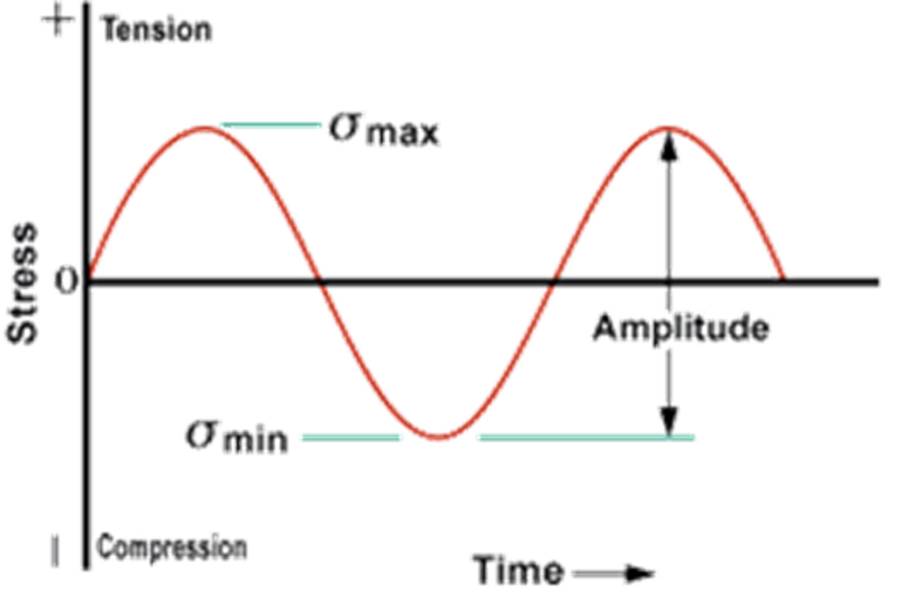
Cyclic loading

Slide 8
Cyclic loading
80%

Slide 9
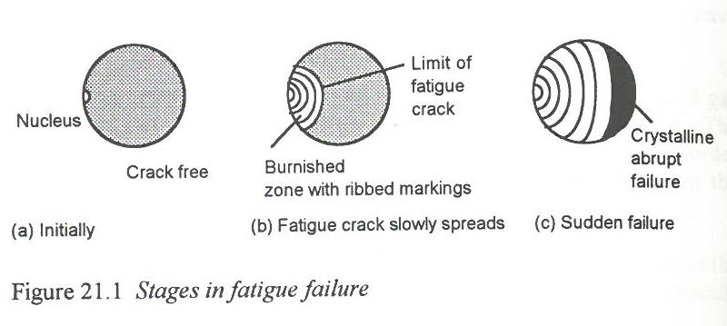
How?

Slide 10
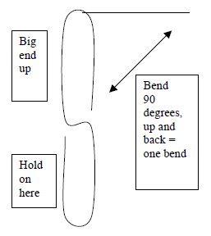
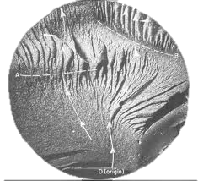
Experiment method
Bend paperclips into S shapes
Bend long end to 90 degrees and back
Count this as 1 cycle
Count how many cycles it takes for the paperclip to fracture
Paperclip Fracture

Slide 11
Experiment method
Histogram of Maintenance Results

Slide 12
Experiment method
Histogram of Tool Making Results

Slide 13
Fatigue crack propagation testing
Each second of video is 2000 cycles
Crack can be seen to extend into the material until failure occurs

Slide 14
What is creep?
In material science, creep or cold flow is the feature of a solid material to slowly move or deform permanently under the influence of mechanical stress
When a material is subjected to a stress that is greater than or equal to its yield stress, the material deforms plastically
Meaning what?
When load is removed material remains at its new length
When the stress is below this level, then in principle it should only deform elastically
Meaning what?
When load is removed material returns to its original length
Provided the temperature is relatively high, plastic deformation can occur even when the stress is lower than the yield stress. – THIS IS CREEP

Slide 15
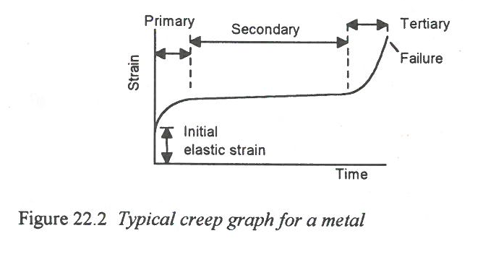
How?

Slide 16
Experiment method
Suspend length of coiled solder from clamp
Using external heat source warm solder
Measure the extension to determine the creep
Watch below videos

Slide 17
HANDOUTS

Slide 18
What do you think?
Does this happen at work?
Answer the CREEP Key Questions in your workbook

Slide 19
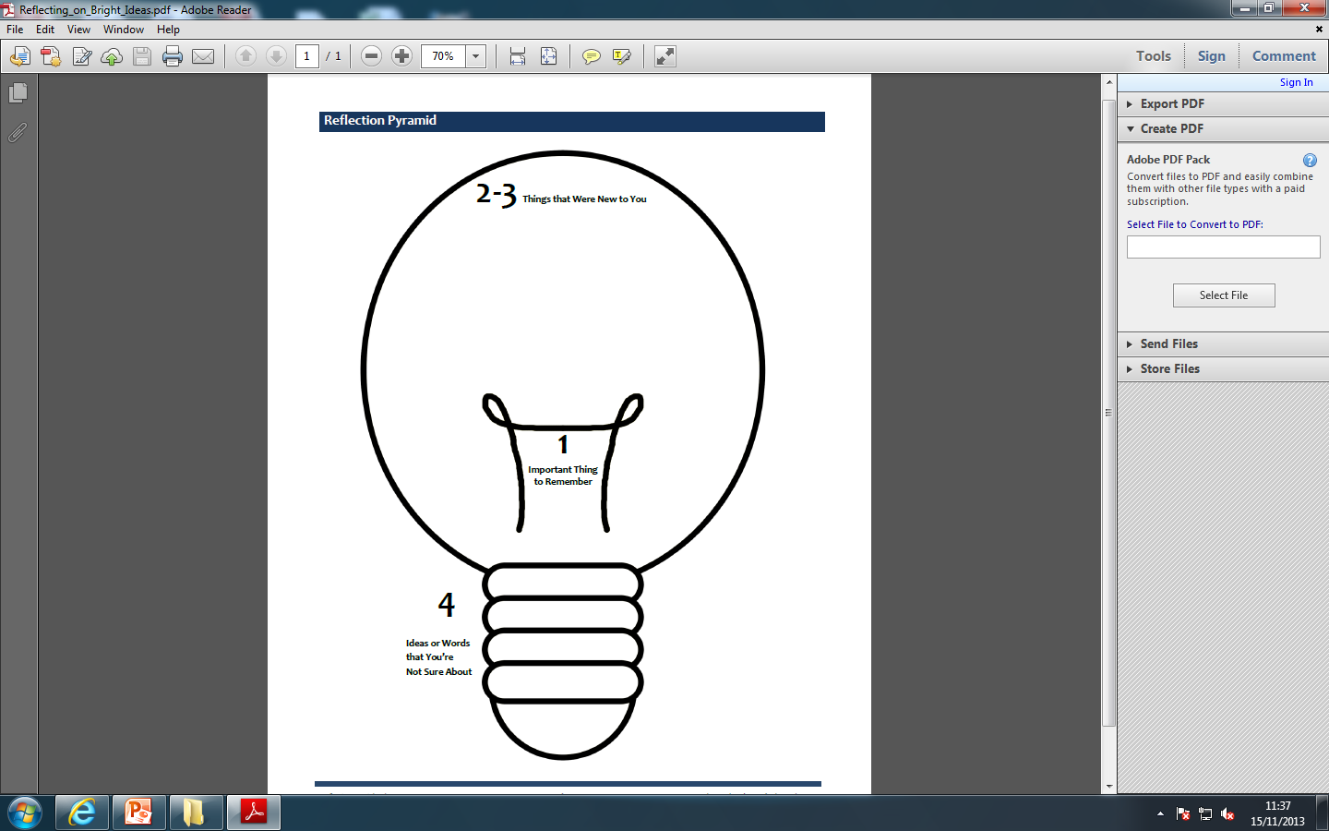
Reflection
Pyramid

Slide 20
Creep
What is Creep or Cold Flow?
Define Plastic Deformation?
Define Elastic Deformation?
What effect did increasing the temperature have on the Creep rate and amount?

Slide 21
Fatigue Experiment
Answer the following questions following your paperclip experiments
Did the paper clip get warmer during bending?
What does this indicate?
Differences between results include the below:
  Speed of bending
  Quality of steel
  Defects in the metal

Slide 22
Fatigue Experiment
Answer the following questions following your paperclip experiments
Describe the three stages of fatigue failure
  Stage 1
  Stage 2
  Stage 3
Can you think of any components at work that have failed due to Fatigue?

Slide 23
Fatigue Experiment
Plot the group results on the below graph
(you will need to include a scale)
Key Questions
 | 90⁰ Bend | 180⁰ Bend
Cycles

Slide 24

For further information please contact The STEM Alliance enquiries@STEMalliance.uk or visit www.STEMalliance.uk

