Slide 1
Enterprise in the Curriculum Review Meeting 22nd September 2010

Slide 2
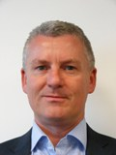
YOUR PRD ADVISERS
Michael
Howard
Elaine

Slide 3
Aims and Purposes
Gather and discuss the learning obtained so far
Review progress to date and agree criteria for evaluation
Agree mechanisms for capturing the outcomes for learners resulting from the projects, and what might constitute appropriate impact measures
Outline LSIS monitoring and reporting expectations
Show how to map projects back to the CIF and capture evidence for your self assessment report
Consider opportunities to disseminate the good practice and resources developed across the wider Learning and Skills sector

Slide 4
Workshop programme
10.45 Some key considerations for the project planning
11:00 Sharing and reviewing workshop
12:30 Lunch
13:15 Framing the project to ensure CtI
14:30 Summary and next steps
15:00 Close and departure

Slide 5
In table groups:
Update each other on the progress of your projects to date. Consider:
What have you put in place?
What’s been going well?
What made it go so well?
What’s been going less well?
What was that?
What have you done to address this?

Slide 6
PURPOSES
STRATEGIES
OUTCOMES (+ outcome measures)
REVIEW

Slide 7
Project Reports
Interim report required by ..............
Reporting template provided with guidance questions
Report should contain:
clear outcomes for learners with illustrative data
clear statement of impact, using appropriate indicators
clear statements of lessons learned
for teams and individuals involved
for enterprise in the curriculum
for your organisation
Recommendations for improvement:
Relating to the project
Relating to leadership and management

Slide 8
In Pairs:
Update each other on the projects so far, this time focusing on:
What differences have you made to your learners? How do you know?
Is this what you wanted for them?
Have there been any unexpected outcomes for your learners or for others involved or for the organisation?
If so, what did/will you do to
Embed the positive outcomes and minimise the negative outcomes?
Use the project report template to record your notes

Slide 9
Pairs join up to make fours:
This time share:
What have we learned so far about:
Embedding enterprise/entrepreneurship in the curriculum
The differences we can make to learners
The organisation
Our effectiveness in planning, monitoring and reviewing improvement initiatives?
Use the project report template to record your notes

Slide 10
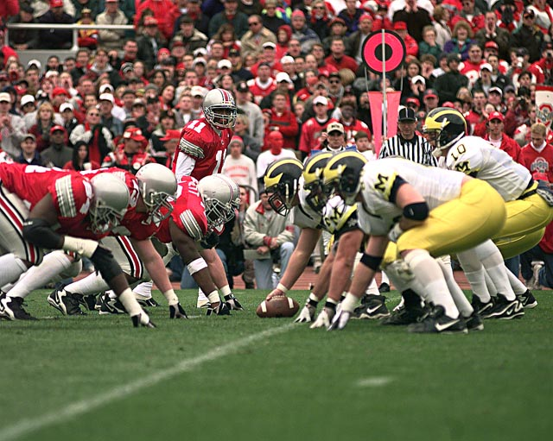
Live self-assessment
The football coach

Slide 11
Live self-assessment
The football coach:
Purpose: to ensure that the team is the best it can be
Role: to influence the outcome of each game - before it ends – in order to influence the season before it ends.

Slide 12
Live self-assessment
The football coach
Observes the game:
Right players in right positions?
Skills/strategy/fitness/nourishment?
Mood/morale/relationships/teamwork?
State of the opposition?
Pitch conditions / weather conditions?
Kit?

Slide 13
Live self-assessment
The football coach:
Observes the game in order to:
Decide longer term interventions as necessary to influence the season and next year’s season
Make immediate interventions to influence the current game

Slide 14
Organisation chart: the curriculum

Slide 15
Organisation Chart: the curriculum

Slide 16
Organisation chart: the curriculum

Slide 17
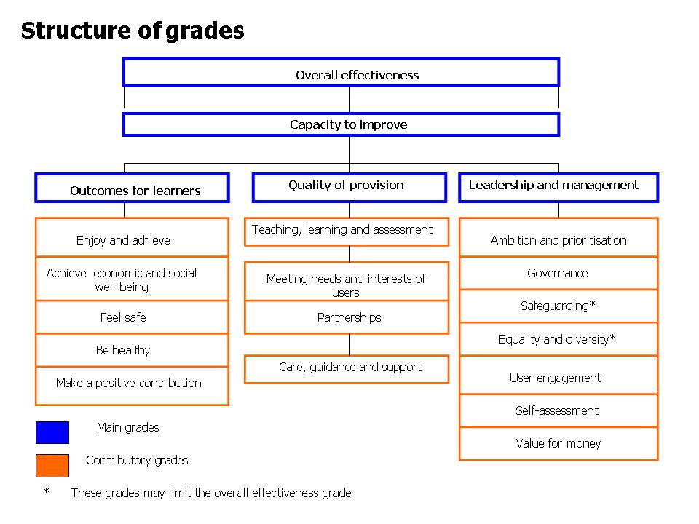
Common Inspection Framework
Notes:
Ok so here’s a copy of the Ofsted grading structure. Looks fine – perhaps a bit dry. Let’s look at this another way.

Slide 18
Organisation chart: the curriculum
Leadership & Management
Outcomes for Learners
Quality of Provision

Slide 19
In pairs/3s
Map your project notes to the organisational chart to show where you have made changes and had an impact
b) Map your notes back to the CIF

Slide 20
In table groups, consider:
How can we, as PRD groups, best share our learning about enterprise in the curriculum learning with the sector?
What needs to be on the agenda for our final meeting on 24th February 2011?

Slide 21
Next steps

