Slide 1
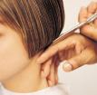
Cutting Stage 1
Milton Keynes College
Christine McMillan - Bodell
Notes:
To print

Slide 2
Topic
Cutting – Technology (Hairdressing)
Aims
This resource provides, instructions on: Introduction to basic cutting pack, One length cut, Long graduated cut, Uniform/basic layer cut, Short graduated cut, Fringes, Points to consider during a consultation, Health and safety when cutting, Skull Structure, lines in sectioning & hot Cross bun sectioning To assist the learner, facilitate Health & Safety, complete a professional consultation prior to cutting hair
Level
Stage 2
Method
PowerPoint slides ALL SLIDES ARE HANDOUTS (apart from slide 2, which will be hidden) – Each instruction has a visual aid to accompany the style.
Equipment
Laptop & Projector Pens Hand-Outs Text Books Hairdressing – The Foundations Level 2 by Leo Palladino Hairdressing – Basic Hairdressing by Stephanie Henderson
Duration
>1 hour +
Notes:
Hidden

Slide 3
Contents
Introduction to basic cutting pack
One length cut
Long graduated cut
Uniform/basic layer cut (angles and measurements)
Short graduated cut
Fringes
Points to consider during a consultation
Health and safety when cutting
Skull Structure, lines in sectioning & hot Cross bun sectioning
Word Meanings
Notes:
To Print

Slide 4
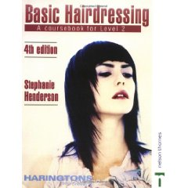
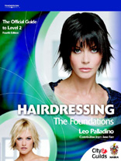
Introduction
In this pack we will introduce to you the basics of cutting hair.
Included is a step by step guide to the haircuts, points to remember during a consultation, the health and safety requirements when cutting and a helpful glossary for some of the word meanings.
You will need a textbook to assist you with your research, books that will help you complete this package are:
Hairdressing – The Foundations Level 2 by Leo Palladino
Hairdressing – Basic Hairdressing by Stephanie Henderson
Notes:
To Print

Slide 5
One Length
Cut
Section the head into 4 across the crown from ear to ear and through the centre from forehead to nape (known as the hot cross bun section) see fig 1
First section is taken in the nape area, ½ inch section taken in straight line (no inversion) see fig 3 clients head tilted forward. Ensure that the client is sitting straight and not with their legs crossed.
Hold the hair close to the head, bring the centre section straight down and cut to the desired length at a 0 degree angle (0 degree angle to ensure no graduation around base line), using the club cutting technique. Angle the side back sections slightly towards the centre section to retain length through the contours of the head.
Continue to work in this way up to the occipital bone. From the occipital bone take a horse shoe section to start incorporating the sides to just above the ears, this section to be combed back into an extension of the back, resting on the shoulders see fig 2. Continue sections around both sides, working alternately to ensure even balance, weight & length. (Checking the cut is even before moving to a new section). Remember to relax the tension over the ears; this will avoid a jump and an uneven perimeter.
Working up to a centre parting, if a side parting is required place in at the end of the cut & re-check, cutting any remaining hair. Checking balance, weight & length.
Cross checking by moving your clients’ head forwards, sideways removing any graduation. Check your balance by distributing your own weight and standing straight, square and using your mirror visually.
If a fringe is required see separate sheet
It is important to Blow dry the hair into the desired style to enable you to check the haircut thoroughly.
Your tutor can demonstrate other methods of checking your finished look to achieve optimum effect.
Notes:
To Print

Slide 6
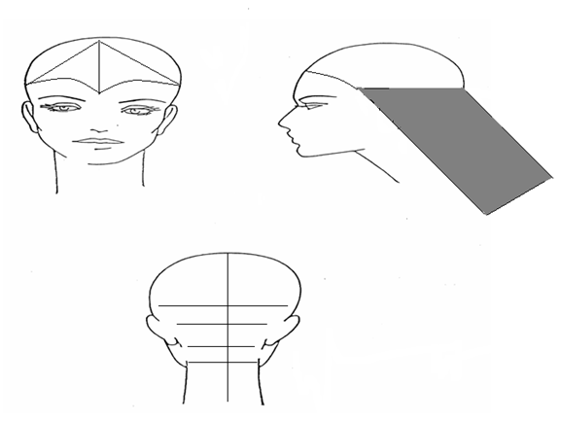
One Length
Cut
Fig 1
Fig 2
Fig 3
Notes:
To Print

Slide 7
Long
Graduated Cut
Section the head into a hot cross bun.
Follow the one length hair cut on previous page prior to creating graduated layers.
Internal layering starts with your guide line on the crown.
Sectioning the hair 2 inches horizontally across the crown
see fig 1.
Take a meche piece ½ inch depth, pulling up to a 90 degree angle and cut in desired guideline length see fig 2. Continue this to the front hairline always using some previously cut hair for your guide line. Cross check by combing the hair in the opposite direction at a 90 degree angle. Checking balance, weight & length (Checking the cut is even before moving to a new section).
Split the hair into a middle parting. Section down the centre from the crown to the nape, taking a guide line from the top holding the hair up at a 145 degree (approx) taking the section down to the nape insuring length remains & depending on the clients requirements see fig 3. Continue around the back of the head using some of the previously cut hair for guideline using orange segments sections. Cross check through out using horizontal sections. Checking balance, weight & length
Repeat for the side sections. Once you have got to the last 2 sections on the sides slightly over direct to preserve length on hairline.
Cross check through out using horizontal sections. Checking balance, weight & length. Check your balance by distributing your own weight and standing straight, square and using your mirror visually.
If a fringe is required see separate handout.
It is important to Blow dry the hair into the desired style to enable you to check the haircut thoroughly.
Your tutor can demonstrate other methods of checking your finished look to achieve optimum effect.
Notes:
To Print

Slide 8
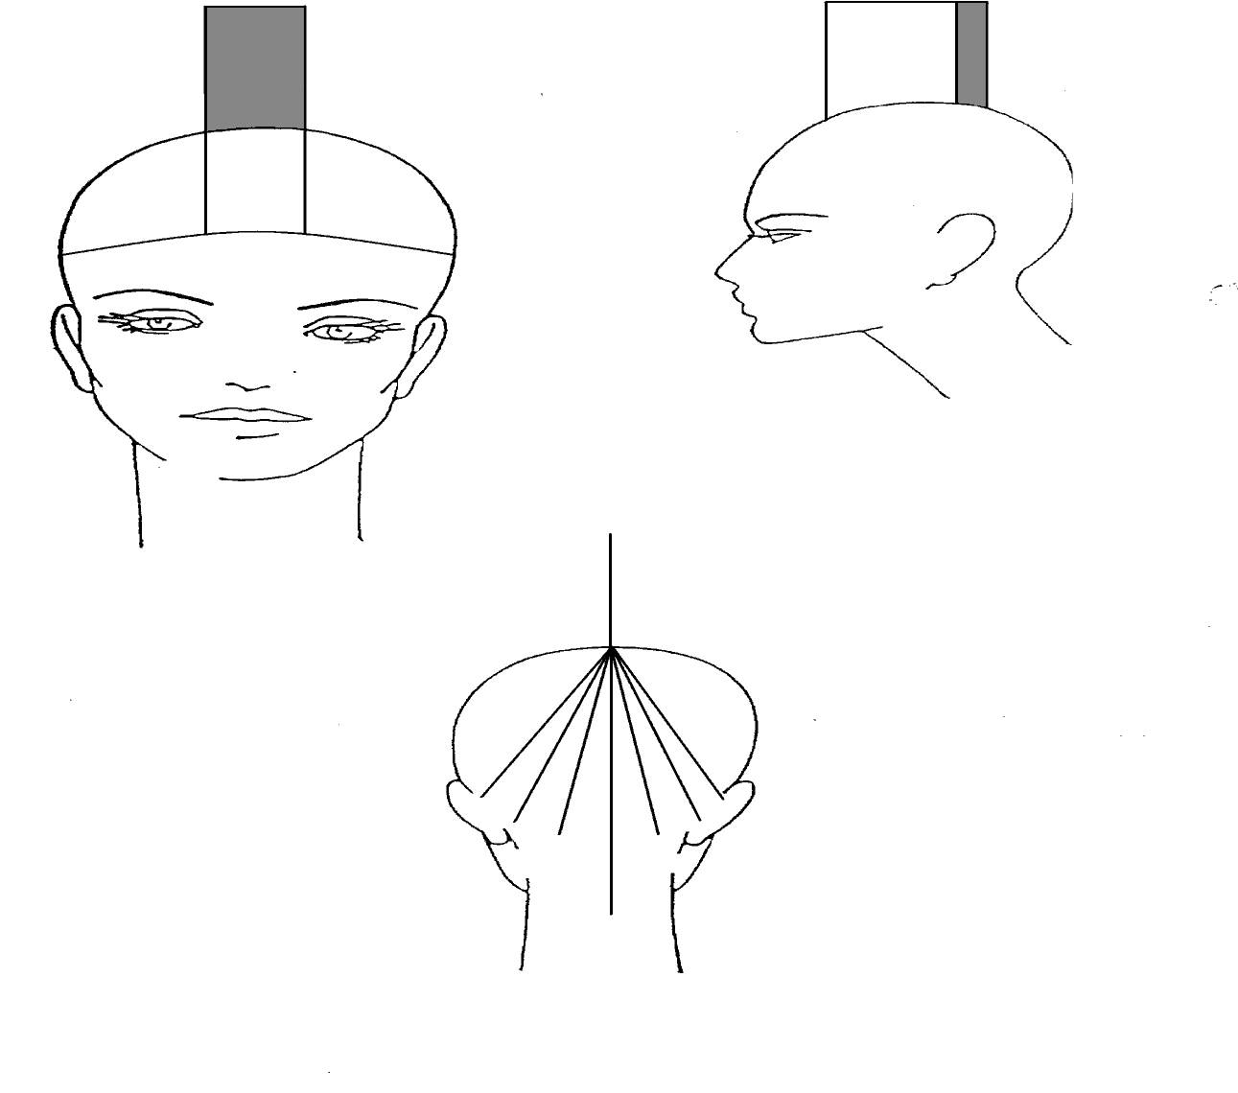
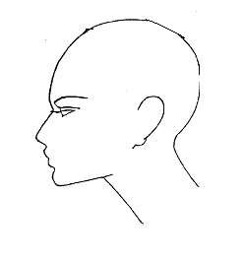
Long
Graduation
Start point 90 Degree Angle
Fig 1
Fig 2
First Guideline for Back Section
Fig 3
145 Degree
Angle
Fig 4
Notes:
To Print

Slide 9
Uniform Layer/
Basic Layer
Section the head into a hot cross bun.
Sectioning the hair 2 inches horizontally across the crown see fig 1.
Taking a meche piece ½ inch depth, pulling up to a 90 degree angle and cut in desired guideline see fig 2
Continue this to the front hairline always using some of the previously cut hair for your guideline. Cross check by combing the hair in the opposite direction at a 90 degree angle. Checking balance, weight & length (Checking the cut is even before moving to a new section).
Split into a middle parting. Section down the centre from the crown to the nape, taking a guide line from the top holding the hair up at a 90 degree angle, taking the section down to the nape Continue around the back of the head using some of the previously cut hair for guideline using orange segments sections. Cross check through out using horizontal sections.
Base line cut to the client’s desired length.
Fringe see separate hand-out.
Uniform layer should be the same length all over the head always using a 90 degree angle
It is important to Blow dry the hair into the desired style to enable you to check the haircut thoroughly.
Your tutor can demonstrate other methods of checking your finished look to achieve optimum effect
Notes:
To Print

Slide 10
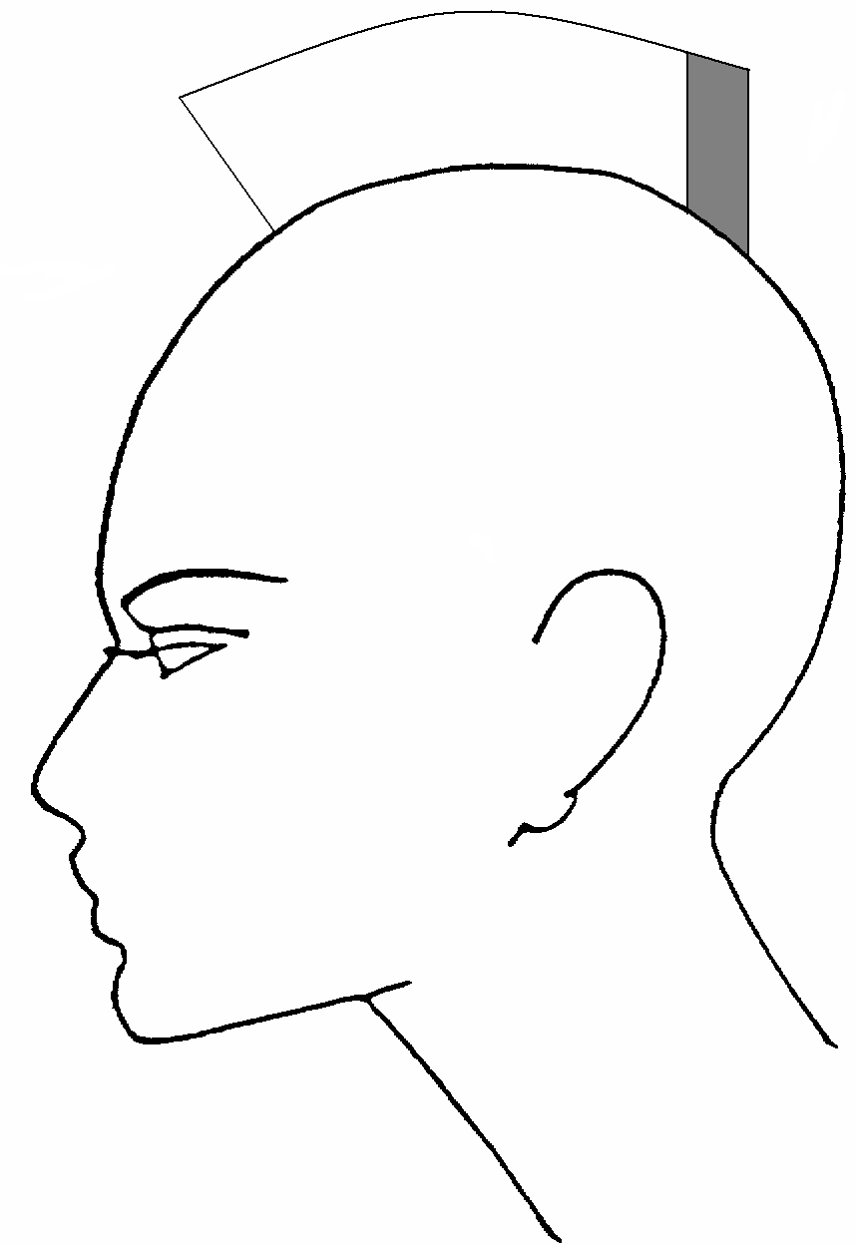
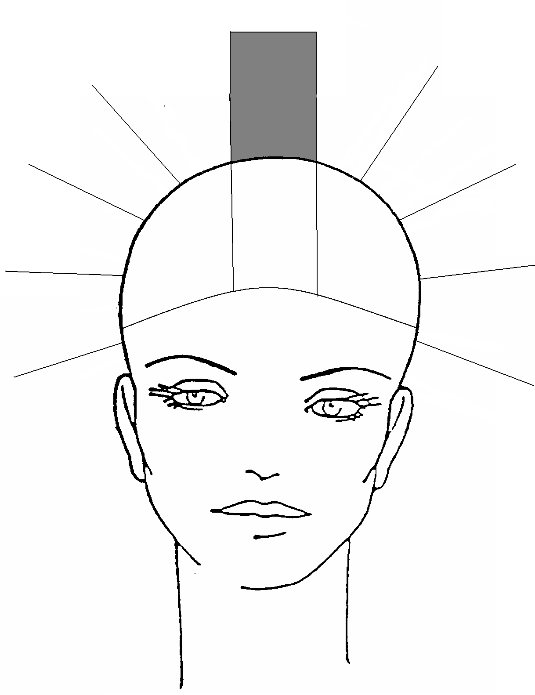
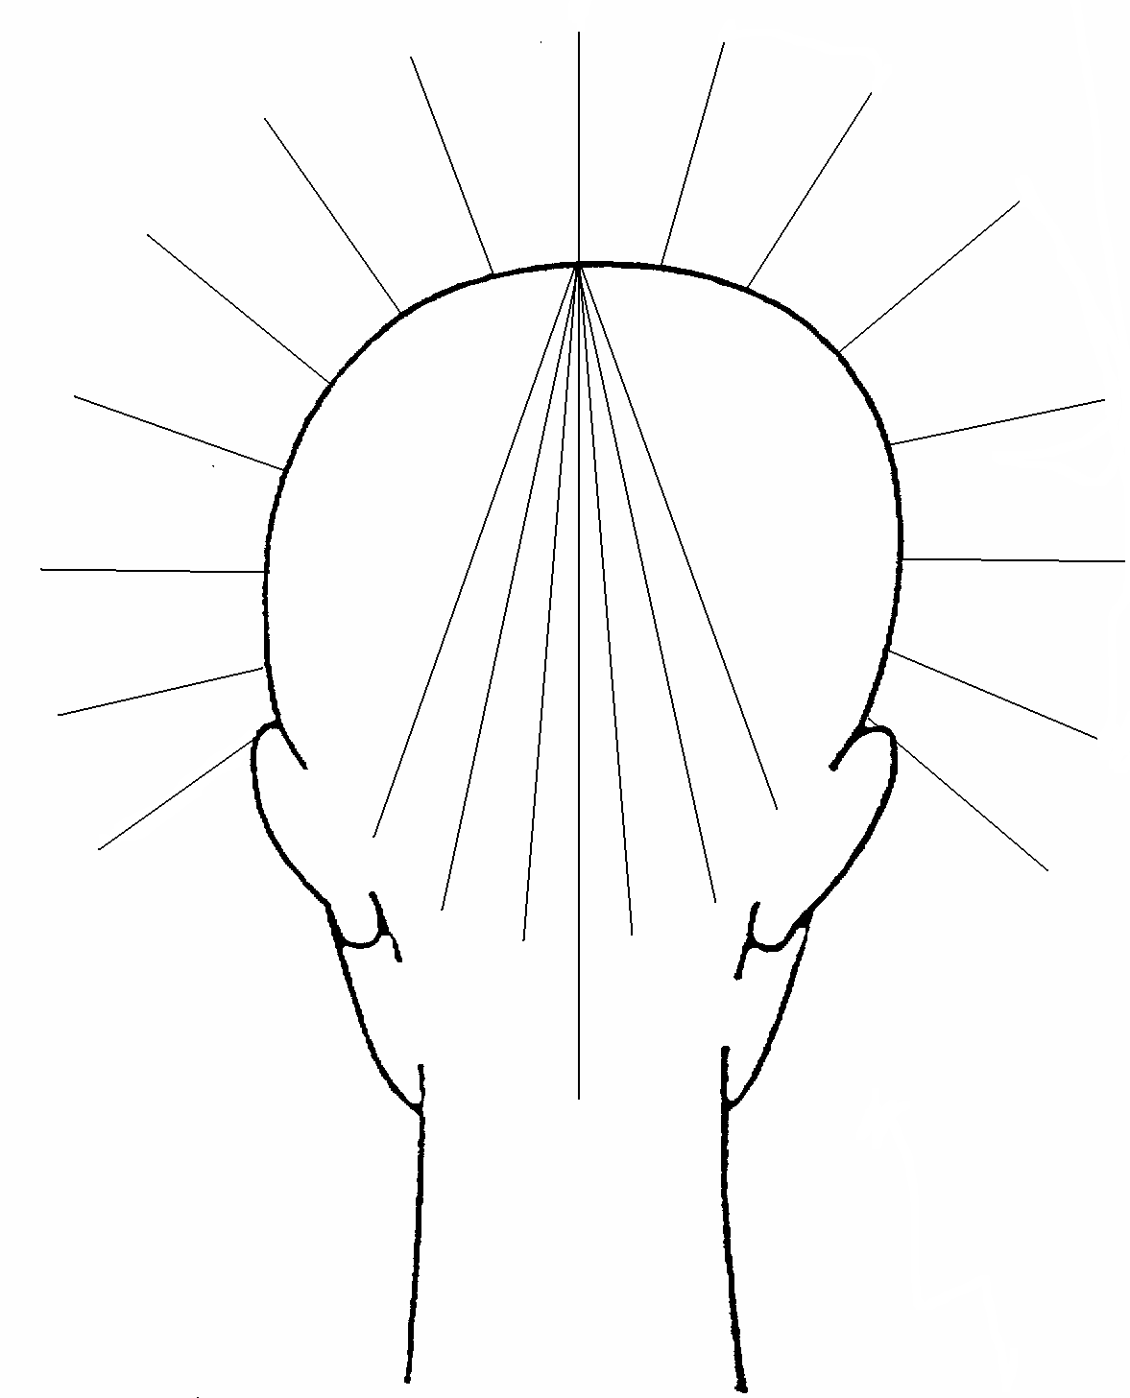
Uniform Layer
Start point
Fig 1
Fig 2
90 Degree Angle
Fig 3
Notes:
To Print

Slide 11
Short Graduated
Cut
Section the hair into a hot cross bun.
Follow the uniform layer hair cut on previous page prior to creating short graduated layers.
Section the hair into a centre parting to the nape area, section the hair horizontally to the occipital bone and clip the hair out of the way.
Your first section is to be taken at the centre of the nape, ½ inch meche width and hold at a 45 degree angle. See fig 1. Work around to the back sections in orange segments until you reach the side of the nape area, always using some of the previously cut hair for your guideline. Cross check by combing the hair in the opposite direction. Checking balance, weight & length (Checking the cut is even before moving to a new section).
Take a horse shoe section incorporating the sides to just above the ears. From the front hairline create a side guideline holding the hair at a 45 degree angle. See fig 2. Continue sections around both sides, working alternately to ensure even balance, weight & length.
Cross checking through out using horizontal sections.
Base line cut to the client’s desired length
Fringe see separate handout.
It is important to Blow dry the hair into the desired style to enable you to check the haircut thoroughly.
Your tutor can demonstrate other methods of checking your finished look to achieve optimum effect
Notes:
To Print

Slide 12
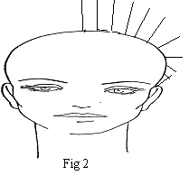
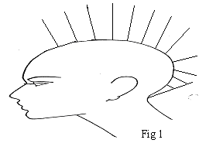
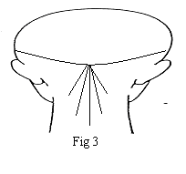
Short Graduated
45 Degree angle
Fig 1
45 Degree angle
Fig 2
Fig 3
Notes:
To Print

Slide 13
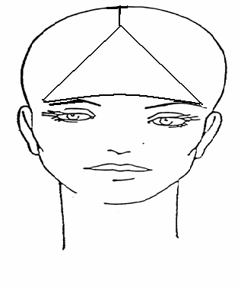
Fringe
Take a triangular section from the centre parting, with the widest point being the front hairline. Never cutting any further than the outer edges of the eye brow. See fig 1
Taking a ½ inch horizontal meche sections across the triangle, working backwards from front hairline to the point of the triangle. Cut to the client’s desired length (Club/point cut).
Fig 1
Notes:
To Print

Slide 14
Cutting
Techniques
Technique | Method | Resulting Effect | Performed on wet/dry hair
Club cutting
Graduation
Thinning with scissors
Notes:
To Print

Slide 15
Cutting
Techniques
Technique | Method | Resulting Effect | Performed on wet/dry hair
Thinning with a razor
Scissor over comb
Clippering
Notes:
To Print

Slide 16
Points to
Consider
Client requirements – always discuss client expectations and needs
Hair length – is the hair long enough to achieve the desired effect
Hair texture – will the texture allow you to achieve the look required and what techniques do you need to use
Hair density – will the thickness of the hair allow you to achieve the look required
Hair movement – will the movement of the hair allow you to achieve the look required
Direction of growth/natural partings – identify these before agreeing to the look, the hair may not fall in the direction of the chosen style
Root lift/natural volume – will the natural volume of the hair enable you to achieve the look
Hair growth patterns – look for the following:
High or low hair growth at the nape
High or low growing front hairlines
Double crown
Widow’s peak
Cowlick
Nape whorl
Identify a suitable style or cutting technique to prevent the growth pattern being predominant
Hair condition – if the hair is in poor condition, discuss with the client how much should be removed to improve the look of the hair
Head and face shape – choose a style that will complement the face shape
Lifestyle and image of the client – lifestyle and image are important when choosing a style (will the client be able to manage his/her hair and does the look give off the right messages.
Notes:
To Print

Slide 17
Health &
Safety
Scissors/cutting tools must have blades protected when not in use
Scissors/cutting tools must be stored securely when not in use
Hair cuttings should be removed from face and neck for client comfort
Before commencing the next service the floor must be swept to remove all hair from the floor to avoid slipping and maintain a healthy environment
On completion of the treatment ensure all hair is removed from the gown in order to prevent hair clinging to clients clothes
If you cut a client:
Inform them and apologise
Ask clients to apply pressure to the wound with cotton wool, this will stop the bleeding
Cover a small cut with a sterile dressing from the first aid box
Larger cuts may require medical treatment inform your manager or first aider
Do not allow your hands to come into contact with blood use rubber gloves if necessary
Record the accident in the first aid book
Wash your tools if you drop them
Your tools should be washed and sterilised after each client
Notes:
To Print

Slide 18
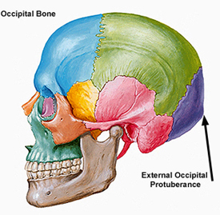
Health & Safety
Notes:
To Print

Slide 19
Sectioning
Horizontal
Vertical
Diagonal
Hot cross bun sectioning
Section the head into 4 across the crown from ear to ear and through the centre from forehead to nape.
Notes:
To Print

Slide 20
Word
Meaning
Balance a finished style with even proportions
Baseline the length at the base of the haircut
Club cutting to cut hair bluntly which produces level ends
Cowlick strong hair growth pattern on the front hairline
Cross check to check accuracy of the cut the opposite way to which you cut it
Crown hair growth pattern on the upper area of the head
Density the amount of hairs on the head
External layers the outer lengths of hair
Free hand cutting cutting without forcing the hair out of its natural position
Graduation to cut hair with shorter lengths at the nape, gradually lengthening towards the crown
Guideline the first cut section of hair that is used as a guide for the rest of the haircut
Hot cross bun a method of sectioning the hair prior to cutting, a section runs down the middle from the front hairline to nape and then from ear to ear, thus resembling a hot cross bun
Internal layers the inner lengths of hair
Inversion the baseline is cut which resembles an upside down U-shape
Layer to reduce the lengths at different areas on the head
Movement the amount of direction the hair can move within a given style
Nape whorl whorl like patterns found in the nape of the neck
Occipital bone the bone found at the back of the head above the nape line
Partings to separate or divide the hair
Perimeter otherwise known as baseline, the overall length of the haircut
Point cutting a method of removing hair from the ends of the hair section
Reverse Graduation the inner layers of the hair lengths are shorter than the outline shape
Section divisions of hair
Tension pulling pressure put on the hair, causing it to stretch
Texture diameter of the hair shaft
Widow’s peak the front hairline grows forward to form a strong centre peak
Notes:
To Print

Slide 21
For further information please contact The STEM Alliance enquiries@STEMalliance.uk or visit www.STEMalliance.uk

