Slide 1
“Guess the bonding in the bottle”
Marisa Fernandez
Barnet and Southgate College
Students Name: …………………………………………………………………..

Slide 2
Topic
Structure and Bonding/Chemistry
Aims
Consolidate ideas on how structure and bonding affects properties Deduction/Group Collaboration
Level
Level 2 & Level 3 (16 -18 year olds)
Method
Can be done as a PowerPoint slide with a sheet given to the students for their answers, or can be solely handouts, apart from slide 1 and 2 and the answer slides.
Equipment
Laptop & Projector Hand-out Pens
Duration
>30 Minutes – depending on discussion or stretch activities

Slide 3
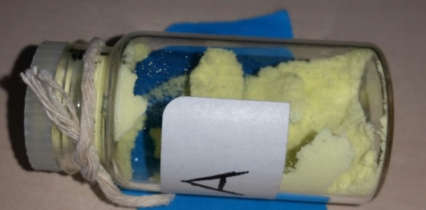
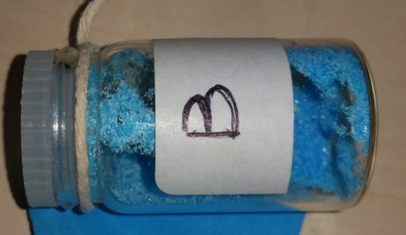
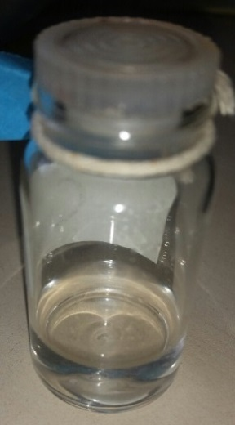
Guess
Melting temperature = 115⁰C
BONDING
_______________________________
_______________________________
A
“I dissolve in water”
BONDING
_______________________________
_______________________________
B
Melting temperature = 0⁰ C
C
BONDING
_______________________________
_______________________________

Slide 4
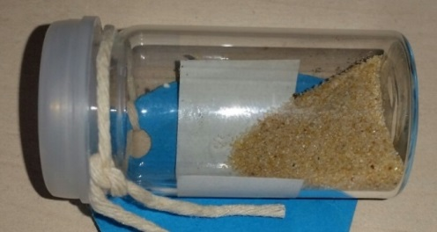
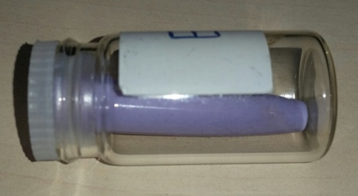
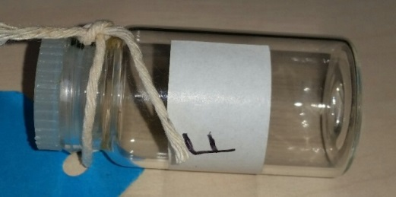
Guess
“I do not conduct electricity, even if you melt me”
Melting temperature 1723⁰C
BONDING
_______________________________
_______________________________
D
“When you heat me up I soften. I do not conduct electricity”
BONDING
_______________________________
_______________________________
E
“I exist as single atoms” Melting temperature = -189.3⁰C
F
BONDING
_______________________________
_______________________________

Slide 5
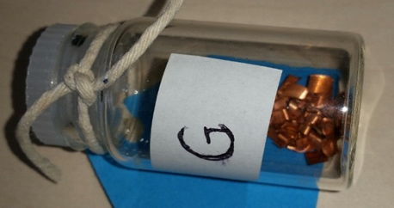
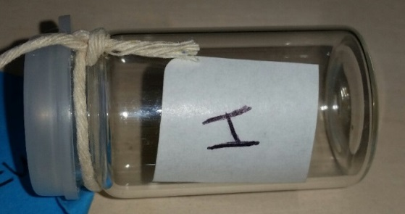
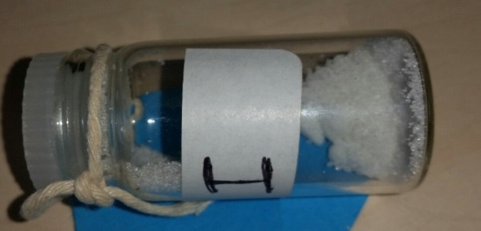
Guess
“I conduct electricity when solid” Melting temperature 1085⁰C
BONDING
_______________________________
_______________________________
G
Melting temperature = - 55.6⁰C
BONDING
_______________________________
_______________________________
H
“I conduct electricity only if you melt me or dissolve me”
Melting temperature = 681⁰C
I
BONDING
_______________________________
_______________________________

Slide 6
Answers

Slide 7
Guess
Melting temperature = 115⁰C
BONDING
Answer
(simple covalent) sulphur
A
“I dissolve in water”
BONDING
Answer
(ionic) copper sulphate pentahydrate
B
Melting temperature = 0⁰ C
C
BONDING
Answer
(simple covalent) water

Slide 8
Guess
“I do not conduct electricity, even if you melt me”
Melting temperature 1723⁰C
BONDING
Answer
(giant covalent) silicon dioxide
D
“When you heat me up I soften. I do not conduct electricity”
BONDING
Answer
(covalent) polymer
E
“I exist as single atoms” Melting temperature = -189.3⁰C
F
BONDING
Answer
(no bonding) noble gas – argon

Slide 9
Guess
“I conduct electricity when solid” Melting temperature 1085⁰C
BONDING
Answer
(metallic bonding) copper
G
Melting temperature = - 55.6⁰C
BONDING
Answer
(simple covalent) carbon dioxide
H
“I conduct electricity only if you melt me or dissolve me”
Melting temperature = 681⁰C
I
BONDING
Answer
(ionic) potassium iodide

Slide 10
For further information please contact The STEM Alliance enquiries@STEMalliance.uk or visit www.STEMalliance.uk

