Slide 1
Heart Structure
Jennifer Dean Hill
City and Islington College
Students Name: …………………………………………………………………..

Slide 2
Topic
Heart Structure (Human Biology)
Aims
A group activity used in order to revise or learn the function of the major body systems. It is tailored to level 2 BTEC biology and would help the students to complete their assignment
Level
Level 2
Method
PowerPoint slide (hand-out) – with Teacher slides hidden 5 and 6 – Answers
Equipment
Laptop & Projector Hand-out Print out (Slides 1, 3 & 4) Pens
Duration
5-10 Minutes

Slide 3
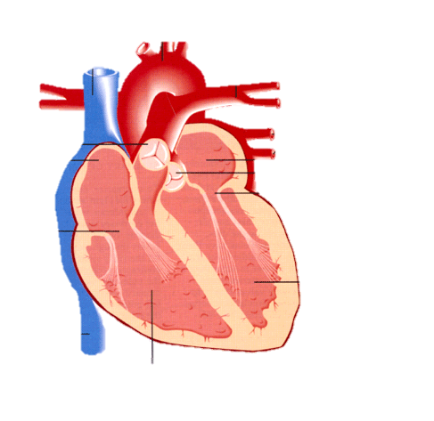
The Heart
2
1
3
13
4
12
5
6
7
11
8
10
9
Notes:
TEACHERS SLIDE – ANSWERS

Slide 4
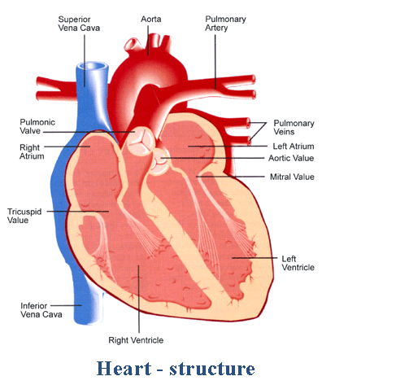
The Heart
1
2
3
14
4
12
5
6
7
11
8
10
9
1 = Superior Vena Cava
2 = Aorta
3 = Pulmonary Artery
4 = Pulmonary Veins
5 = Left Atrium
6 = Aortic Valve
7 = Mitral Valve
8 = Left Ventricle
9 = Right Ventricle
10 Inferior Vena Cava
11 Tricuspid Valve
12 right Atrium
13 Pulmonic Valve
Notes:
TEACHERS SLIDE – ANSWERS

Slide 5
The Heart
Structure | Describe it’s structure | How it’s structure is linked to it’s role
Artery
Vein
Atrium
Ventricle
Valve
Notes:
TO PRINT OUT

Slide 6
The Heart
Structure | Describe it’s structure | How it’s structure is linked to it’s role
Artery | Very thick walled tube which is elastic. | Arteries carry blood away from the heart and have a thick, elastic, muscular wall. The thick walls stretch as blood is pumped in and the muscle wall contracts to force blood along.
Vein | Thin walled tube which is flexible and elastic. | Veins have a relatively thinner and less muscular wall than arteries. The blood is under a lower pressure than in the arteries. To ensure that blood does not flow back towards the heart between heartbeats, valves are present every few centimetres. The valves of this thin walled tube only allow blood to flow in one direction.
Atrium | Small chamber with an entrance and an exit. Walls made of cardiac muscle. | The wall of the right atrium is made of a specialized tissue forming a structure called the sinoatrial node (SAN) also known as the pacemaker. It spontaneously produces electrical impulses which spread to the two atria causing them to contract. The brain controls the heart rate and the pacemaker receives two nerves from the brain stem.
Ventricle | Large chamber with an entrance and an exit. Walls made of thick cardiac muscle. | The muscle wall surrounding the left ventricle is thicker than the wall surrounding the right ventricle due to the higher force needed to pump the blood through the systemic circulation to the rest of the body.
Valve | Small strong tissues that moves | The valves keep the deoxygenated blood flowing from the body to the lungs and oxygenated blood flowing from the heart to the rest of the body. Rhythmic opening and closing of the valves create the lub-dub sound of the heartbeat.
Notes:
TEACHERS SLIDE – ANSWERS

Slide 7
For further information please contact The STEM Alliance enquiries@STEMalliance.uk or visit www.STEMalliance.uk

