Slide 1
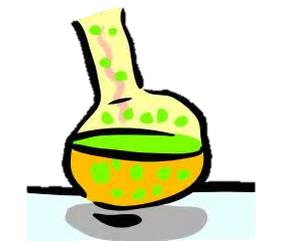
Kc Expressions
& Units
David Martin
City and Islington College
Students Name: …………………………………………………………………..

Slide 2
Topic
Chemistry
Aims
This worksheet provides some exercises to help introduce students to writing Kc expressions and calculating the units. It goes well with the numeracy hand-out concerning powers.
Level
Level 2 & Level 3 (16-19 years old)
Method
PowerPoint Slide 3 is the Questions, Slide 5 Answers. Hand-out Slide 3 for students to complete.
Equipment
Laptop & Projector Pens Hand-Outs
Duration
>10-20 Minutes

Slide 3
Kc
Write the Kc expressions for the equilibrium below and workout the units for Kc
i) H_{2(g)} + I_{2(g)} 2HI_{(g)}
ii) CO_{(g)} + Br_{2(g)} COBr_{2(g)}
iii) 2NO_{(g)} + O_{2(g)} 2NO_{2(g)}
iv) PCl_{5(g)} PCl_{3(g)} + Cl_{2(g)}
v) Fe³⁺_{(aq)} + SCN⁻ Fe(SCN)²⁺ (aq)

Slide 4
Kc
ANSWERS

Slide 5
Kc
Answers
i)
ii)
iii)
iv)
v)

Slide 6
For further information please contact The STEM Alliance enquiries@STEMalliance.uk or visit www.STEMalliance.uk

