Slide 1
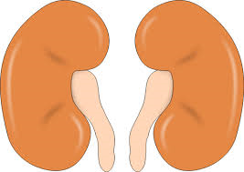
Kidney Instructions
Zoe Ablett
West Suffolk College

Slide 2
Topic
Kidney Instructions
Aims
A resource which is interactive Also linked to assessment Stretching and Challenging
Level
Level 2 & Level 3
Method
Hands on resource, examining the outside of the Kidney, drawing a diagram of any details. Identifying elements of the Kidney. Exercises and note taking.
Equipment
Hand-outs Kidney Scalpels/Sharp Scissors Pens/Pencils Note Pads
Duration
> 1 Hour

Slide 3
Kidney Instructions
Safety – Use of scalpels/sharp scissors, cut away from yourself and take caution when using. Dispose of any blades (if disposable blades are used)
Examine the outside of the kidney, drawing a diagram of any details (pictures can also be taken)
Identify where the ureter, renal artery and renal vein enter into the kidney
Let the kidney lie flat and cut in half lengthwise from the side
Cut through the kidney until it is split almost entirely in half
Open the kidney up to reveal its internal structures
Draw a diagram of the kidney to show all of the main structures, label these. (Pictures can also be taken)
Dispose of kidney in appropriate manner
Place all equipment in washing trays
Clean desks

Slide 4
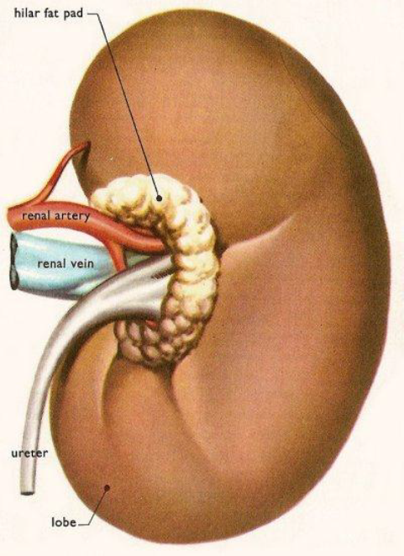
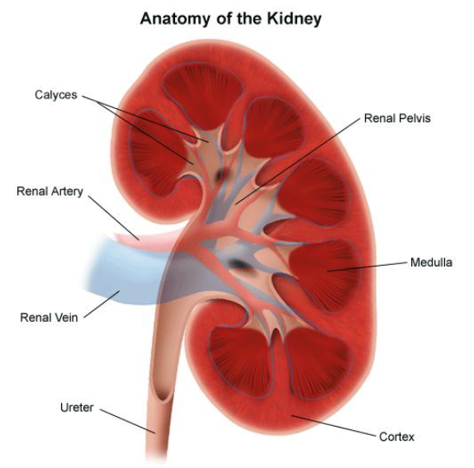
Kidney Instructions

Slide 5
Kidney Instructions
Questions to consider
What is the main function of the kidney?
Track the pathway of blood through the kidney.
How can you distinguish between the renal artery and the renal vein?
Which area of the kidney contains the glomeruli and Bowman’s capsules?
In which part of the kidney does the majority of water reabsorption occur?
What structure carries urine out of the kidney and where does it go?
Track the pathway of other fluids (water and urine) through the kidney.

Slide 6
Kidney Instructions
P4 - Produce explanatory notes on the role of the kidney in the homeostatic control of water balance – including diagrams to explain how the kidney works’
Use your diagrams and images from the kidney dissection to create explanatory notes on the kidney.
This lesson can be used for this part of assignment 4 or for working on assignment 3 (due in 26th November).
For P4 – the explanatory notes should be completed as though you are a student nurse/student doctor and have been tasked with creating information for patients to explain the kidneys, and how they are important in water balance and homeostasis.
You may wish to use lesson PowerPoints but can also use a variety of resources online to support your explanation of how the kidney works.
REMEMBER! – You have to explain, not just describe.

Slide 7
Kidney Instructions
Useful Links for 13d (Assignment 4)
Reliable Websites
http://www.kidney.org.au/KidneyDisease/Howourkidneyswork/tabid/590/Default.aspx
http://kidney.niddk.nih.gov/kudiseases/pubs/yourkidneys/
http://www.nhs.uk/video/pages/ckdwhatkidneysdo.aspx
Google Books
Hunt, WA. (2011) Kidney Disease: A guide for Living. Maryland: John Hopkins University Press. Accessed online via [http://books.google.co.uk/books?id=HIUOrb7yJ-kC&printsec=frontcover&dq=kidneys&hl=en&sa=X&ei=vKpgVLijM4vxaOHpgcgB&safe=on&redir_esc=y#v=onepage&q=kidneys&f=false]
Smith, HW. (1951) The Kidney: Structure and Function in Health and Disease. Oxford: Oxford University Press. Accessed online via [http://books.google.co.uk/books?id=ym3EAGvhwVsC&printsec=frontcover&dq=kidney&hl=en&sa=X&ei=nqtgVPrFLcLpaN7igJgD&safe=on&redir_esc=y#v=onepage&q=kidney&f=false] (Chapter 1 is particularly helpful)
Journals/Links through WSC online resources
On the West Suffolk College internal journal subscriptions search (available via http://www.wsc.ac.uk/library/ on the WSC website and through your hub homepage), if you search for ‘Kidney Physiology’ there are 23,702 results for normal and abnormal kidney function.
‘The kidney – and organ of critical importance in physiology’ is quite useful without being too complex. Accessed via Wiley online resources (the college subscribes to this on your behalf). The author is L Robson
‘The kidneys and the renal system’ is listed on here and can also be accessed via google books. The author is Kara Rogers (please note that this may not work on college due to Janet blocking it)

Slide 8
For further information please contact The STEM Alliance enquiries@STEMalliance.uk or visit www.STEMalliance.uk

