Slide 1
Maths & Xmas Quiz
West Anglia College

Slide 2
Topic
Maths
Aims
Fun and interactive quiz to refresh learning and encourage team work
Level
Level 1 & Level 2
Method
Electronic
Equipment
PC/Laptop
Duration
1 hour +

Slide 3
Introduction
Welcome to …
MULTI - Q
Question & Answer Review Game
RULES
PLAY
Notes:
Based on an idea provided by
Shelley Gwyn-Jones
Lecturer in Key/Functional Skills
T106 Eastgate Annexe
Colchester Institute
Tel: 01206 712773

Slide 4
Rules 1
Multi – Q Rules
Points are collected as a team; however, each player must answer his/her question
without help
from team mates
NEXT

Slide 5
Rules 2
Multi – Q Rules
If a question is answered
correctly that team adds
Those points to their team score. The opposing team may now choose a question.
NEXT

Slide 6
Rules 3
Multi – Q Rules
If a question is answered
Incorrectly, the team score does not change.
The opposing team may now choose a question.
NEXT

Slide 7
Rules 4
Multi – Q Rules
This game does not support automatic scoring.
Please assign a scorekeeper for your team. This person should keep track of points for both teams.
NEXT

Slide 8
Subject Intro
Multi – Q Rules
You will choose questions from the following six topic areas.
The higher the score the harder the question!
NEXT

Slide 9
Subjects
Multiplying
dividing
christmas
fractions
percentages
randoms
START

Slide 10
Quiz Board
Multiplying
Dividing
Christmas
Fractions
Percentages
Randoms
10
10
10
10
10
10
20
20
20
20
20
20
30
30
30
30
30
30
40
40
40
40
40
40
50
50
50
50
50
50
Team 1 Bonus Question
Tie Breaker
Team 2 Bonus Question

Slide 11
1:10:Q
Multiplying for 10 points
7 x 8 =
Check Answer

Slide 12
1:10:A
The correct answer is …
56
Return

Slide 13
1:20:Q
Multiplying for 20 points
112 x 10 =
Check Answer

Slide 14
1:20:A
The correct answer is …
1120
Return

Slide 15
1:30:Q
Multiplying for 30 points
130 x 4 =
Check Answer

Slide 16
1:30:A
The correct answer is …
520
Return

Slide 17
1:40:Q
Multiplying for 40 points
3 x 6 x 5 =
Check Answer

Slide 18
1:40:A
The correct answer is …
90
Return

Slide 19
1:50:Q
Multiplying for 50 points
8 x 8 x 3 =
Check Answer

Slide 20
1:50:A
The correct answer is …
192
Return

Slide 21
2:10:Q
Dividing for 10 points
60 ÷ 4 =
Check Answer

Slide 22
2:10:A
The correct answer is …
15
Return

Slide 23
2:20:Q
Dividing for 20 points
80 ÷ 5 =
Check Answer

Slide 24
2:20:A
The correct answer is …
16
Return

Slide 25
2:30:Q
Dividing for 30 points
96 ÷ 8 =
Check Answer

Slide 26
2:30:A
The correct answer is …
12
Return

Slide 27
2:40:Q
Dividing for 40 points
1664 ÷ 10 =
Check Answer

Slide 28
2:40:A
The correct answer is …
166.4
Return

Slide 29
2:50:Q
Dividing for 50 points
176 ÷ 11 =
Check Answer

Slide 30
2:50:A
The correct answer is …
16
Return

Slide 31
3:10:Q
Christmas for 10 points
In the song The Twelve Days of Christmas, how many pipers are there?
Check Answer

Slide 32
3:10:A
The correct answer is …
11
Return

Slide 33
3:20:Q
Christmas for 20 points
What did the three wise men bring as presents for the baby Jesus?
Check Answer

Slide 34
3:20:A
The correct answer is …
Gold, frankincense and myrrh
Return

Slide 35
3:30:Q
Christmas for 30 points
What is the title of the biggest selling Christmas single, globally, of all time?
Check Answer

Slide 36
3:30:A
The correct answer is …
White Christmas
Return

Slide 37
3:40:Q
Christmas for 40 points
What is the chemical formula of snow?
Check Answer

Slide 38
3:40:A
The correct answer is …
H₂0
Return

Slide 39
3:50:Q
Christmas for 50 points
London's Trafalgar Square Christmas tree is traditionally given by which country?
Check Answer

Slide 40
3:50:A
The correct answer is …
Norway
Return

Slide 41
4:10:Q
Fractions for 10 points
½ of 300 is…
Check Answer

Slide 42
4:10:A
The correct answer is …
150
Return

Slide 43
4:20:Q
Fractions for 20 points
The way to work out fractions of amounts is:
Check Answer

Slide 44
4:20:A
The correct answer is …
Divide by the bottom, times by the top
Return

Slide 45
4:30:Q
Fractions for 30 points
¼ of 500 is…
Check Answer

Slide 46
4:30:A
The correct answer is …
125
Return

Slide 47
4:40:Q
Fractions for 40 points
Find ¾ of 900
Check Answer

Slide 48
4:40:A
The correct answer is …
675
Return

Slide 49
4:50:Q
Fractions for 50 points
Find 4/12 of £480
Check Answer

Slide 50
4:50:A
The correct answer is …
160
Return

Slide 51
5:10:Q
Percentages for 10 points
10% of 125 =
Check Answer

Slide 52
5:10:A
The correct answer is …
12.5
Return

Slide 53
5:20:Q
Percentages for 20 points
20% 0f 42 =
Check Answer

Slide 54
5:20:A
The correct answer is …
8.4
Return

Slide 55
5:30:Q
Percentages for 30 points
30% of 320 =
Check Answer

Slide 56
5:30:A
The correct answer is …
96
Return

Slide 57
5:40:Q
Percentages for 40 points
17.5% of £200 =
Check Answer

Slide 58
5:40:A
The correct answer is …
£35
Return

Slide 59
5:50:Q
Percentages for 50 points
16% of $500 =
Check Answer

Slide 60
5:50:A
The correct answer is …
$80
Return

Slide 61
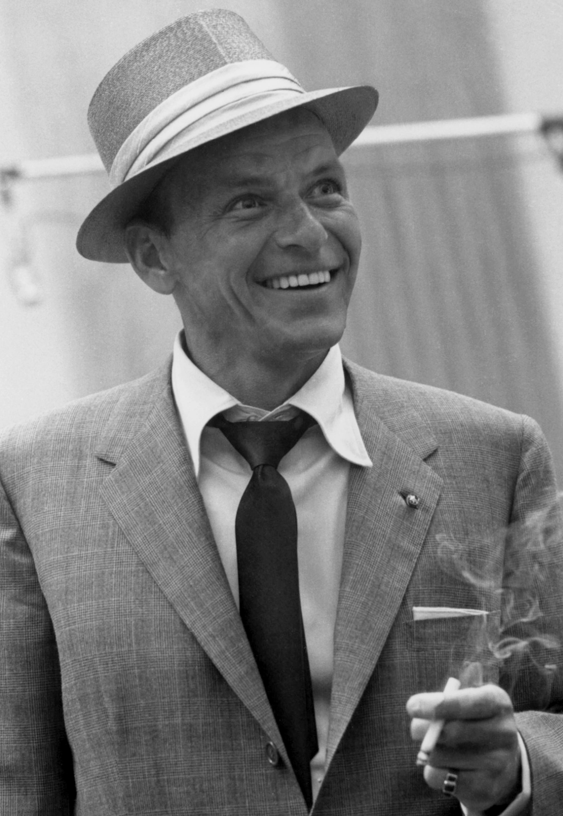
6:10:Q
Randoms for 10 points
Name this person:
Check Answer

Slide 62
6:10:A
The correct answer is …
Frank Sinatra
Return

Slide 63
6:20:Q
Randoms for 20 points
What is the name of the family doctor in ‘The Simpsons’?
Check Answer

Slide 64
6:20:A
The correct answer is …
Dr Hibbert
Return

Slide 65
6:30:Q
Randoms for 30 points
On ‘Family Guy’, Seth McFarlane does the voice for Peter Griffin – name two other character that he voices
(he does another 4 characters!)
Check Answer

Slide 66
6:30:A
The correct answer is …
Brian, Stewie, Quagmire and Tom Tucker
Return

Slide 67
6:40:Q
Randoms for 40 points
Name 3 plays by William Shakespeare
Check Answer

Slide 68
6:40:A
The correct answer is …
Return

Slide 69
6:50:Q
Randoms for 50 points
Name the original eight reindeer from the poem ‘The night before Christmas’
Check Answer

Slide 70
6:50:A
The correct answer is …
Comet, Cupid, Dasher, Dancer, Prancer, Vixen, Donner, Blitzen
Return

Slide 71
Team 1 Bonus:R
Team One Bonus Question
Rules
Decide how many points the team wants to gamble from the current score
If correct the team adds that amount to the final score
If incorrect the team subtracts that amount from the final score
The team may confer on this question
Bonus Question

Slide 72
Team 1 Bonus:Q
Team One Bonus Question
Name 3 Christmas number ones from the last 20 years
Check Answer

Slide 73
Team 1 Bonus:A
Team One Bonus Question : Correct Answer
Return

Slide 74
Team 2 Bonus:R
Team Two Bonus Question
Rules
Decide how many points the team wants to gamble from the current score
If correct the team adds that amount to the final score
If incorrect the team subtracts that amount from the final score
The team may confer on this question
Bonus Question

Slide 75
Team 2 Bonus:Q
Team Two Bonus Question
Fill in the blanks:
roasting on an open fire, Jack Frost on your nose, Yuletide carols being sung by a choir, And folks dressed up like .
Check Answer

Slide 76
Team 2 Bonus:A
Team Two Bonus Question : Correct Answer
Chestnuts
Nipping
Eskimos
Return

Slide 77
Tie Breaker: R
TIE BREAKER
Rules
Sudden death play off
The team may confer on this question
Each team writes the answer on paper
The tutor decides which team goes first
The correct answer scores 1 point
Question
Notes:
Make this a real tough question!!!!!!!!!!!!!

Slide 78
Tie Breaker: Q
TIE BREAKER Question
How many gifts are given in total in the song ‘The Twelve Days of Christmas’?
Check Answer

Slide 79
Tie Breaker: A
TIE BREAKER Question : Correct Answer
364
Return

Slide 80
For further information please contact The STEM Alliance enquiries@STEMalliance.uk or visit www.STEMalliance.uk

