Slide 1
Maths Quiz College of West Anglia

Slide 2
Topic
Maths
Aims
Maths quiz covering various subsectors Interactive to encourage teamwork and can also be used as a competition between students Used to refresh knowledge
Level
Level 1 & Level 2
Method
Paper/Electronic If paper, print out slides 3 – 11 and use slide 11 as a worksheet to record answers
Equipment
Pc/Laptop/Computer
Duration
1 Hour +

Slide 3
Maths Quiz
What is the biggest/smallest number you can make using +, -, x, ÷ and the numbers
10, 5, 8, 2, 7, 75
What is the biggest/smallest number you can make using all of +, -, x, ÷ at least once and the numbers above

Slide 4
Maths Quiz
Using the numbers only once and as many of the operations +, -, x, ÷ required to make the total
Numbers
Total
5, 6, 1 , 8, 75, 100
212
1, 5 ,6, 7, 10, 25
349
4, 8, 2, 5, 8, 25
235

Slide 5
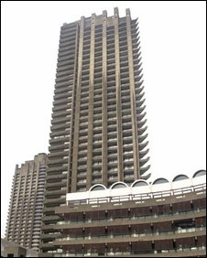
How Many
Approx. how many floors has the tower block?
Estimate the number of people who live there?

Slide 6
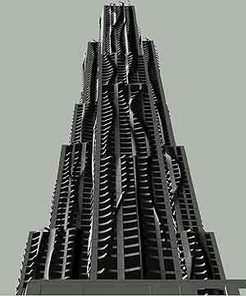
How Many
Approx. how many floors has the tower block?
Estimate the number of people who live there?

Slide 7
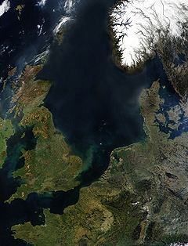
How Would
you Do It
Approx. how much water is there in the North Sea?
Estimate the average depth?
Estimate the maximum depth?

Slide 8
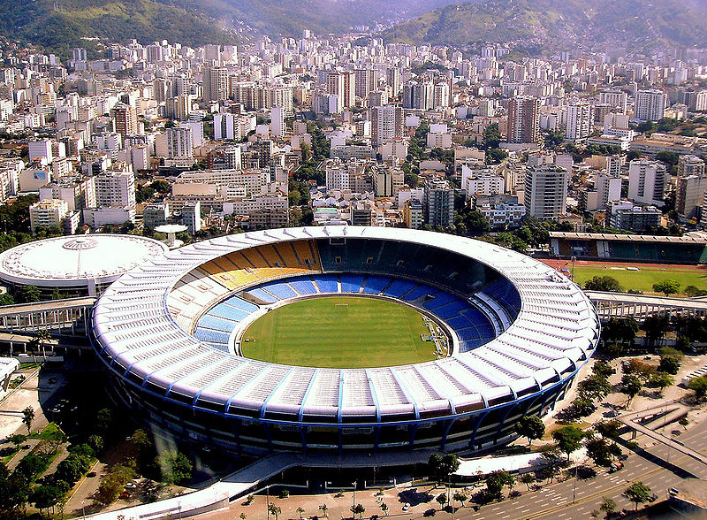
How Many
Approx. how many people will it hold?
Seating?
Standing?
Estadio do Maracana –
Rio De Janeiro
Estimate how far it is to Rio?

Slide 9
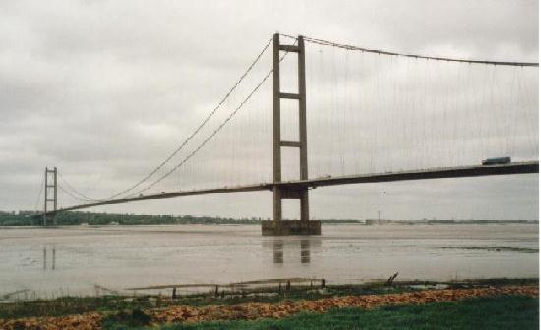
How Big
How high are the towers?
All measurements in m
Towers: 155.5 m high
Span: 1410 m between towers
2220 m between shores
How long is the bridge?
Between towers?
Shore to shore?

Slide 10
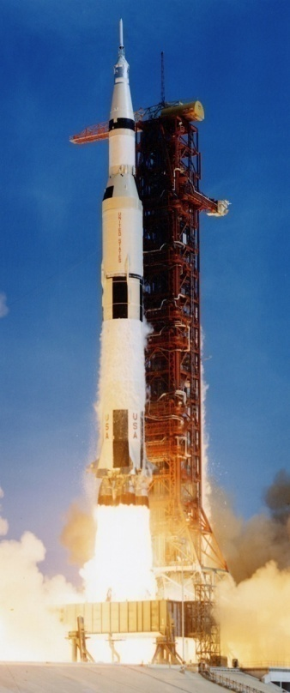
How Long
Estimate how long it would take?
If the sun is 150,000,000 km away
How long would it take to get there travelling in:
A car at 100 km/h
A plane at 500 km/h
A rocket 25,000 km/h
A light beam at 300,000 km/h

Slide 11
Worksheet
Page | Answer
3
4
5
6
7
8
9
10

Slide 12
For further information please contact The STEM Alliance enquiries@STEMalliance.uk or visit www.STEMalliance.uk

