Slide 1
Keeping safe online
Click through each slide

Slide 2
Click for the next slide

Slide 3
Click for the next slide

Slide 4
Lets look at passwords
Click for the next slide

Slide 5
Click for the next slide to find out

Slide 6
Click for the next slide

Slide 7
Click for the next slide to find out

Slide 8
Click for the next slide

Slide 9
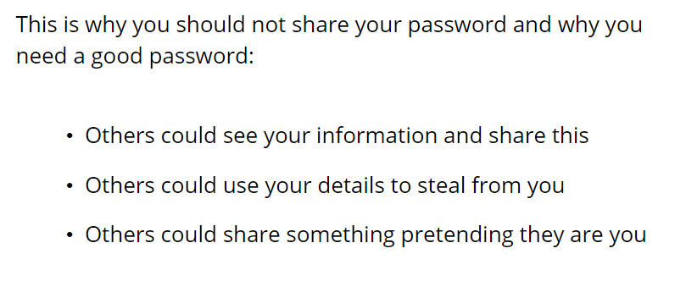
Click for the next slide

Slide 10
Click for the next slide

Slide 11
Lets talk about sharing personal information
Click for the next slide

Slide 12
Click for the next slide

Slide 13
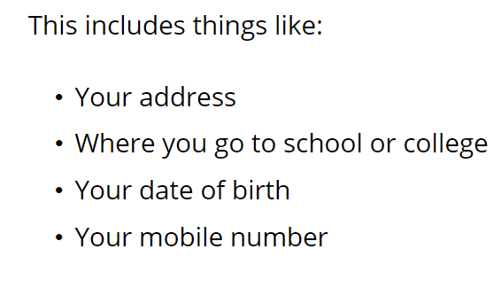
Click for the next slide

Slide 14
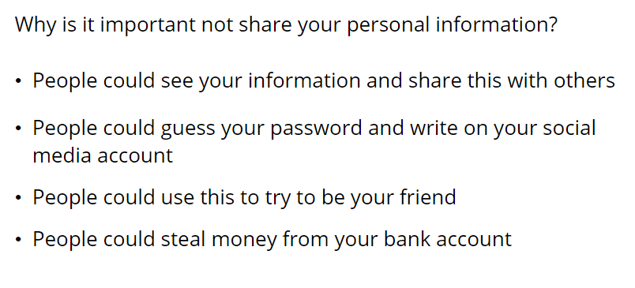
Click for the next slide

Slide 15
Click for the next slide

Slide 16
Lets talk about banter
Click for the next slide

Slide 17
Click for the next slide to find out

Slide 18
Click for the next slide to find out

Slide 19
Click for the next slide

Slide 20
Click for the next slide

Slide 21
Click for the next slide

Slide 22
Lets talk about bullying online
Click for the next slide

Slide 23
Click for the next slide to find out

Slide 24
Click for the next slide

Slide 25
Click for the next slide

Slide 26
Click for the next slide

Slide 27
Lets look at talking to people online
Click for the next slide

Slide 28
Click for the next slide find out

Slide 29
Click for the next slide

Slide 30
Click for the next slide to find out

Slide 31
Click for the next slide

Slide 32
Do you accept their friend request?
Click for the next slide to find out

Slide 33
Click for the next slide

Slide 34
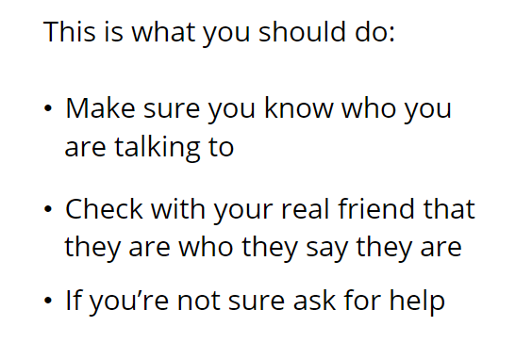
Click for the next slide

Slide 35
Click for the next slide to find out

Slide 36
Click for the next slide

Slide 37
Click for the next slide

Slide 38
Click for the next slide

Slide 39
Lets talk about sharing feelings online
Click for the next slide

Slide 40
Click for the next slide to find out

Slide 41
Click for the next slide

Slide 42
Click for the next slide

Slide 43
Click for the next slide

Slide 44
Click for the next slide

Slide 45
Click for the next slide to find out

Slide 46
Click for the next slide

Slide 47
Click for the next slide to find out

Slide 48
Click for the next slide

Slide 49
Click for the next slide

Slide 50
Click for the next slide

Slide 51
Click for the next slide

Slide 52
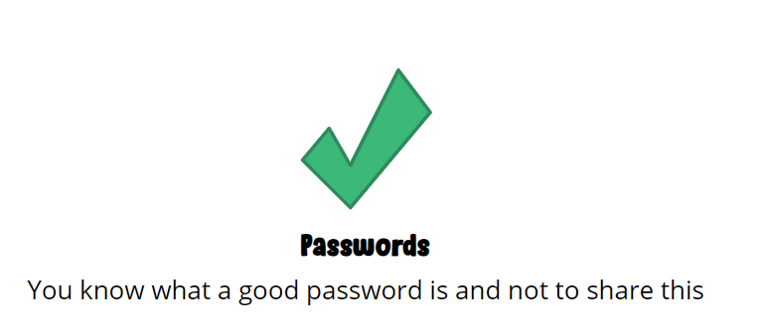
Click for the next slide

Slide 53
Click for the next slide

Slide 54
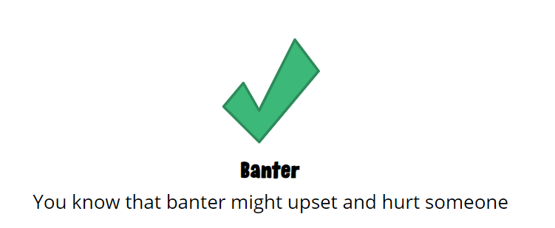
Click for the next slide

Slide 55
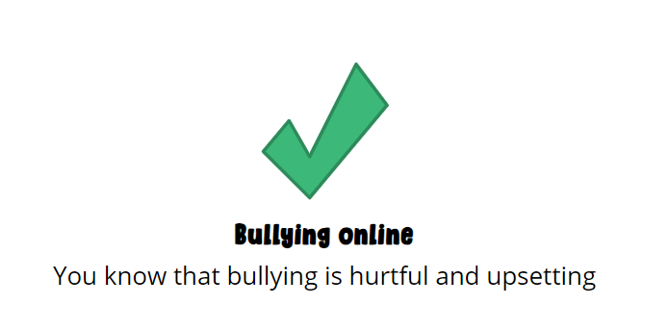
Click for the next slide

Slide 56
Click for the next slide

Slide 57
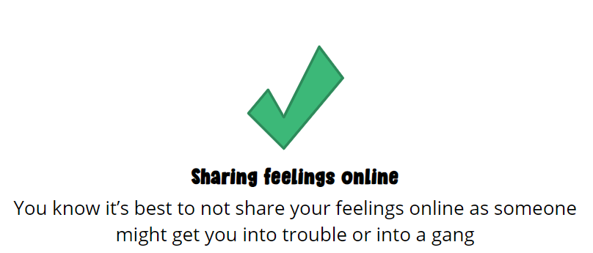
Click for the next slide

Slide 58
Click for the next slide

Slide 59
Click for the next slide

Slide 60
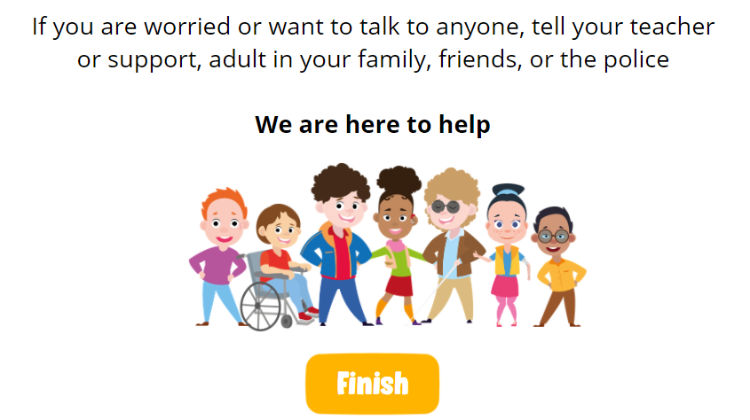
We are here to help

