Slide 1
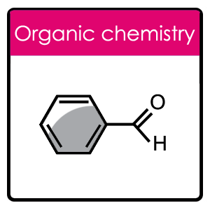
Lunar Survival Exercise
Michelle Fearn
North Herts College
Organic Identification of Unknowns
Guide + Worksheets
David Martin
City & Islington College
Students Name: …………………………………………………………………..
Notes:
To Print

Slide 2
Topic
Organic Identification of Unknowns
Aims
A workbook that contains organic practical tests to identify unknown A selection of possible unknowns and a sheet for students to fill in to show their reasoning This is an excellent resource for the VTEC Unit 22 – Chemical Laboratory Techniques
Level
Level 3
Method
A workbook that contains practical tests (for students), to identify unknown. Also attached to this workbook is a sheet for students to fill in showing their reasons, and a selection of possible unknowns.
Equipment
Hand-Outs Slideshow/Laptop/Projector Printer Pens/Pencils/Note Pads
Duration
> 30 Minutes
Notes:
Hidden

Slide 3
Organic Identification
of Unknowns
A collection of practical organic tests for identifying functional groups in organic chemistry
Testing for Hydrocarbons
Experiment 1 – Combustion
Procedure
Carefully place a few drops of the hydrocarbon on a watch glass in a fume cupboard.
Carefully light the hydrocarbon with a splint and observe the following:
- the colour of the flame
- the soot content of the flame
- the colour of the watch glass at the end of the burning
Experiment 2 – the addition of bromine water
Procedure
Put about 1cm³ of your hydrocarbon into a test tube.
Add 5 drops of bromine water to the test tube.
Put a bung on the tube and shake
Care – Bromine and bromine water are very corrosive and toxic. Perform this experiment in a fume cupboard.
Possible Results
Hydrocarbon | Burning | Bromine water
Alkane | Clean yellow flame, very little soot | Stays orange
Alkene | Yellow flame, some soot | Orange - colourless
Arene | Orange flame, lots of soot | Stays orange
Notes:
To Print

Slide 4
Organic Identification
of Unknowns
Testing for Carbonyl Compounds
The test for the carbonyl group – both aldehydes and ketones will give a positive test in this reaction.
Procedure
Add 5cm³ of 2,4 dinitrophenylhydrazine (2,4 DNP) to a test tube.
Add 5 drops of your unknown to the tube
Cork the test tube and shake the mixture. If a solid does not form within a few minutes add 1 cm³ of dilute sulphuric acid drop-wise and shake.
Oxidation reactions – methods to distinguish aldehydes from ketones
Silver mirror test
Use a really clean test tube.
To a test tube add 2cm³ of silver nitrate and 1 drop of dilute sodium hydroxide solution. You should get a brown solid. Add dilute ammonia solution drop wise and shake until all the brown solid dissolves.
Add 3 drops of your unknown to the solution of silver nitrate in ammonia. Then place the tubes in a beaker of near boiling water for 5 minutes. If a silver mirror forms your unknown compound is an aldehyde.
Fehling’s test
Add 1cm³ of solution 1 (the blue solution) to a test tube and the add 1cm³ of solution 2 the (colourless solution) into solution 1 and shake till you get a deep blue solution.
Add 3 drops of your unknown to the deep blue solution and then place the test tube in a beaker of boiling water for 5 minutes. If a red solid forms your unknown compound is an aldehyde.
Notes:
To Print

Slide 5
Organic Identification
of Unknowns
Testing for Carboxylic Acid
Test the pH of a solution of a carboxylic acid
A carboxylic acid solution should:
i) Turn blue litmus paper red.
ii) Or turn universal indicator paper red.
Add sodium carbonate solid to a solution of the carboxylic acid
On the addition of solid sodium carbonate to a solution of a carboxylic acid fizzing should be observed as carbon dioxide gas is generated.
This gas could be tested with a drop of lime water – the lime water should go milky
Test for an amine
Test the pH of a solution of an amine
An amine solution should:
i) Turn red litmus paper blue.
ii) Or turn universal indicator paper blue.
Notes:
To Print

Slide 6
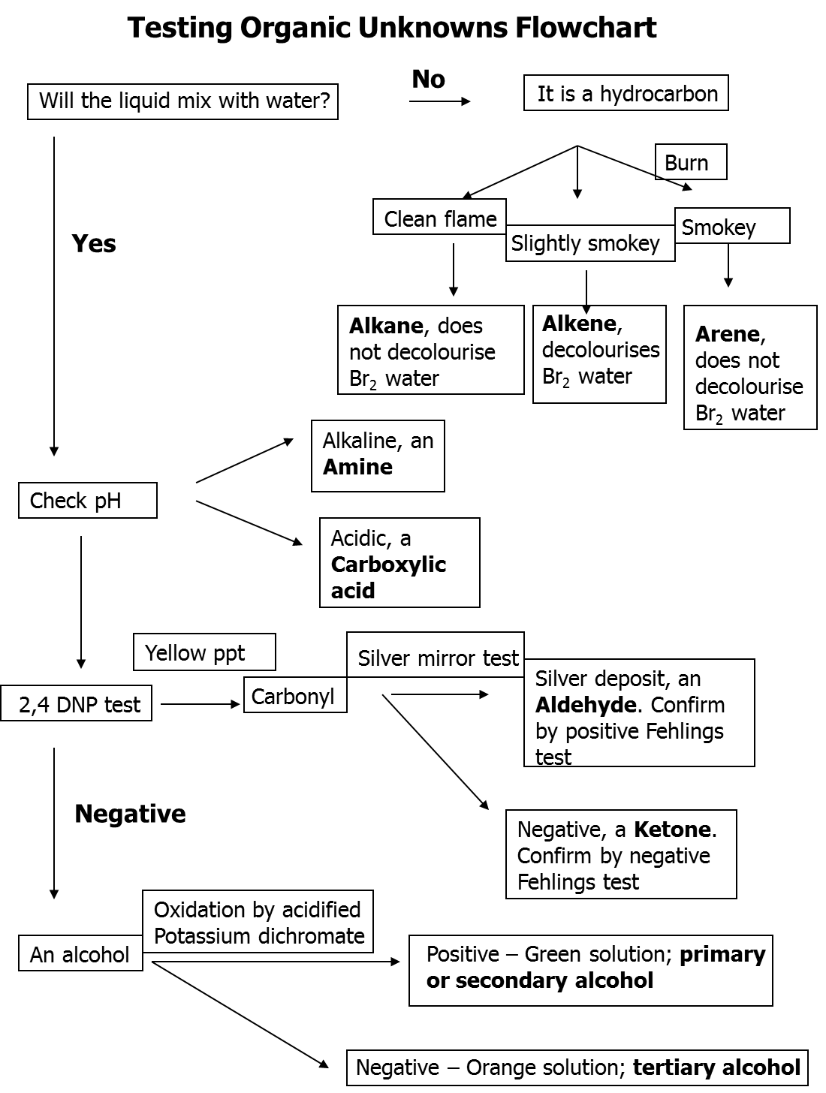
Testing Organic
Unknowns Flowchart
Notes:
To Print

Slide 7
Organic Identification
Of Unknowns
Name ___________________________Date _____________
Letter ________________
Test | Result | Inference
Add about 5cm³ of distilled water to a test tube. Add about 1cm³ of your unknown. Put a bung on the tube and shake.
The identity of the unknown compound is ______________________________
Notes:
To Print

Slide 8
Organic Identification
Of Unknowns
Identification unknown organic chemicals
Practice Practical
A = Methanol
B = Propan 2 ol
C = 2 Methyl propan 2 ol
D = Carboxylic acid
E = Acetone
F = Aldeyhde
G = Amine
H = Methyl Benzene
I = Hexane
J = Hex 1 –ene
Identification unknown organic chemicals
Assessed Practical
A Ethanol
B Hexane
C Ethanoic Acid
D Ethanal
E Propanone
F Phenylamine (aniline)
G 2-methyl propan-2-ol
H Hex-1-ene
I Methyl benzene
J Propan-2-ol
Notes:
To Print

Slide 9
For further information please contact The STEM Alliance enquiries@STEMalliance.uk or visit www.STEMalliance.uk

