Slide 1




Programming Control Systems using Minibloq
Sayande Adekoye
College of North West London
Students Name: …………………………………………………………………..
Notes:
To Print

Slide 2

Topic
Control Systems Using IT – An Introduction
Aims
To teach IT Helps to design a control system Looks at Minibloq – and how to use the programming section
Level
Level 3
Method
PowerPoint Slide Show, on the programming control system using Minibloq Minibloq is a graphical development environment for Arduino and other platforms. Its main objective is to help in teaching programming. It is specially used in robotics at elementary, middle and high schools. It's widely used in Argentina, where just in the San Luis province, more than 60000 children has been trained with this software in public schools.
Equipment
Laptop Projector Printer Notepad/Pens/Pencils
Duration
20 Minutes
Notes:
Hidden

Slide 3


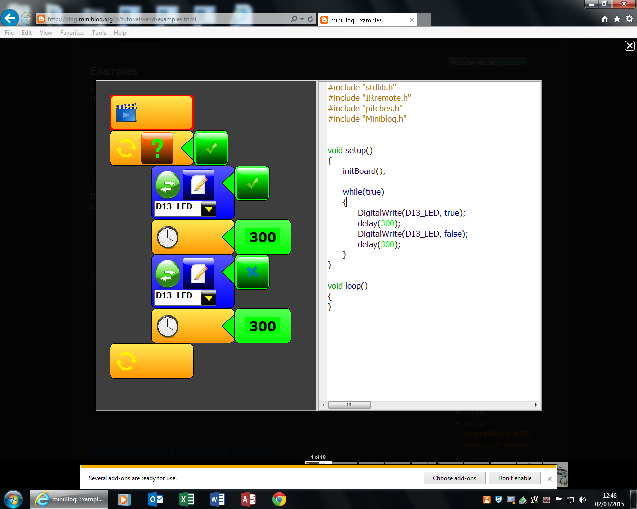
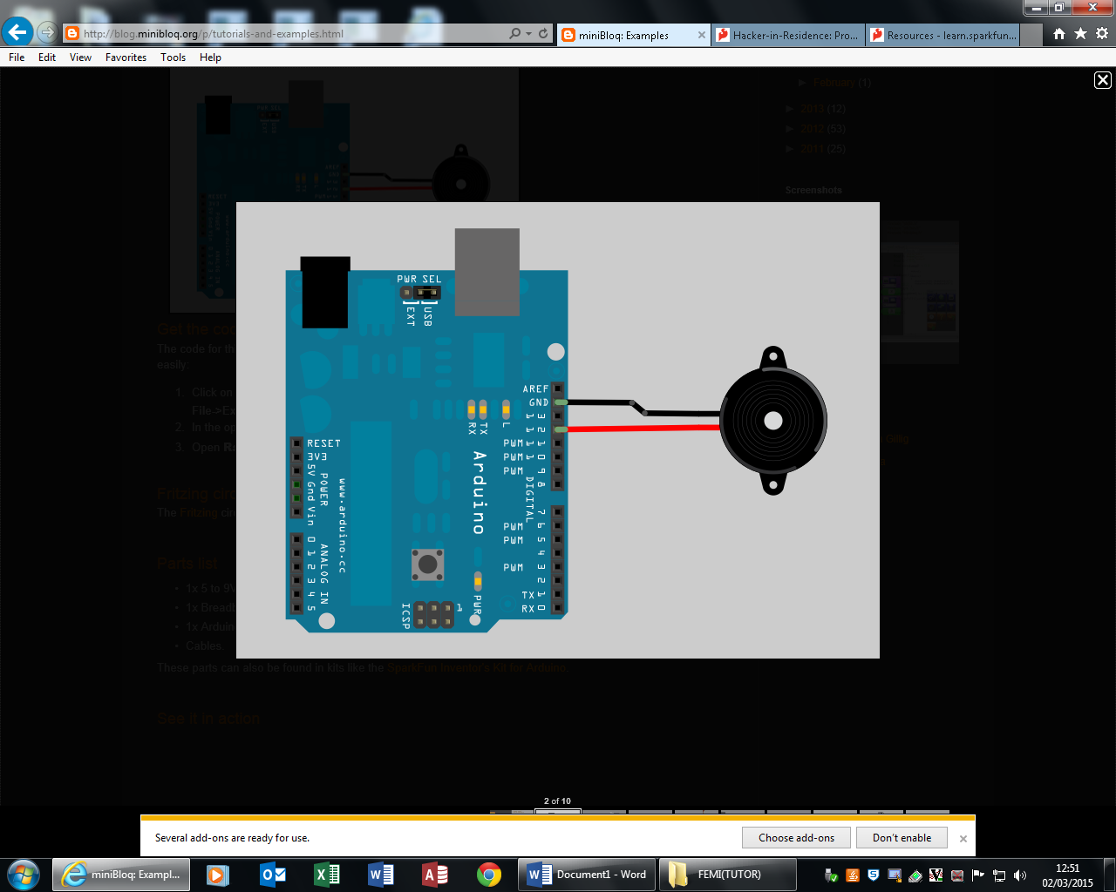
Programming
Control Systems
Minibloq
Part 1
Notes:
To Print

Slide 4
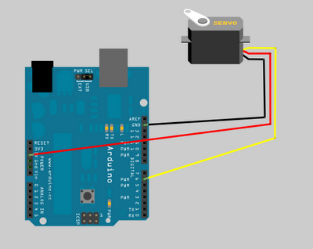
Programming
Control Systems
Minibloq
Servo (Incremental Position)
Get the code
The code for this example is included with Minibloq's current distribution (v0.82.Beta). You can find the code easily:
1. Click on the File->Examples menu
2. In the open file dialog, go to the folder DuinoBot\300.ServoIncrementalPos
3. Open ServoIncrementalPos.mbqc
Notes:
To Print

Slide 5
Programming
Control Systems
Minibloq
Continuous rotation servo with user defined block
Antonio Lomba, from Galicia, has sent this article, which explains how to use continuous rotation servos with Minibloq and user defined blocks (this is the original post from his blog (Galician): http://www.tecnoloxia.com/index.php/control/224-motor-servo-de-rotacion-continua-con-minibloq.html):
Continuous rotation servos work with small electric pulses. According to the duration of the pulses, the servo rotates clockwise, counter clockwise, or remain stopped. To drive this kind of servomotors is necessary to know it's working characteristics.
For example, for a S35/STD de GWS servo, the manufacturer recommends 0.9 ms pulses to rotate clockwise, 1.5 ms pulses to brake the motor, and de 2.1 ms pulses rotate it counter clockwise. It's also important to control the signal period, which is the total sign time taking into account both the high and the low pulse. The recommended period to obtain the optimal rotation speed is between 16 and 23 ms.
To connect the motor to an Arduino Uno board, we will need to take a look to the colours in the conexion cable, connecting as showed in the following image (brown cable = GND, red cable = 5V and yellow cable for the control pin):
Notes:
To Print

Slide 6
Programming
Control Systems
Minibloq
Notes:
To Print

Slide 7
Programming
Control Systems
Minibloq
Notes:
To Print

Slide 8

For further information please contact The STEM Alliance enquiries@STEMalliance.uk or visit www.STEMalliance.uk

