Slide 1
Recognising Opportunities to Include Functional Skills
Maths
Lucy Crofts

Slide 2
Topic
Embedding Maths
Aims
Understanding the importance of embedding maths Explaining the benefits Know ways of embedding | To develop maths and function skills, needed to achieve their main learning goals and aims Learners appreciate the importance of improving their maths
Level
Level 2
Method
The following resource uses PowerPoint Slides (Slide Show). Slide 3 fun slide, Slide 4 fun slide, Slide 5 averages , Slide 7 function skills, Slide 8 activity, Slide 9 examples, Slide 10 examples, Slide 11 (Hidden) for Tutor use only – Session Outcomes (Teacher Notes at bottom of slides)
Equipment
Jar of sweets Paper plates Tape Measure String Tube of Smarties Stop Watch Play Money | Lego Thermometer Pack of Cards Graph Paper Calculator Clock Laptop Projector
Duration
30-45 Mins

Slide 3
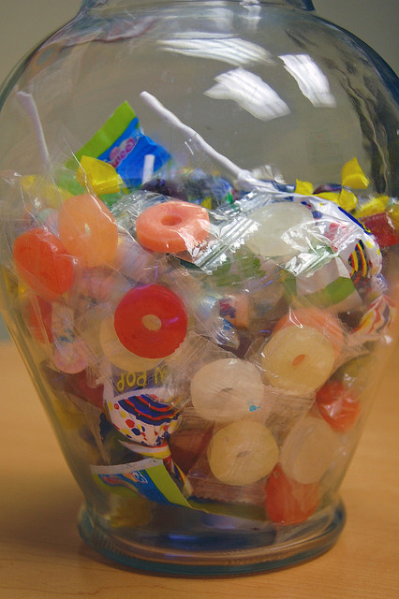
How many
sweets in the jar?
Notes:
Starter Activity-Learners will play the guess how many sweets in the jar game on arrival. Learners will write the figure on the whiteboard. When all the learners have written down their guesses, the tutor will ask the learners to work out the range of guesses and will reveal the correct answer.
Tutor will also ask learners to identify on a Post It note what they think the biggest challenge might be with regards to embedding function skills within sessions.
Prize for the Winner
Whiteboard
Marker Pens
Sweet Jar with Sweets
Post It Notes

Slide 4
Including Maths
& English……
How ‘Confident’ Are You?
Notes:
Learners will use paper plates to rate themselves 1-10 to identify how confident they feel with regards to embedding Maths & English.
Tutors will line up in numerical order and will work out an average score.
Tutor will use direct questioning to explore why learners feel the way that they do.

Slide 5
Including Maths
& English……
Averages
Mean – Add up all the numbers, then divide by how many numbers there are
Mode – The number which appears most often
Median – is the “middle number”

Slide 6
Why are Functional
Skills Important?
Notes:
Learners will have 3 minutes to identify as many reasons as they can think of as to why functional skills are important to learners and their progression.
Tutor will lead the discussion and discuss points raised by recently Ofsted report.
Tutor will encourage learners to think specifically about their own learner needs.
Flipchart Paper
Timer
Marker Pens

Slide 7
Why are Functional
Skills Important?
‘One in five children do not achieve the expected literacy levels by the end of primary school’.
‘One in three from ‘disadvantaged’ backgrounds.’
‘One in seven adults, as many as five million people, lack basic literacy skills’.
‘Too many young adults lack the functional skills to make their way in the modern world’.
Reference: www.ofsted.gov.uk
Notes:
Learners will have 3 minutes to identify as many reasons as they can think of as to why functional skills are important to learners and their progression.
Tutor will lead the discussion and discuss points raised by recently Ofsted report.
Tutor will encourage learners to think specifically about their own learner needs.
Flipchart Paper
Timer
Marker Pens

Slide 8
What could we do?
The Box
..of…………
Delights
Notes:
Learners will each be given a box containing a toolkit of resources, for each resource learners will identify one way that it could be used to embed maths within their subject specialism.
Learners will then feedback their ideas as a group.
Tutor will reinforce the discussion using theory on the PowerPoint.
Box to contain:
Paper Plates
Tape measure
String
Tube of Smarties
Stop Watch
Play money
Lego
Thermometer
Pack of cards
Graph paper
Calculator
Clock

Slide 9
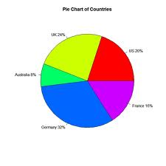
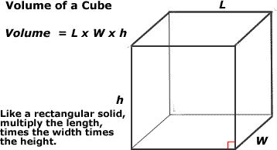
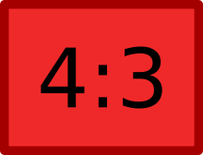
Maths Examples
Shape, Space and Measure
area, perimeter, volume, shapes
Averages
speed, weight, spend
Data Handling
questionnaire data, pie charts, bar charts
Ratio and Proportion
recipes, hair colour, mortar
Time
target setting, hair colour, estimation
Notes:
Tutor will feed back ideas to learners

Slide 10
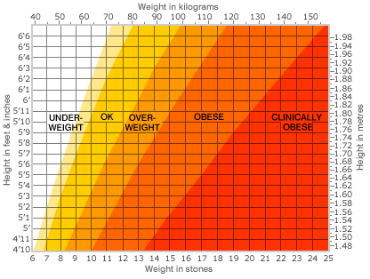
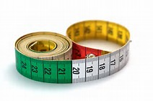
Maths Examples
Fractions, Decimals and Percentages
money, VAT, ordering stock
Formulae
BMI, area, perimeter
Calculations
money, budgets, wages
Conversions
measurement, money
Notes:
Tutor will feed back ideas to learners

Slide 11
Session Outcomes
When did we? How did we?
Explore how to recognise opportunities to include Maths within teaching, learning and assessment
Create an action plan to record ideas and future proprieties
Notes:
Introduce the session outcomes

Slide 12
Any Questions?
Notes:
Any Questions?

Slide 13
For further information please contact The STEM Alliance enquiries@STEMalliance.uk or visit www.STEMalliance.uk

