Slide 1
Respitory System
Jennifer Dean Hill
City and Islington College
Students Name: …………………………………………………………………..
Notes:
To print

Slide 2
Topic
Respitory System (Human Biology)
Aims
A group activity used in order to revise or learn the function of the major body systems.
Level
Level 3
Method
PowerPoint slides (hand-out) – Teacher slides 6 & 7 Answers (hidden from slide show)
Equipment
Laptop & Projector Pens Hand-outs (print slides 1, 3, 4 & 5)
Duration
>5-10 Minutes
Notes:
Hidden

Slide 3
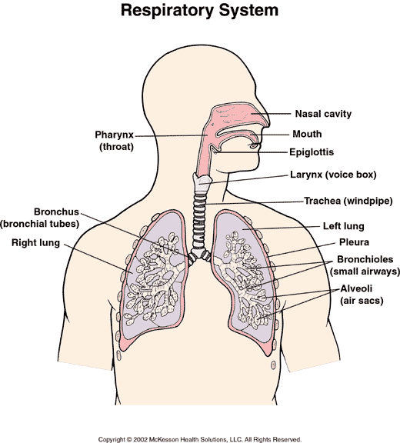
Respitory
System
1
12
2
3
4
5
11
6
10
7
8
9
Notes:
To Print

Slide 4
Respitory
System
1
12
2
3
4
11
5
6
10
7
8
9
Notes:
Hidden (answer)

Slide 5
Respitory
System
Structure | Describe it’s structure | How it’s structure is linked to it’s role
Alveoli
Diaphragm
Bronchiole
Notes:
To Print

Slide 6
Respitory
System
Structure | Describe it’s structure | How it’s structure is linked to it’s role
Trachea
Ribs
Notes:
To Print

Slide 7
Respitory
System
Structure | Describe it’s structure | How it’s structure is linked to it’s role
Alveoli | Hollow bag, very small and with only one entrance/exit. Walls are only one cell thick. | Alveoli are extremely tiny structures in the lungs where the exchange of oxygen and carbon dioxide takes place. Their walls are very thin and moist to help oxygen and carbon dioxide pass through. This process is called diffusion.
Diaphragm | Stretchy, large band of muscle. | To inhale, the diaphragm contracts and flattens, the intercostal muscles contract and cause the ribcage to expand and move up. The diaphragm contracts drops downwards. Thoracic volume increases, lungs expand, and the pressure inside the lungs decreases, so that air flows into the lungs in response to the pressure gradient. These movements cause the chest cavity to become larger and the pressure to be smaller, so air rushes in from the atmosphere to the lungs
Bronchiole | Small hollow tubes, thin walled. | Are the two tubes of the respiratory tubes that transport air to and from the lungs. The bronchi pass air to the bronchioles, then to the alveoli. The bronchi is lined with mucous membrane and cilia, which are minute hair-like structure, to trap particles and dust.
Notes:
Hidden (answers)

Slide 8
Respitory
System
Structure | Describe it’s structure | How it’s structure is linked to it’s role
Trachea | Large hollow tube. Have tiny hairs (cilia) on the inside. | The trachea or windpipe is about 10 cm long and is supported by C-shaped rings of cartilage to prevent the tube from collapsing during breathing. The cilia, which are minute hair-like structure, to trap particles and dust.
Ribs | Curved bone and cartilage structure. Strong but flexible, surrounds the lungs. | The ribs and intercostal muscles of the chest which protect the lungs, trachea and bronchi. The intercostal muscles are responsible for the movements of the rib cage during breathing. Contraction of the external intercostal muscles moves the ribs upwards and outwards during inspiration. Relaxation of the external intercostal muscles causes the ribs to move downwards and inwards during expiration at rest.
Notes:
Hidden (answers)

Slide 9
For further information please contact The STEM Alliance enquiries@STEMalliance.uk or visit www.STEMalliance.uk

