Slide 1
SPagMat
Charbohydrates
Jo Byrne & Cerian Ayres
Petroc

Slide 2
Topic
Integrating Technical English Effectively Into STEM Classroom Teaching & Learning
Aims
This resource has been designed to support staff with the effective implementation of study programmes to support STEM learner progression. All teaching staff are required to work within every lesson to integrate English, Mathematics, IT and Employability Skills. This resource allows teachers to support learners with their spelling, punctuation and grammar and in particular to develop the technical language of their subject specialism. In this case the SPaG Mats have been developed for the AQA A AS Biology Programme
Level
Level 3
Method
Slide 3 and 4 to be printed for students
Equipment
Printer Scissors Pen/Pencils
Duration
5 minutes

Slide 3
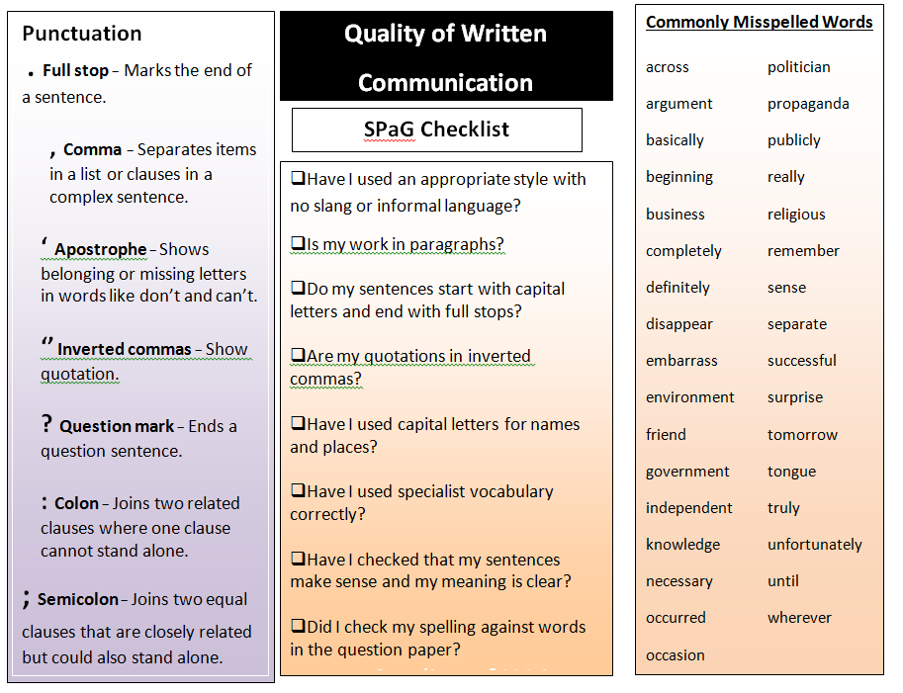

Slide 5
For further information please contact The STEM Alliance enquiries@STEMalliance.uk or visit www.STEMalliance.uk

