Slide 1
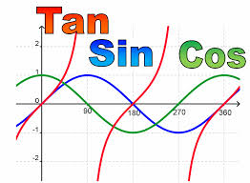
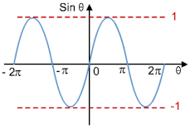
Trigonometrical Graphs
Stephanie Underwood
Petroc
x
sin
cos
y
=

Slide 2
Topic
Trigonometrical Graphs - Matching Graphs with Equations and First Derivatives
Aims
To develop an understanding of : Cubic Equations Factorising to find the point of intersection with the axes Testing Differentiation This resource has been used to provide checks on learning at the end of delivery of this subject matter. The activity allows for effective recap
Level
Level 3
Method
PowerPoint slides, slide 3 to need the cutting out (copies for every Student), Learners are then required to match the equations with the first derivatives and then match them to the graph.
Equipment
Printer Scissors Pen/Pencils
Duration
10-20 Minutes

Slide 3
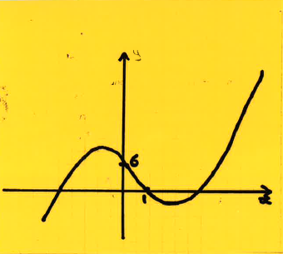
Match
Equations, First Derivatives, Graphs
Notes:
Please cut out the graphs individually

Slide 4
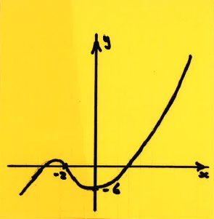
Match
Equations, First Derivatives, Graphs
Notes:
Please cut out the graphs individually

Slide 5
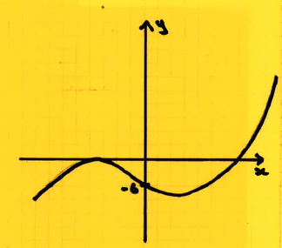
Match
Equations, First Derivatives, Graphs
Notes:
Please cut out the graphs individually

Slide 6
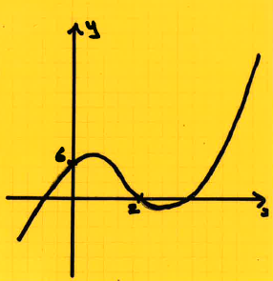
Match
Equations, First Derivatives, Graphs
Notes:
Please cut out the graphs individually

Slide 7
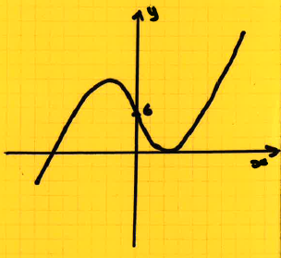
Match
Equations, First Derivatives, Graphs
Notes:
Please cut out the graphs individually

Slide 8
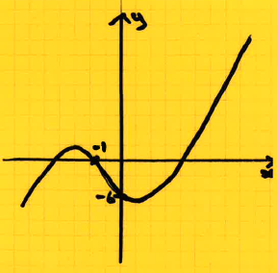
Match
Equations, First Derivatives, Graphs
Notes:
Please cut out the graphs individually

Slide 9
Match
Equations, First Derivatives, Graphs
y = (x-2) (x+1) (x3)
y = (x-3) (x+2) (x-1)
= 3x³ – 8x +1
y = x-3 + 4x2 (x+2) (x-1)
y = (x-1) (x-1) (x-6)
= 3x² – 4x -5
y = x³ + 4x² – 11x +6
y = (x+1) (x+1) (x-6)
Notes:
Please cut out the graphs individually

Slide 10
Match
Equations, First Derivatives, Graphs
Y= (x+1) (x+2) - (x-3)
= 3x² + 8x +1
y = x³ – 4x² +x + 6
y = x³ – 2x² – 5x +6
= 3x² + 8x - 11
y = x³ – 4x² – 11x - 6
= 3x² - 7
= 3x² – 8x -11
Notes:
Please cut out the graphs individually

Slide 11
For further information please contact The STEM Alliance enquiries@STEMalliance.uk or visit www.STEMalliance.uk

