Slide 1
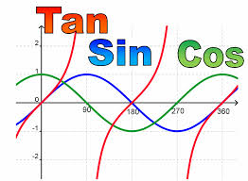
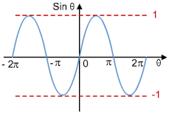
Trigonometrical Graphs
Statements, Equations and Graphs Activity
Stephanie Underwood
Petroc
x
sin
cos
y
=

Slide 2
Topic
Trigonometrical Graphs
Aims
To develop an understanding of Straight Line Graphs/Linear Equations and Interpretation The importance of the use of mathematics in everyday life – Functional Maths!
Level
Level 2
Method
Learners to review the statement cards. The statements model linear equations. The learners need to match the statement, equations and graphs. All to print out apart from slide 2 and slide 19. Need to cut out the Linear Equations and Interpretation.
Equipment
Printer Scissors Pen/Pencils
Duration
> 30 Minutes

Slide 3
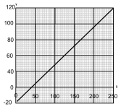
Match
Statement, Equations and Graphs
Matching
You need to look at the hand out and cut outs you have been given by your Teacher.
You then need to match the Statements, Equations and Graphs together.
MATCHING
The exchange rate is £1= $1.75
The journey is 300 miles long. We travel at 50mph

Slide 4
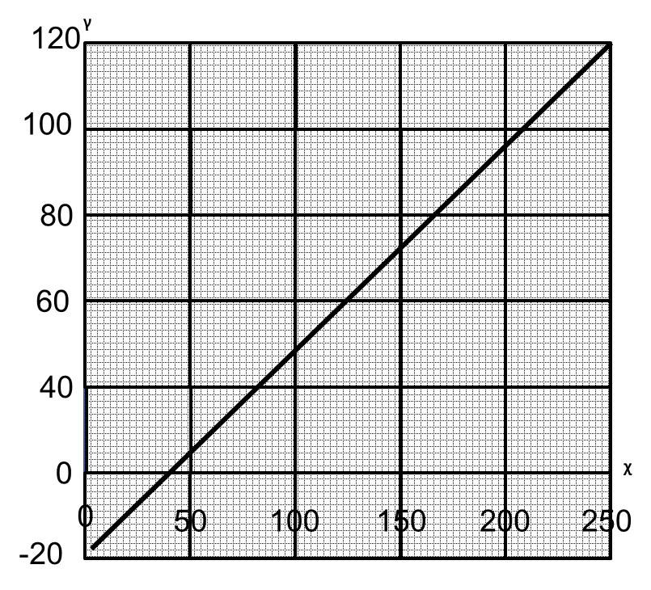
Match
Statement, Equations and Graphs
Straight
Line Graphs
Notes:
Please cut out the graphs individually

Slide 5
Match
Statement, Equations and Graphs
Straight
Line Graphs
ᵞ
250
200
150
100
50
0
ᵡ
0
200
400
600
800
1000
Notes:
Please cut out the graphs individually

Slide 6
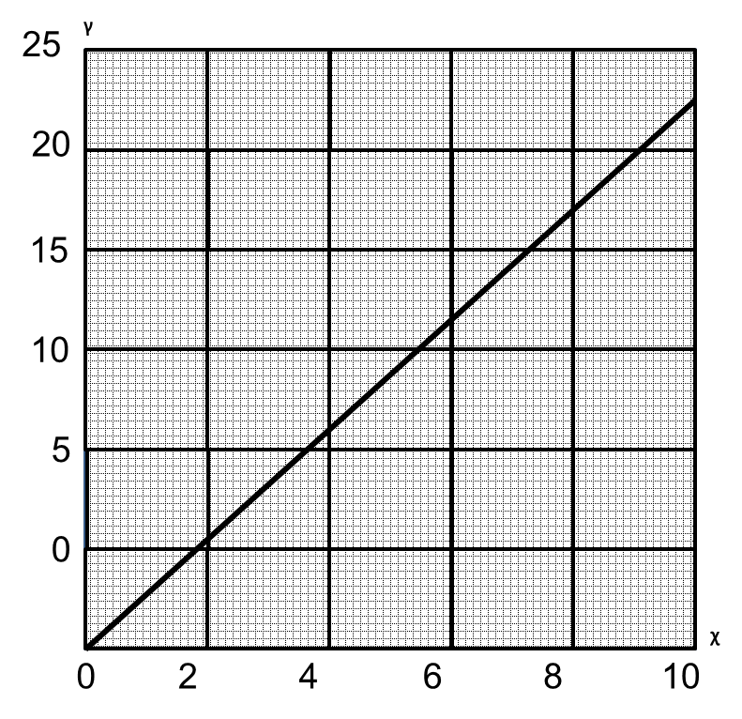
Match
Statement, Equations and Graphs
Straight
Line Graphs
Notes:
Please cut out the graphs individually

Slide 7
Match
Statement, Equations and Graphs
Straight
Line Graphs
ᵞ
300
250
200
150
100
50
0
ᵡ
ᵡ
0
1
2
3
4
5
6
Notes:
Please cut out the graphs individually

Slide 8
Match
Statement, Equations and Graphs
Straight
Line Graphs
15
ᵞ
10
5
0
ᵡ
0
1
2
3
4
5
-5
-10
Notes:
Please cut out the graphs individually

Slide 9
Match
Statement, Equations and Graphs
Straight
Line Graphs
50
ᵞ
40
30
20
ᵡ
5
10
0
ᵡ
0
10
20
30
40
50
60
Notes:
Please cut out the graphs individually

Slide 10
Match
Statement, Equations and Graphs
Straight
Line Graphs
100
ᵞ
80
60
40
20
0
ᵡ
0
10
20
30
40
50
Notes:
Please cut out the graphs individually

Slide 11
Match
Statement, Equations and Graphs
Straight
Line Graphs
ᵞ
1000
800
600
400
200
0
ᵡ
0
100
200
300
400
500
Notes:
Please cut out the graphs individually

Slide 12
Match
Statement, Equations and Graphs
Straight
Line Graphs
500
ᵞ
400
300
200
100
0
0
2
4
6
8
10
12
14
ᵡ
Notes:
Please cut out the graphs individually

Slide 13
Match
Statement, Equations and Graphs
Straight
Line Graphs
ᵞ
160
120
80
40
0
ᵡ
0
20
40
60
80
100
Notes:
Please cut out the graphs individually

Slide 14
Match
Statement, Equations and Graphs
Straight
Line Graphs
ᵞ
20
15
10
5
0
0
20
40
60
80
100
120
ᵡ
140
-5
-10
-15
-20
Notes:
Please cut out the graphs individually

Slide 15
Match
Statement, Equations and Graphs
Straight
Line Graphs
ᵞ
300
250
200
150
100
50
0
ᵡ
0
2
4
6
8
10
Notes:
Please cut out the graphs individually

Slide 16
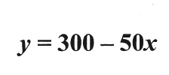
Match
Statement, Equations and Graphs
Linear Equations
Notes:
Please cut out the graphs individually

Slide 17
Match
Statement, Equations and Graphs
Linear Equations
Notes:
Please cut out the graphs individually

Slide 18
Match
It costs £10 to make the cheese. We sell it at £5 per kilogram. If we sell more than 2 kilograms we make a profit
The plumber charges £40 for a call-out plus £25 per hour.
Interpretation
The exchange rate is £1= $1.75
The journey is 300 miles long. We travel at 50mph
5 miles is equal to 8km
When full the tank holds 450 litres. We use 30 litres per day.
When we take it from the freezer its temperature is -18⁰C. Its temperature rises at a rate of ¼⁰C per minute.
The printing firm charges £50 for design plus 20p per poster
Notes:
Please cut out the graphs individually

Slide 19
Match
1 Kilogram = 2.2 pounds
The water boiled at 1000C. It cools at a rate of 20C per minute
Interpretation
To convert from Fahrenheit to Centigrade, subtract 32, then multiply by 5 and divide by 9
The delivery form charges £25 plus 40p per mile
Notes:
Please cut out the graphs individually

Slide 20
For further information please contact The STEM Alliance enquiries@STEMalliance.uk or visit www.STEMalliance.uk

