Slide 1
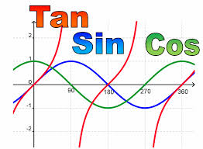
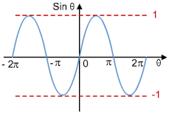
Trigonometrical Graphs
Common Trigonometrical Ratios and their Exact Values
Stephanie Underwood
Petroc
x
sin
cos
y
=

Slide 2
Topic
Common Trigonometrical Ratios and their Exact Values
Aims
To develop understanding of trigonometrical ratios of angles greater than 90 degrees in terms of trigonometrical ratios of acute angles and hence their exact values. Asses learning in terms of whether students know the relationship between angles greater than 90 degrees
Level
Level 3
Method
Teacher to cut out cards, and ask the students to see if they know the relationship between angles greater than 90 degrees
Equipment
Printer Scissors Pen/Pencils
Duration
> 30 Minutes

Slide 3
Angles
This activity will assess your learning, in terms of the relationship between angles greater than 90 degrees
CUT OUT
Cos 30
Cos 0
Cos (-60)
Cos 120
Cos 60
Cos 90

Slide 4
Angles
CUT OUT
Cos 210
Cos 180
Cos 150
Cos 330
Cos 270
Cos 240

Slide 5
Angles
CUT OUT
Cos 360
Tan 0
Tan (-45)
Tan (-150)
Tan 60
Tan 45

Slide 6
Angles
CUT OUT
Tan 30
Tan 180
Tan 240
Tan 135
-1
0

Slide 7
Angles
CUT OUT
Tan 210
1
½
- ½
Sin 0
Sin (-30)

Slide 8
Angles
CUT OUT
Sin (-60)
Sin 90
Sin 60
Sin 30
Sin 120
Sin 180

Slide 9
Angles
CUT OUT
Sin 150
Sin 270
Sin 240
Sin 210
√3/2
-√3/2

Slide 10
Angles
CUT OUT
2 sin 60
√3
1/√3

Slide 11
For further information please contact The STEM Alliance enquiries@STEMalliance.uk or visit www.STEMalliance.uk

