Slide 1
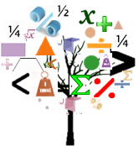
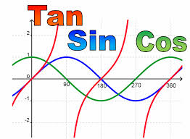
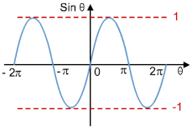
Trigonometrical Graphs
Matching Graphs to the Equations
Stephanie Underwood
Petroc
x
sin
cos
y
=

Slide 2
Topic
Developing an Understanding of Cubic Equations
Aims
To recognise properties of cubic equations and the effects of repeated factors when matching equations to graphs
Level
Level 3
Method
Teachers to cut out graphs and equations, Learners to match these.
Equipment
Printer Scissors Pen/Pencils
Duration
10-20 Minutes

Slide 3
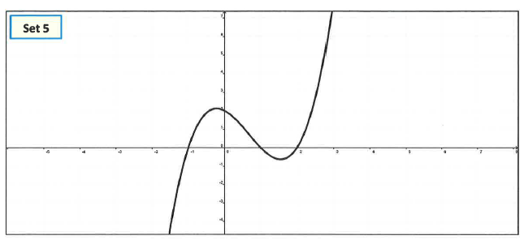
Match
The aim required is to match the graphs to the equations
CUT OUT
Notes:
Please cut out the graphs individually

Slide 4
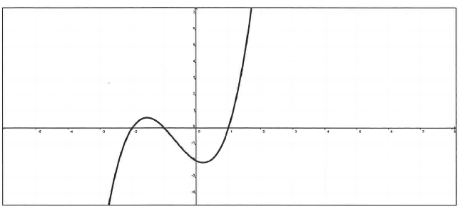
Match
CUT OUT
Notes:
Please cut out the graphs individually

Slide 5
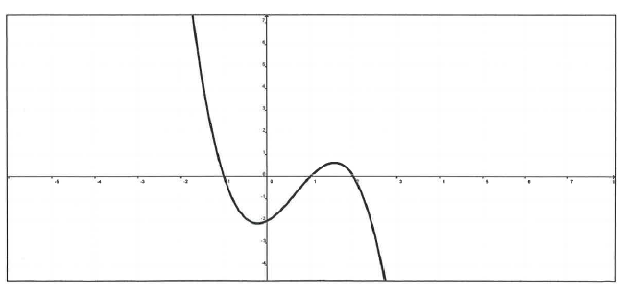
Match
CUT OUT
Notes:
Please cut out the graphs individually

Slide 6
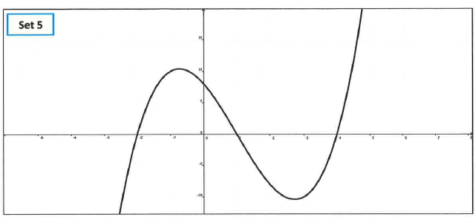
Match
CUT OUT
Notes:
Please cut out the graphs individually

Slide 7
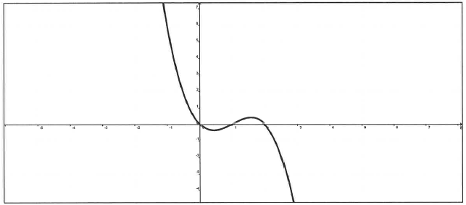
Match
CUT OUT
Notes:
Please cut out individual equations to match against the cut out graphs

Slide 8
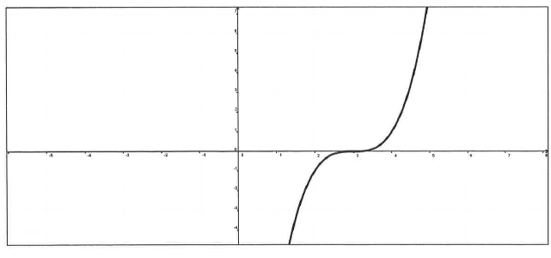
Match
CUT OUT
Notes:
Please cut out individual equations to match against the cut out graphs

Slide 9
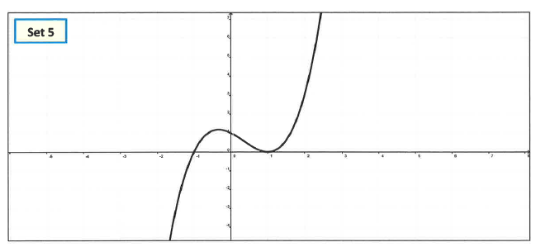
Match
CUT OUT
Notes:
Please cut out individual equations to match against the cut out graphs

Slide 10
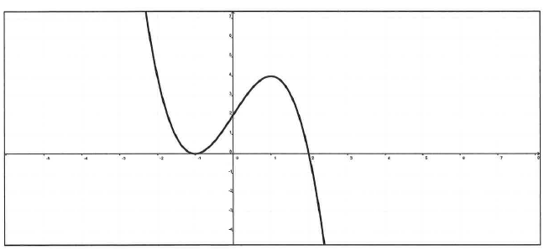
Match
CUT OUT
Notes:
Please cut out individual equations to match against the cut out graphs

Slide 11
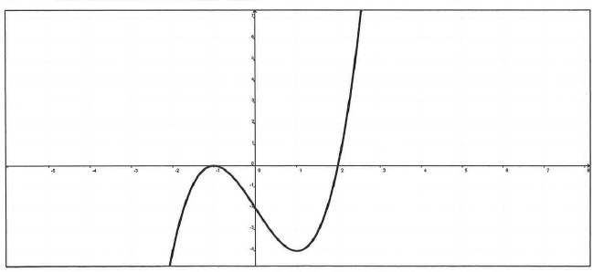
Match
CUT OUT
Notes:
Please cut out individual equations to match against the cut out graphs

Slide 12
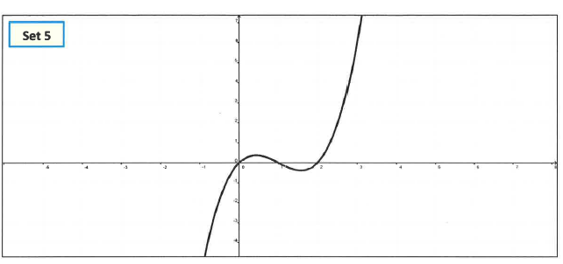
Match
CUT OUT
Notes:
Please cut out individual equations to match against the cut out graphs

Slide 13
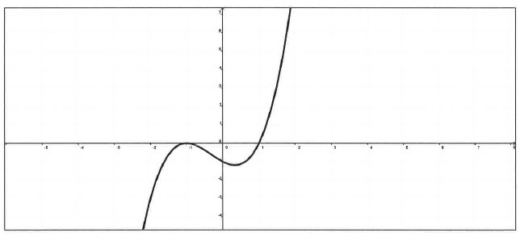
Match
CUT OUT
Notes:
Please cut out individual equations to match against the cut out graphs

Slide 14
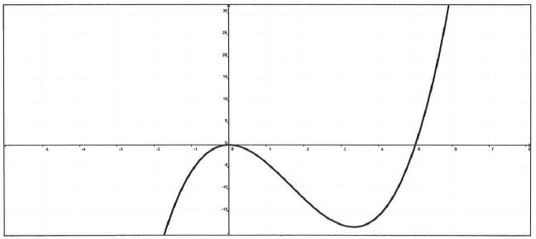
Match
CUT OUT
Notes:
Please cut out individual equations to match against the cut out graphs

Slide 15
Match
CUT OUT

Slide 16
Match
CUT OUT

Slide 17
For further information please contact The STEM Alliance enquiries@STEMalliance.uk or visit www.STEMalliance.uk

