Slide 1
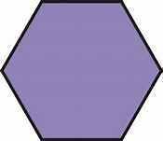
Trigonometrical Graphs
Algebraic Simplification
Petroc
Stephanie Underwood

Slide 2
Topic
Trigonometrical Graphs – Algebraic Simplification
Aims
To support learners to develop their algebraic skills. The resource can be used by individuals or by groups of learners and is focussed on algebraic simplification The resource has been used with higher level 2 learns and also as an icebreaker at the start of level 3 programmes It has been more successfully used by groups of learners with an element of timed competition introduced
Level
Level 2 & Level 3
Method
PowerPoint slides, from slide 3 to 6 all the triangles to be cut out and given to the Students, the Students then need to match the edges and form a large Hexagon. This is a tarsia puzzle. Can be done as ice breaker or a timed exercise
Equipment
Printer Scissors Pen/Pencils Note pads
Duration
10-20 Minutes

Slide 3
Match

Slide 4
Match

