Slide 1
Homeostasis
Practical
Science
Instructions
West Suffolk College
Zoe Ablett
Students Name: …………………………………………………………………..
Notes:
To print

Slide 2
Topic
Homeostasis – Worksheet (Science)
Aims
Interactive Linked to an assessment Stretching and Challenging
Level
Level 2/ Level 3
Method
PowerPoint Hand-outs, this resource can either be done in a group or individual. Hand-outs to be printed from slide 3 – 8.
Equipment
Hand-Outs Pens Hand-Outs Thermometers Blood Pressure Cuff | Peak flow Meter Stethoscope Soft click needle, antibacterial wipe, blood glucose meter, testing strip, tissue and plaster
Duration
>1 Hour
Notes:
Hidden

Slide 3
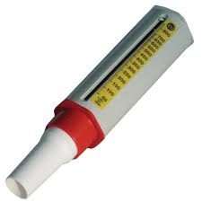
Peak Flow
Place tube onto the end of the peak flow meter & ensure meter is set to
Take in a deep breath
Exhale all of this, as quickly as possible, through the tube
Record result
Repeat steps 2-4 three times to calculate an average result
Result 1 | Result 2 | Result 3 | Result 4 | Mean Result
Anything that may have affected the results:
Notes:
To Print

Slide 4
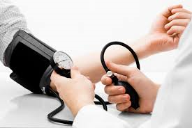
Blood Pressure
Place cuff around arm
Ensure that arm is still
Press start on the BP Machine
When cuff deflates record the BP that is shown on the screen
Person having blood pressure recorded should go up and down the stairs for approx. 2.5 minutes
Repeat steps 1-4
Before exercise | After exercise | Time spent exercising
Anything that may have affected the results:
Notes:
To Print

Slide 5
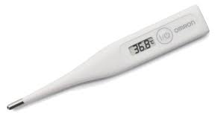
Temperature
Place thermometer on the body where appropriate (dependant on type of thermometers – forehead on forehead, large thermometers under arm, oral thermometers under tongue).
Wait for temperature reading to settle (approx. 2 mins)
Record results
Person having hear rate recorded should walk/jump/go up and down the stairs for approx. 2.5 mins
Repeat steps 1-4
Before exercise | After exercise | Time spent exercising
Anything that may have affected the results:
Notes:
To Print

Slide 6
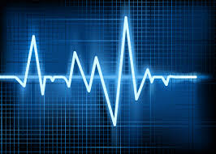
Heart Rate
Using a stethoscope, or finding a pulse point on a partner, listen to the number of heartbeats in one minute (use a stopwatch to ensure 1 minute)
Record results
Person having heart rated recorded should go up and down the stairs for approx. 2.5mins
Repeat steps 1-2Repeat steps 1-4
Before exercise | After exercise | Time spent exercising
Anything that may have affected the results:
Notes:
To Print

Slide 7
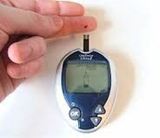
Blood Glucose
Gather equipment (soft click needle, antibacterial wipe, blood glucose meter, testing strip, tissue, plaster) and prepare the blood glucose meter with a strip
Wipe fingertip with antibacterial wipe
Place soft click needle on fingertip and press to pierce the skin
Throw needle into sharps bin immediately
Wipe away first drop of blood
Place the blood glucose meter (with strip loaded) onto the second drop of blood
Place a tissue onto fingertips with some pressure if still bleeding, placing a plaster over the area if needed.
Record the resulting blood glucose level that is shown on the blood glucose meter
Blood Glucose Level
Anything that may have affected the results:
What can impact on the level of glucose in the blood?
Notes:
To Print

Slide 8
REMEMBER!!!!!!!
You should be recording units for each experiment you complete
Notes:
To Print

Slide 9
For further information please contact The STEM Alliance enquiries@STEMalliance.uk or visit www.STEMalliance.uk

